Slide 1
13.4-5 PMTU discovery, connection state machine
박준영
2014020853

Slide 2
13.4 Path MTU Discovery with TCP
Path MTU: minimum MTU in the current path between two hosts
Knowing the path MTU can help avoid fragmentation
Unlike UDP, TCP determines what segment size to use and hence can control the size of IP datagrams generated
In this section, we will discuss how Path MTU Discovery (PMTUD) is used by TCP

Slide 3
TCP’s regular PMTUD process
Choosing the initial SMSS
  The basis for send maximum segment size (SMSS) is the MSS announced by the other end
  If the other end does not specify an MSS, the sender assumes a default of 536 bytes
Once the initial SMSS is chosen,
  All IPv4 datagrams have DF bit field set
  It is implicit for IPv6

Slide 4
TCP’s regular PMTUD process
If Packet Too Big (PTB) is received,
  The segment size is decreased and retransmitted
  Use the size in PTB’s suggested next-hop MTU, if exists
  If not, try a variety of values
As routes can change dynamically,
  A larger SMSS can be tried
  [RFC1191] and [RFC1981] recommends 10 minutes of time interval
It is a problem for PMTUD, if PTB messages are blocked by firewalls

Slide 5
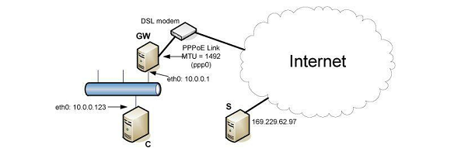
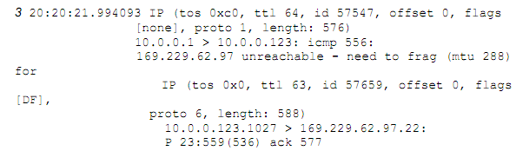
13.4.1 Example
when an intermediate router has an MTU less than either of the endpoints’ MSS
  set MTU size on intermediate PPPoE link as 288 bytes
  588-byte packet generates PTB message

Slide 6
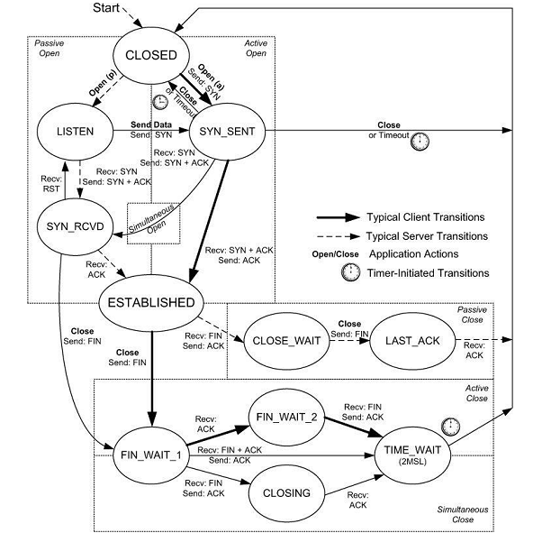
13.5 TCP State Transitions

Slide 7
13.5 TCP State Transitions
Transitions are triggered by
  Receipt of a segment with certain control bit fields set
  Application actions
  Timer expiring
TCP starts in the CLOSED state
  Immediate transition depending on, active or passive open

Slide 8
13.5 TCP State Transitions
Normal client transitions (solid arrow)
Normal server transitions (dotted arrow)
ESTABLISHED state
  Data transfer can occur

Slide 9
13.5 TCP State Transitions
Active Close
  When the local application initiates a close request
Passive Close
  Waiting for a peer to acknowledge a FIN segment
Simultaneous close
  Double active close

Slide 10
13.5 TCP State Transitions
Transition from LISTEN to SYN_SENT
  Legal in the TCP protocol but rarely seen
Transition from SYN_RCVD back to LISTEN
  Valid only if SYN_RCVD state was entered from LISTEN state

Slide 11
13.5 TCP State Transitions
TIME_WAIT (2MSL Wait) state
  Waits for a time equal to twice the Maximum Segment Lifetime (MSL)
  MSL: maximum amount of time any segment can exist in the network before being discarded
  [RFC0793] specifies the MSL as 2 minutes

Slide 12
13.5 TCP State Transitions
TIME_WAIT (2MSL Wait) state
  When TCP performs an active close and sends the final ACK, that connection must stay for 2MSL
    This lets TCP resend the final ACK in case it is lost
    Active opener knows final ACK is lost, because the passive opener will retransmit its FIN

Slide 13
13.5 TCP State Transitions
The effect of TIME_WAIT state
  During the 2MSL time, the endpoints defining that connection cannot be reused
  We know that delayed segments from an earlier instantiation of this connection cannot be misinterpreted as being part of the new connection
  Active close by the Client
    OS assigns a random port (recommended for security)
  Active close by the Server
    It is a problem that well-known ports cannot be reused immediately

Slide 14
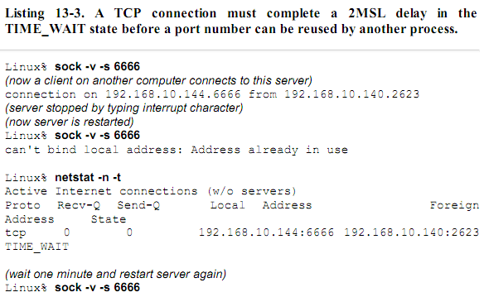
13.5 TCP State Transitions
The effect of TIME_WAIT state (server)

Slide 15
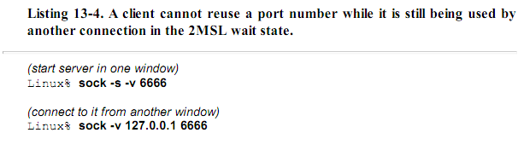
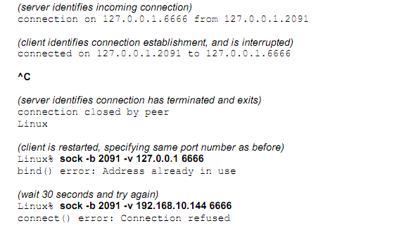
13.5 TCP State Transitions
The effect of TIME_WAIT state (client)

Slide 16
13.5 TCP State Transitions
SO_REUSEADDR
  Berkeley sockets API option
  enables the use of the port number in the 2MSL wait state
  (linux) sock -A

Slide 17
13.5.3 Quiet Time Concept
What if the system crashes and reboots while in the TIME_WAIT state?
  Problem
    after the reboot, the new connection with same local and foreign IP addresses, port numbers can be established immediately
    Delayed segments from an earlier instantiation of a connection can be interpreted as part of a new connection
  Solution
    [RFC0793] TCP should wait MSL time before creating any new connections after reboot or crash (called quiet time)
    Few implementations abide by this because most hosts take longer than the MSL to reboot

Slide 18
13.5.4 FIN_WAIT_2 State
Infinite wait in the FIN_WAIT_2 state
  Unless a half-close is being performed, the active closing TCP can move to the TIME_WAIT state only when FIN is received
  Otherwise, active closing TCP remains in this state forever (while the other end is in the CLOSE_WAIT state)
  Many implementations prevent this infinite wait in the FIN_WAIT_2 state by using the timer (default: 60 seconds)

Slide 19
13.5.5 Simultaneous Open and Close Transitions
Simultaneous Open Transitions
  SYN_SENT state
    The state after both ends sending SYN at the same time
  SYN_RCVD state
    The state after receiving its peer’s SYN segments
    Then, each end resends a SYN and acknowledges the received SYN
  ESTABLISHED
    The state after each end receiving the SYN plus the ACK

Slide 20
13.5.5 Simultaneous Open and Close Transitions
Simultaneous Close Transitions
  ESTABLISHED to FIN_WAIT_1
    When both ends send FIN at the same time
  FIN_WAIT_1 to CLOSING
    When its peer’s FIN arrives
    Each end sends its final ACK
  CLOSING to TIME_WAIT
    Upon receiving a final ACK

