Slide 1
MARS:
A Muscle Activity Recognition System Enabling Self-conﬁguring Musculoskeletal Sensor Networks
IPSN 2013

Slide 2
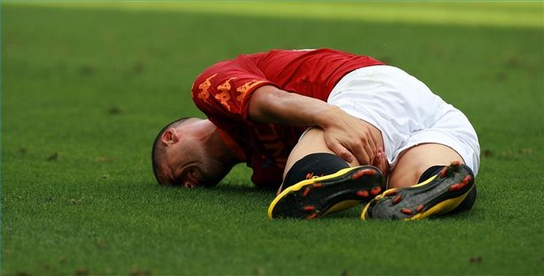
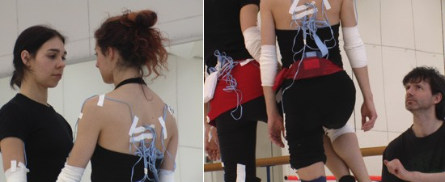
Motivation
Muscle injuries are a major problem for athletes
NEEDS: Correct motion & prevent injury
  Non-intrusive
  Scalable (autonomous setup)
  Accurate
Disadvantage of Related Works
  Vision-based: LOS, clothing & skin cover
  Needles: painful, low level activity
  Larger sensors with contact gels: low level activity

Slide 3
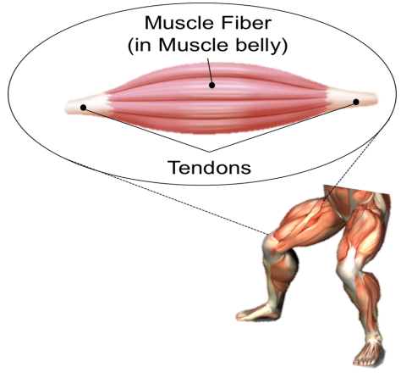
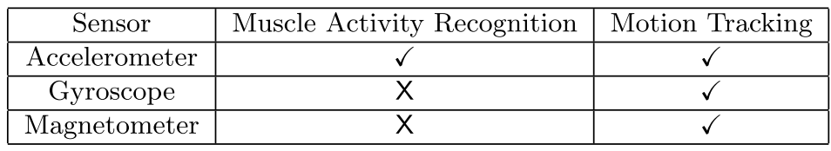
Physiology of Skeletal Muscle
Activating skeletal muscle → resulting in mechanical vibrations
  Oscillations, tremors of the human motor system
  Muscle fibers sliding against each other
  Muscle belly’s circumference increase and decrease
Sensing of Muscles
  Using accelerometer
    Tremors & oscillations: 3.85 Hz ~ 8.8 Hz
    Internal vibration: 10 Hz ~ 40 Hz

Slide 4
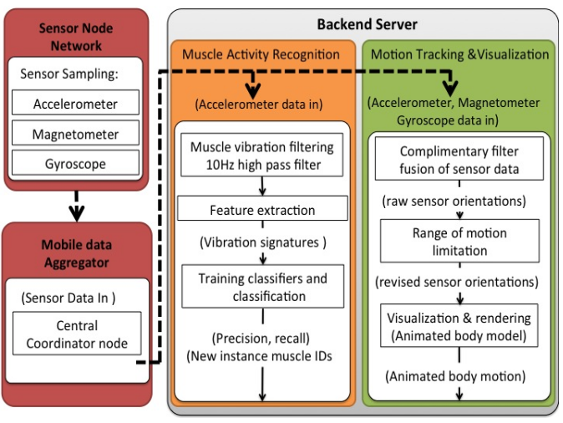
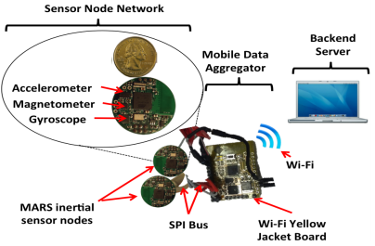
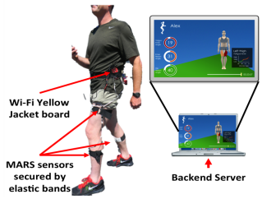
System Overview

Slide 5
System Architecture
The Sensor Node Network
  Provide error detection checksum
    To preserve the integrity of the data In the MARS system
  Anti-alias filter for the accelerometer
  Wired to mobile data aggregator
    SPI interface, 1Mbps
    10 hours for 2200mAh battery
Notes:
Anti-alias filter..나이키스트 샘플링 이론에 의거 샘플링 속도는 측정하고자 하는 신호의 최대 주파수보다 적어도 2배 이상이 되어야 함. 그러나 여타 다른 요소들 때문에 입력주파수보다 더 높은 주파수가 들어오는 경우가 생기고 이는 잘못된 결과를 야기시킬 수 있음. 따라서 low-pass filter등을 이용하여 높은 주파수 영역을 제거해줌

Slide 6
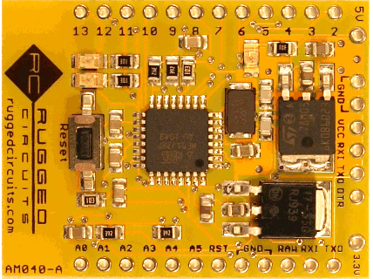
System Architecture
The Mobile Data Aggregator
  On Yellow Jacket board
    Support 6 sensors & 2.5 meters
  Receive data from all nodes by TDMA
  Decode checksum
  Error control
    Damaged sensors
    Out of sync nodes
    → Postpone data sampling until the next cycle
  Wi-Fi to backend server
Notes:
2.5m → to reduce line capacitance

Slide 7
System Architecture
Backend Server – Muscle Activity Recognition
  How the vibration signatures are obtained?
    10Hz high pass filter:
    Feature extraction
  10Hz high pass filter:
    to isolate the lower freq. components
    avoid signal from tremors
    → Tremors & oscillations: 3.85 Hz ~ 8.8 Hz

Slide 8
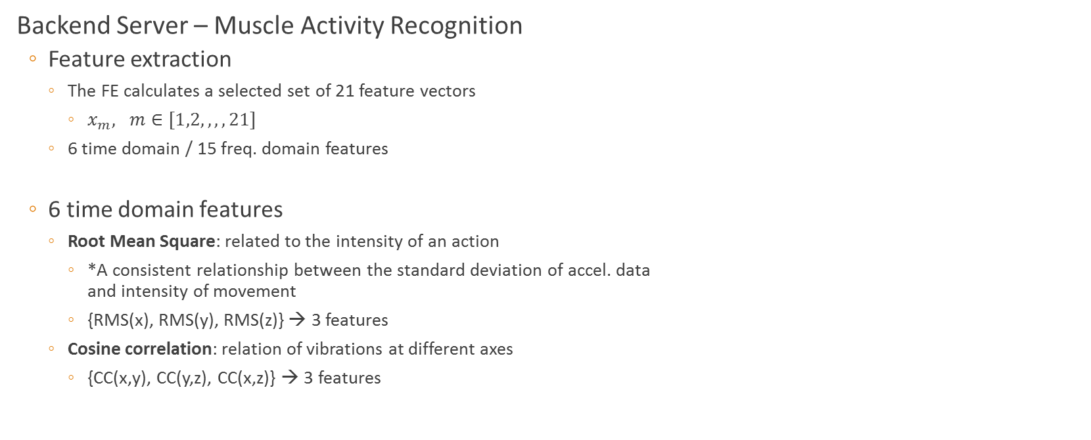
System Architecture
Backend Server – Muscle Activity Recognition
  Feature extraction
    The FE calculates a selected set of 21 feature vectors
      $x_{m}, m∈[1,2, ,,, 21]$
    6 time domain / 15 freq. domain features
  6 time domain features
    Root Mean Square: related to the intensity of an action
      *A consistent relationship between the standard deviation of accel. data
      and intensity of movement
      {RMS(x), RMS(y), RMS(z)} → 3 features
    Cosine correlation: relation of vibrations at different axes
      {CC(x,y), CC(y,z), CC(x,z)} → 3 features
* X. Long, B. Yin, and R. Aarts. Single-accelerometer-based daily physical activity classification. In Engineering in Medicine and Biology Society, 2009. EMBC 2009.
Annual International Conference of the IEEE, volume 2009, pages 6107{6110. IEEE, Jan. 2009.
Notes:
RMS → 실제 실험/관측 결과가 평균적으로 얼마만큼 떨어져 있는지
Cosine correlation → 주로 두 백터의 방향성의 일치를 보고자 할 때 사용됨 (문서 등의 비교)
주요 내용은 아니지만 50% overlap sliding window 사용 → reference paper에 50%가 가장 좋다는 내용 있음

Slide 9
System Architecture
Backend Server – Muscle Activity Recognition
  Feature extraction
  15 frequency domain features
    Apply Discrete Fourier Transform (DFT)
    Signal frequency domain entropy
      To help distinction of activities with a similar energy intensity by comparing their
      periodicities
      → to distinguish cyclic and non-cyclic activities
      {entropy(x), entropy(y), entropy(z)} → 3 features
    Power Spectral Density (PSD)
      The signal power per window
        Low, Medium, Medium high, High
        The similar freq. domain entropies at different freq. bands can be distinguished
        3 * 4 = 12 features
Notes:
Entropy: describes the irregularity, complexity, or unpredictability characteristics of a signal
Frequency domain entropy was computed as the information entropy of the normalized PSD function of the input signal
PSD : 퓨리에(Fourier)변환을 통하여 구한 단위 주파수당 에너지의 분포이다

Slide 10
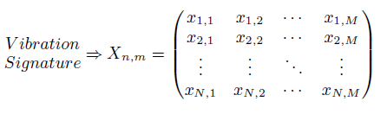
System Architecture
Backend Server – Muscle Activity Recognition
  Training Classifiers and Classification
  J48 decision tree (DT) classifier
    C4.5 algorithm

Slide 11
System Architecture
Backend Server – Motion Tracking & Visualization
  Complimentary filter fusion of sensor data
    Obtain accurate orientations of the sensors
    By quaternion-based complimentary filter
  Range of motion limitation
  Visualization and rendering
    Java & Unity Gaming Engine

Slide 12
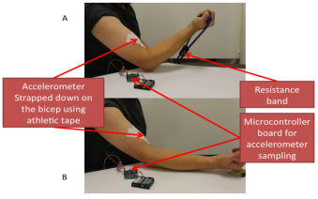
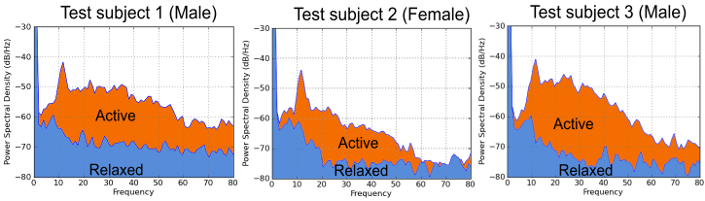
Experiments and Evaluation
Muscle Identity Experiment(Proof of Concept Experiments)
  Power Spectral Densities (PSD) of accelerometer
    Muscle activity can be quantified
    The vibration patterns are different → PSD is unique for different person

Slide 13

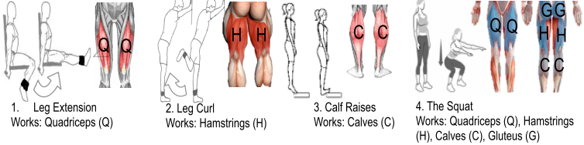
Experiments and Evaluation
User Study Experiment
  4 females & 6 males from different background
  Isolated and compound muscles
  Compare three classifiers
    Naïve Bayes (NB) / Support Vector Machine (SVM) / J48 DT

Slide 14
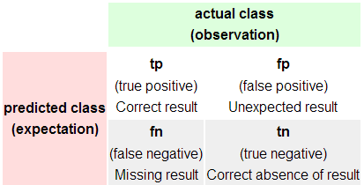
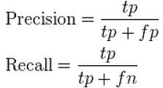
Precision & Recall
Precision: positive predictive value
Recall: as sensitivity
Notes:
Precision은 컴퓨터의 예측 중, 결과가 나올 것이라 예측한 값 중에 실제 결과가 나온 비율이라고 할 수 있고, Recall은 컴퓨터가 맞다고 검색한 결과 중, 실제 정답의 비율이라고 할 수 있다.

Slide 15
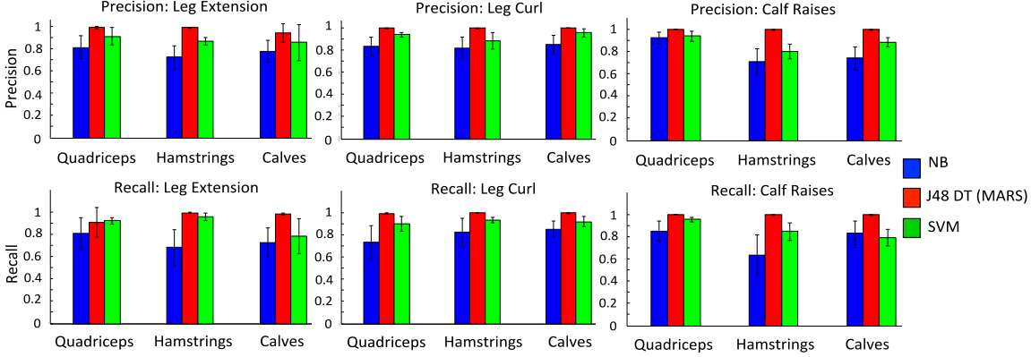
Experiments and Evaluation
User Study Experiment – Isolation type

Slide 16
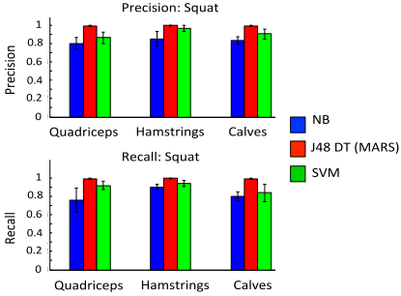
Experiments and Evaluation
User Study Experiment – Compound type

Slide 17
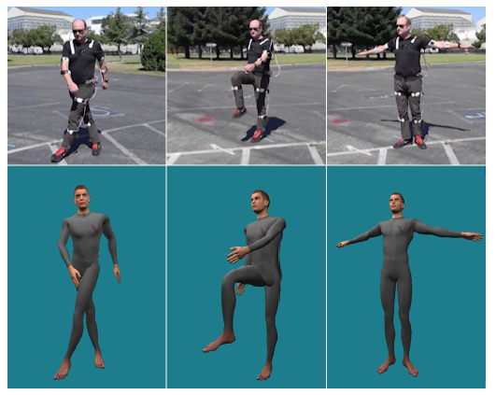
Experiments and Evaluation
Motion Tracking Setup and Results

Slide 18
Conclusion
Presenting MARS,
  a novel non-intrusive
  Autonomous setup capable
  Inertial sensor-based muscle identity recognition
  Motion tracking system
Pros,
  ONLY accelerometer
  Typical approach in recognition problem → chance to introduce useful tools!
Cons
  Not enough to explain motion tracking parts

Slide 19
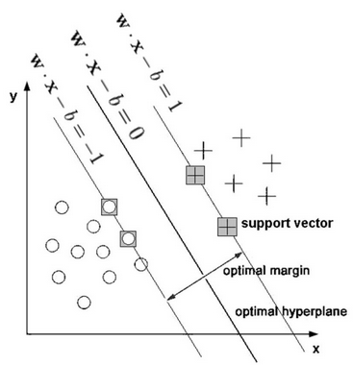
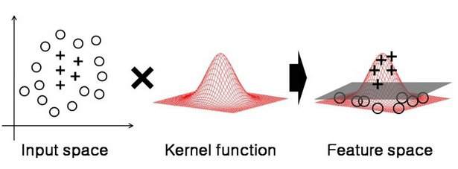
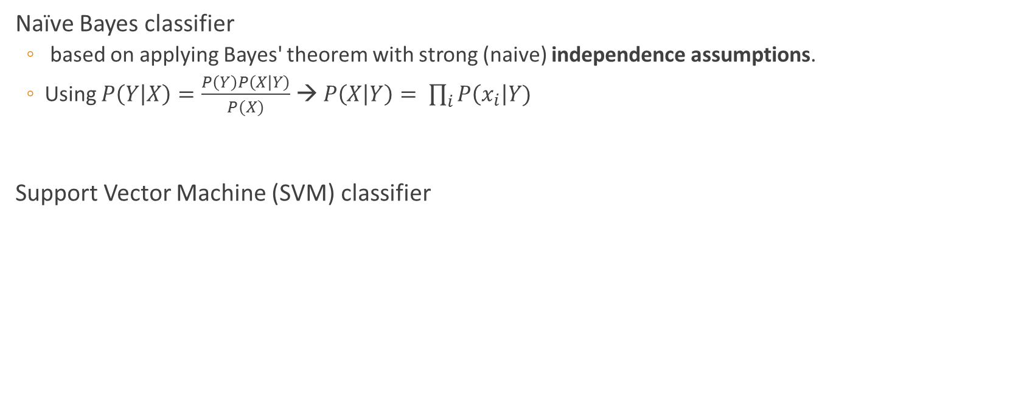
Backup Slide
Naïve Bayes classifier
  based on applying Bayes' theorem with strong (naive) independence assumptions.
  Using $P\left(Y | X\right)=\frac{P\left(Y\right)P\left(X | Y\right)}{P(X)}$ → $P\left(X | Y\right)= \prod_{i}{P\left(x_{i}\right|Y)}$
Support Vector Machine (SVM) classifier
Notes:
X : new feature , Y : class , feature들이 독립이면

Slide 20
Backup Slide

