Slide 1
Dude, Where’s My Card?
RFID Positioning That Works with Multipath and Non-Line of Sight
Jue wang and dina katabi
Sigcomm 2013

Slide 2
Where is my card?
Locating misplaced objects is a major problem in
  Pharmacies, libraries, retail stores, and warehouses
Many industries are looking to address this problem with the deployment of RFIDs
  The two key approaches
    Received signal strength (RSSI)
    Angle of arrival (AoA)
However, both methods is an assumption that the signal is mainly propagating along a direct line-of-sight (LOS) path

Slide 3
PinIt
This paper introduces PinIt
  The first fine-grained RFID positioning system that works in the absence of a LOS path and the presence of rich multipath
  It can provide a resolution on the order of a few to tens of centimeters
  It also includes a database which stores the IDs and 3-D positions of the reference tags
Simple Idea
  Employing reference tags, whose positions are known a priori
  To locate a misplaced object,
    Both the desired tag attached to it and a set of reference tags are queried
    And the nearest tags are identified

Slide 4
PinIt; Challenge
The challenge is
  to identify the nearest tags in a manner robust to multipath and NLOS
PinIt exploits a tag’s multipath profile to locate it
  Signals of nearby tags propagate along closer paths when being reflected off each surface
  Hence, if we can obtain a description of all the paths along which a tag’s signal propagates neighboring tags can be identified

Slide 5
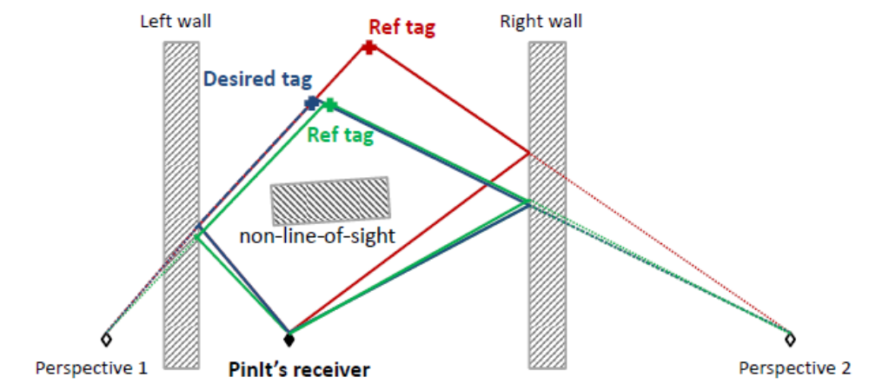
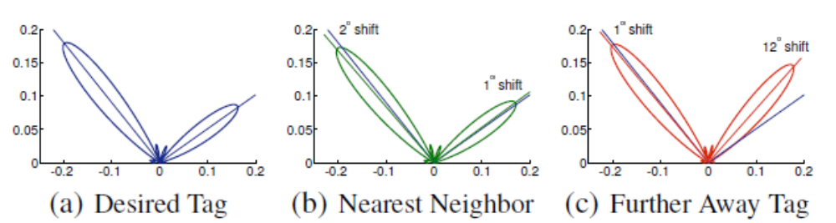
PinIt; Approach
Blue and green tags are separated by 10 cm
Blue and red tags are separated by 60 cm
Perspective 1 :
  Blue := red , blue := green
Perspective 2:
  Blue != red, blue := green

Slide 6
PinIt; Overview
PinIt is a fine-grained UHF RFID localization system
  providing a resolution on the order of a few to tens of centimeters
  leveraging the ultra-low cost of UHF tags (5-10 cents each) to deploy a set of reference tags
  Its infrastructure includes a data base which store the IDs and 3-D positions of reference tags
  Working under the assumption that the objects to be located are tagged with RFIDs
    i.e., every book in a library can have a tag adhered to its spine
To locate an object, PinIt goes through the following steps
  PinIt queries the RFID tag attached to the object as well as the reference tags
  PinIt acquires a multipath profile of each queried tag based on its replies
  By comparing and matching the desired tag’s multipath profile with reference tags’ , PinIt identifies the nearest neighbors of the desired tag
  Based on the position of these nearest neighbors, it estimate the desired tag’s position

Slide 7
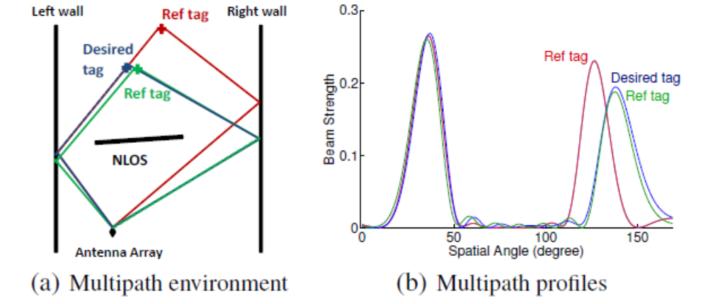
Acquiring a Tag’s Multipath Profile
How to differentiate various paths and acquire such a profile for each tag
  Based on different delays
    Such an approach would require ultra-wideband communication
  Based on directions
    To separate copies of the tag’s signal arriving from different directions, we need to measure the power coming from each direction alone
    A large phased antenna array can achieve this goal

Slide 8
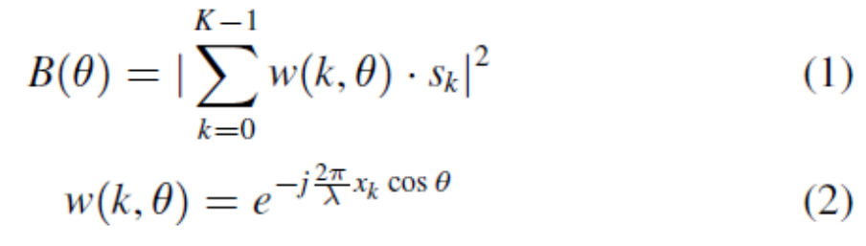
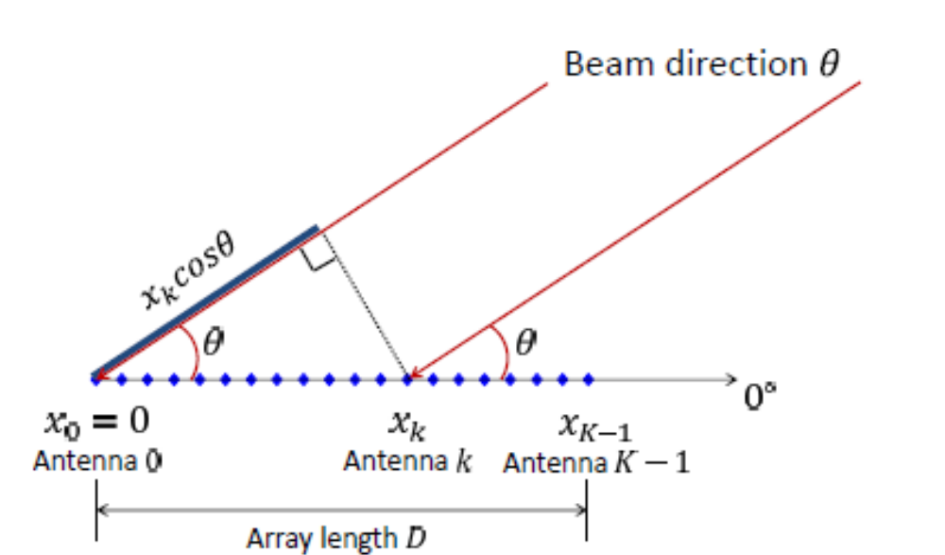
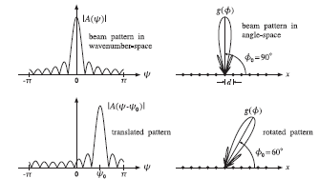
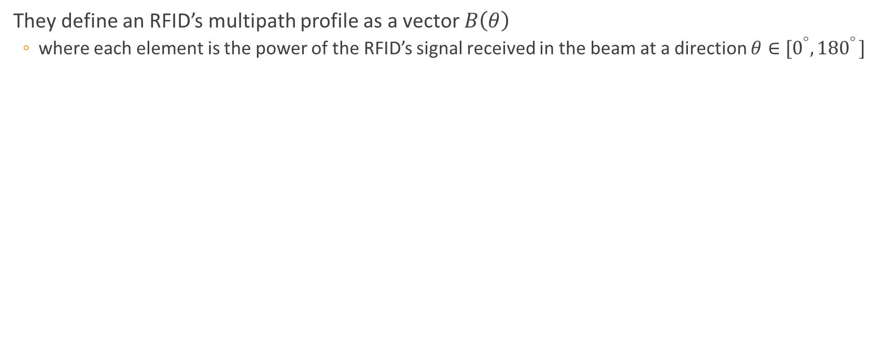
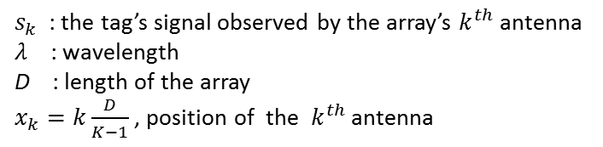
Multipath Profile Acquisition Using Antenna Array
They define an RFID’s multipath profile as a vector $B\left(θ\right)$
  where each element is the power of the RFID’s signal received in the beam at a direction $θ∈[0^{°}{, 180}^{°}]$
$s_{k}$ : the tag’s signal observed by the array’s $k^{th}$ antenna
$λ$ : wavelength
D : length of the array
$x_{k}=k\frac{D}{K−1}$, position of the $k^{th}$ antenna

Slide 9
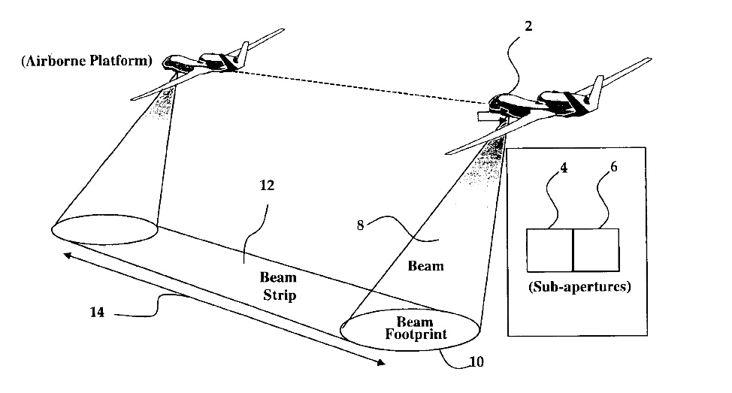
Multipath Profile Acquisition via Antenna Motion
In practice, it is difficult and often infeasible
  to deploy a bulky and expensive antenna array to locate low-cost RFIDs
Synthetic aperture radar (SAR)
  a form of radar whose defining characteristic is its use of relative motion
They want to emulate K-antenna array using a single moving antenna

Slide 10

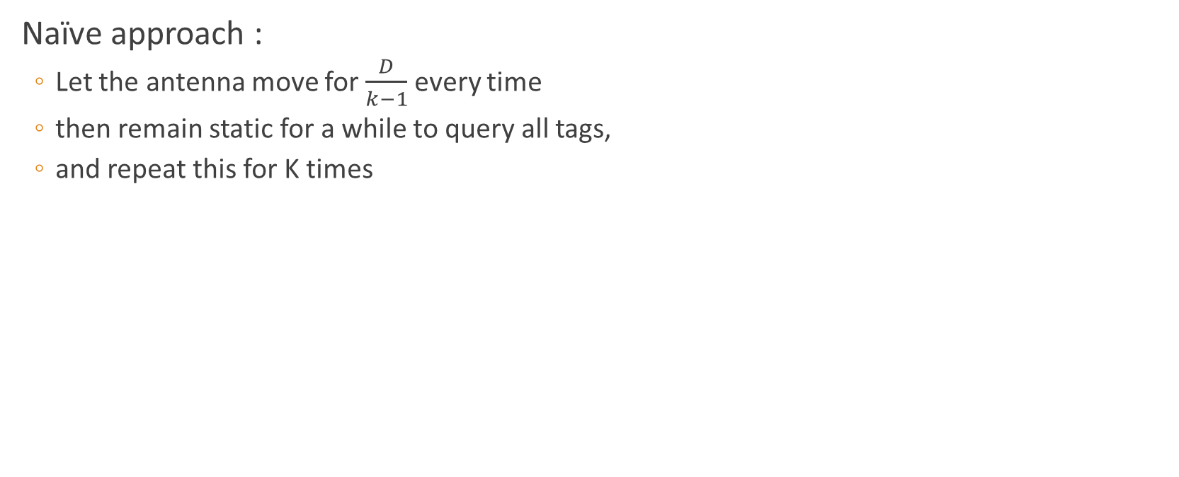

Multipath Profile Acquisition via Antenna Motion
Naïve approach :
  Let the antenna move for $\frac{D}{k−1}$ every time
  then remain static for a while to query all tags,
  and repeat this for K times
$$\frac{D}{k−1}$$
Moving antenna cannot have an immediate stop!

Slide 11
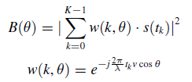



Multipath Profile Acquisition via Antenna Motion
It is much more manageable and preferable to let the antenna keep moving at a constant speed
Design
  PinIt repeatedly queries tags in an interleaving manner
  The tag reply with their IDs
  PinIt then groups the replies received based on the IDs
  For each tag, PinIt computes its multipath profile in post-processing
To measure the power of the tag’s signal, PinIt computs:
$$t_{k−1}$$
$$t_{…}$$
$$t_{0}$$
K replies
$s\left(t_{o}\right), s\left(t_{1}\right), …,s\left(t_{k−1}\right)$ be the complex values of the tag’s signal measured during the K replies

Slide 12
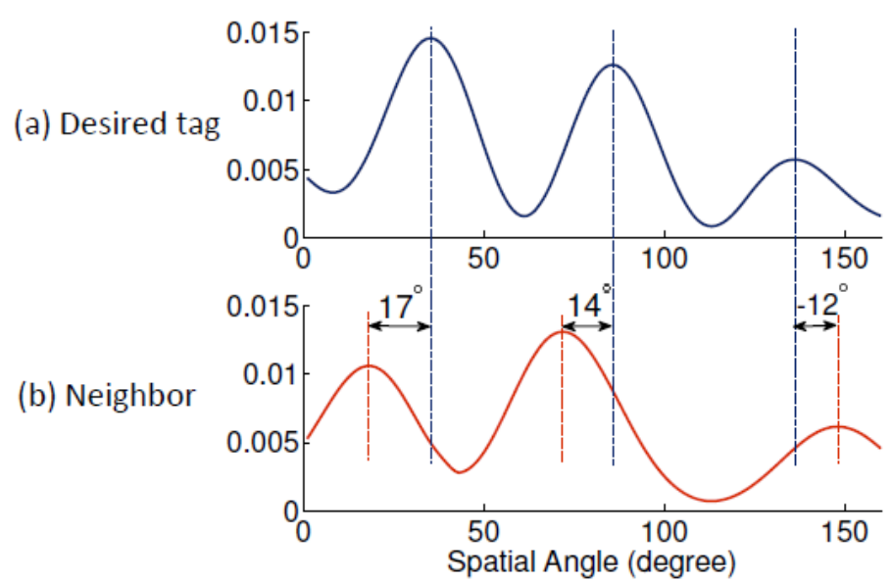
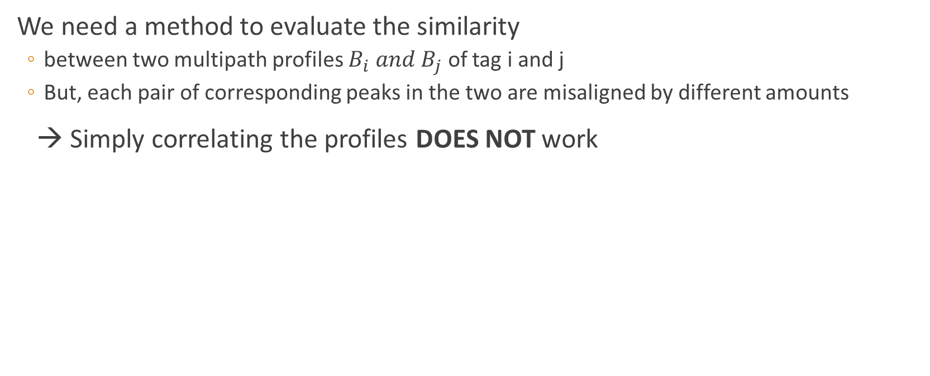
Comparing Multipath Profiles
We need a method to evaluate the similarity
  between two multipath profiles $B_{i} and B_{j}$ of tag i and j
  But, each pair of corresponding peaks in the two are misaligned by different amounts
→ Simply correlating the profiles DOES NOT work

Slide 13

Comparing Multipath Profiles;
Dynamic Warping of Multipath Profiles
Even if the same person says the same word twice, she may intonate and speed up differently
  → two time sequences captured are misaligned at different segments
In matching the utterances, a key challenge is
  to automatically identify these shifts and align corresponding segments
They borrow a well-established technique from speech processing:
  Dynamic Time Warping (DTW)
A
A’

Slide 14
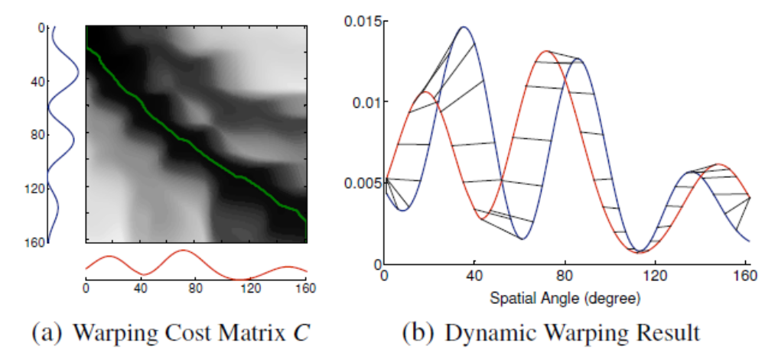
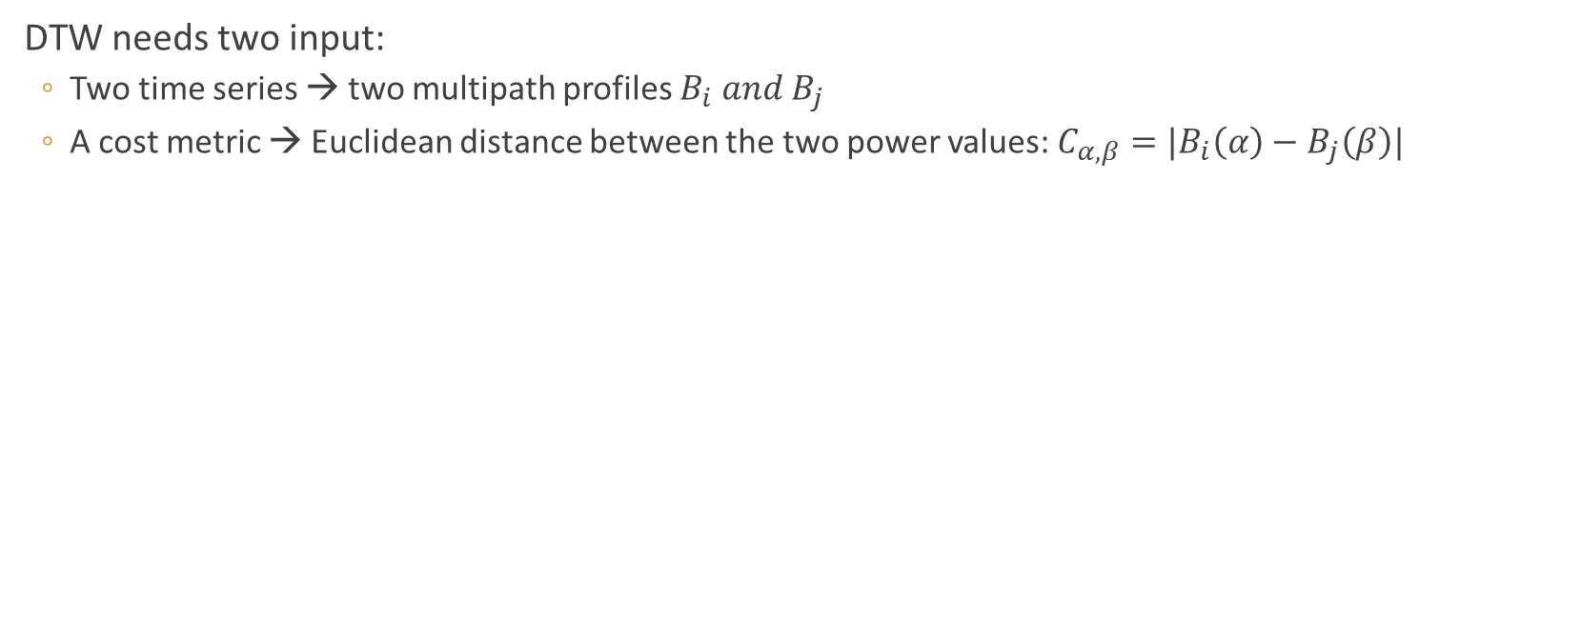
Comparing Multipath Profiles;
Dynamic Warping of Multipath Profiles
DTW needs two input:
  Two time series → two multipath profiles $B_{i} and B_{j}$
  A cost metric → Euclidean distance between the two power values: $C_{α,β}=|B_{i}\left(α\right)−B_{j}\left(β\right)|$

Slide 15
Other challenges
Addressing power scaling challenge
  Using normalized derivative sequences
Estimating the desired tag’s position
  Using hierarchical approach

Slide 16
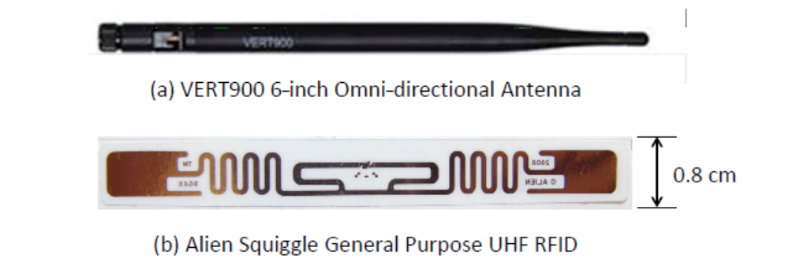
Implementation
PinIt using
  USRP software radios (USRP N210)
  Commercial EPC Gen-2 UHF RFIDs
  Moving Antenna: Omni-directional VERT900 antenna & iRobot Create robot

Slide 17

Evaluation in Field Experiments
They conduct field experiments in
  the engineering library of their university
  200 reference tags evenly spaced by 15cm are deployed on 12 racks (60 shelves)
    The shelves are made of metal and full of books
  They adhere the desired tag to the spine of a book and move the book around to 100 different locations
Comparing with PinIt with two baseline scheme
  RSSI-based
  AoA-based

Slide 18
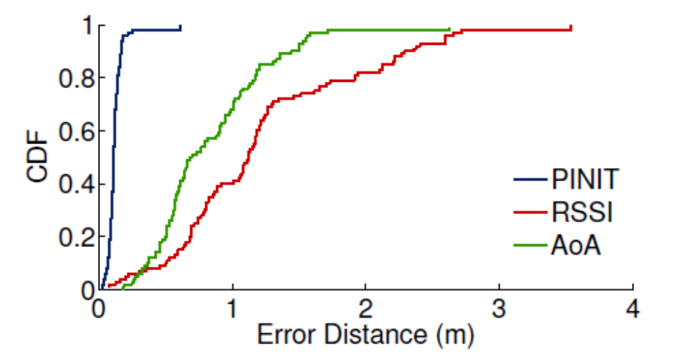
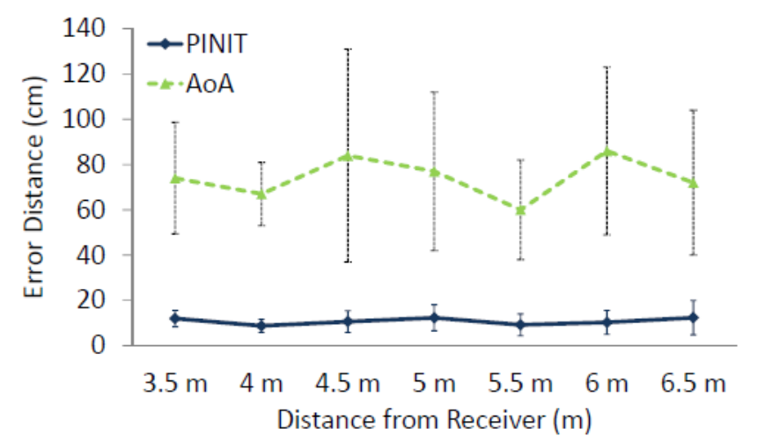
Evaluation in Field Experiments
Accuracy in locating the misplaced book
Effect of the Distance from Desired Tag

Slide 19
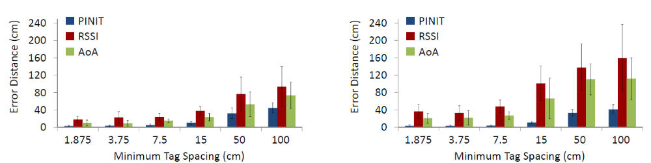
Evaluation in LOS and NLOS
There are two questions
  How do the localization systems compare in LOS and NLOS respectively?
  What is the finest resolution each system can achieve given a large density of reference tag?
They use a separate setup in a typical office lounge for making LOS environment
LOS
NLOS

Slide 20
Concluding Remarks
A common complaint industries have about RFID system is the lack of reliable, fine-grained position information
By exploiting multipath, PinIt presents a solution based on
  Dynamic time warping that achieves 16cm 90th and 25cm 99th percentile accuracy
  Enabling reliable centimeter-scale positioning in densely packed environments

