Slide 1



DAISY
Data Analysis and Information SecuritY Lab
Detecting Driver Phone Use Leveraging
Car Speakers
Presenter: Yingying Chen
Jie Yang†, Simon Sidhom†, Gayathri Chandrasekaran∗ , Tam Vu∗ , Hongbo Liu†,
Nicolae Cecan∗, Yingying Chen†, Marco Gruteser∗, Richard P. Martin∗
†Dept. of ECE, Stevens Institute of Technology
∗ WINLAB, Rutgers University
ACM MobiCom 2011

Slide 2
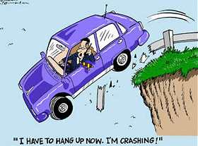
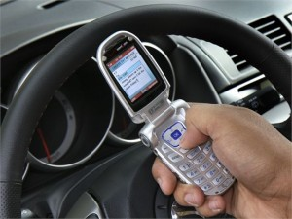
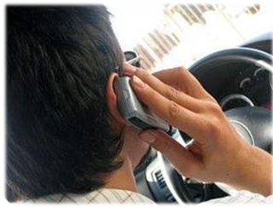
Cell Phones Distract Drivers
  Cell phone as a distraction in 2009 on U.S. roadways
  18% of fatalities in distraction-related crashes involved reports of a cell phone
  995 fatalities
  24,000 injuries
18% of drivers admit to texting
while driving
81% of drivers admit to talking on
phone while driving
Texting on Hand-held Cell
Manu — Hands off wheel
Visual — Eyes off road
Cognitive — Mind off driving
Talking on Hand-held Cell
Visual — Eyes off road
Cognitive — Mind off driving
Source: “Distracted Driving 2009” National Highway Traffic Safety Administration Traffic Safety Facts, 2009

Slide 3
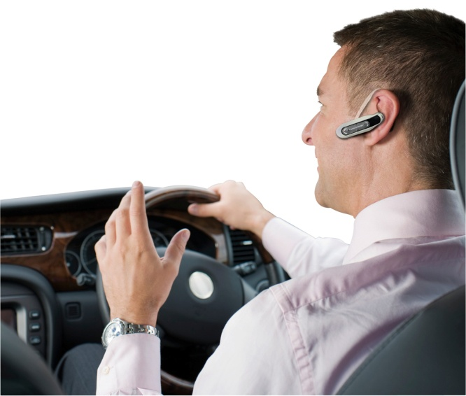

Cell Phones Distract Drivers
  Minds off driving.
Cognitive load distract driver!
  Do hands-free devices solve the problem?
Real-world accidents indicated that hands-free and handheld users are as likely to be involved in accidents

Slide 4
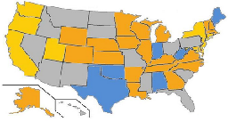
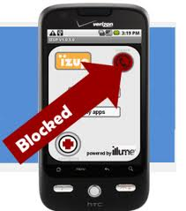
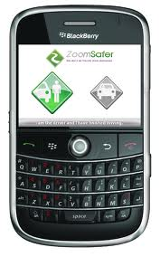
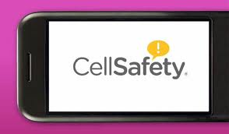
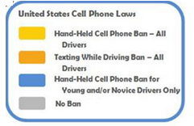



Cell Phone Distraction: What’s Being Done?
Law
  Several States ban handheld phone use
Technology
  Hard blocking: radio jammer, blocking phone calls, texting, chat …
  Soft interaction
    Routing incoming calls to voicemail,
    Delaying incoming text notifications
    Automatic reply to callers
Automatic Reply: “I’m driving right now; will get back with you!”

Slide 5
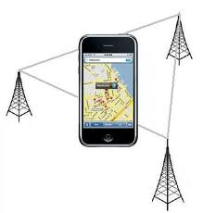
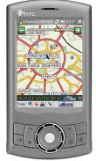
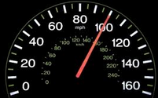

What’s Being Done?
- Is a Cell Phone in a Moving Vehicle ?
  Current Apps that actively prevent cell phone use in vehicle
    ONLY detect the phone is in vehicle or not!
GPS
Handover
Signal Strength
Car’s speedometer

Slide 6
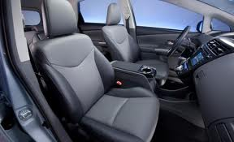

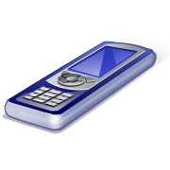
The Driver-Passenger Challenge
I am a passenger!
I want to make a phone call.
38% of automobile trips include passengers !
Source: National highway traffic safety administration: Fatality analysis reporting system

Slide 7
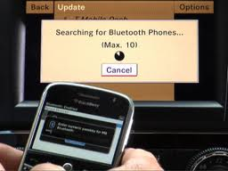
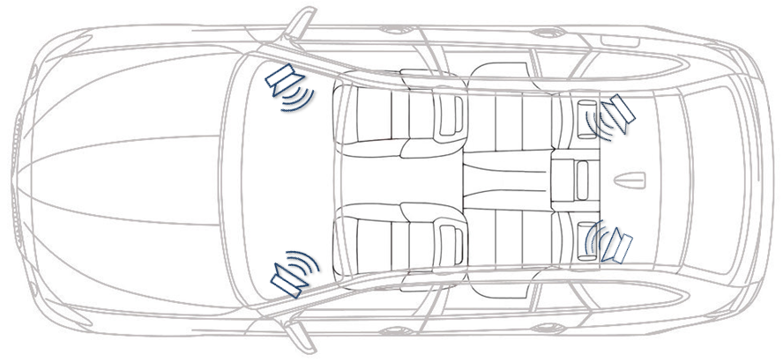
Our Basic Idea
An Acoustic Ranging Approach
  No need of dedicated infrastructure
    Car speakers
    Bluetooth
  Classifying on which car seat a phone is being used
    No need for localization or fingerprinting
      Exploiting symmetric positioning of speakers
Symmetric positioning of speakers
Phone connecting with head unit

Slide 8
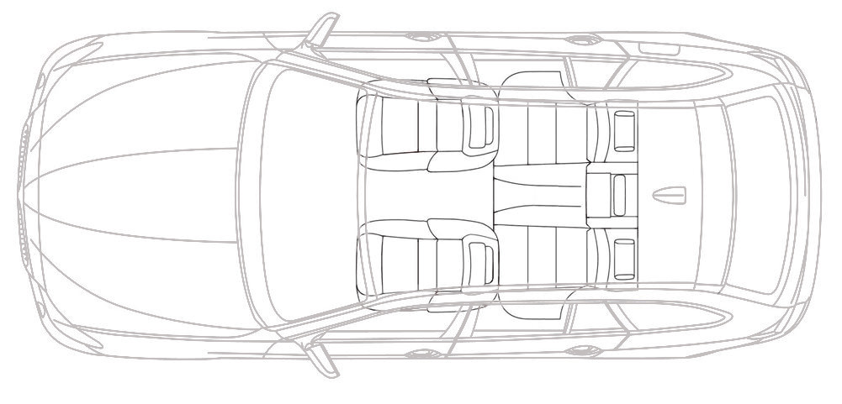

How Does It work?
S1, S2 emit signal simultaneously
S₂
Right
S₃
Travel Time: T2
Audio
Head Unit
Travel Time: T1
S₁
Left
S₄
Time of Arrival - Absolute ranging:
clock synchronization
unknown processing delays
Insert a fixed time interval ∆t
between two channels
S1 always come first
S2 always come second
No need of signal identifier!
No interference from different speakers!
TDOA: T2 – T1
No clock synchronization
Need to distinguish signal from S1 and S2

Slide 9
How Does It work?
t₁
∆t
∆t
S₂
Right
S₃
Rear Right
∆t₂
t₂
Audio
Head Unit
S₁
Left
S₄
Rear Left
t’₂
t’₁
∆t₁
∆t₁
- = ?
∆t₁ - ∆t > 0 => Closer to Left Speaker (S₁ )
∆t₁ - ∆t < 0 => Closer to Right Speaker (S₂ )
∆t₂ - ∆t > 0 => Closer to Front Speaker (S_{1,} S₂)
∆t₂ - ∆t < 0 => Closer to Back Speaker (S_{3,} S₄)

Slide 10

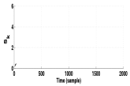

Walkthrough of the detection system
∆t₁ - ∆t
Driver
v.s.
non-Driver
Emit beep signal
Record signal
Filtering
Signal Detection
Relative Ranging
Location Classification

Slide 11
Walkthrough of the detection system
∆t₁ - ∆t
Driver
v.s.
non-Driver
Emit beep signal
Record signal
Filtering
Signal Detection
Relative Ranging
Location Classification
Beep signal design
  Consider two challenges:
    Background noise and unobtrusiveness
∆t
High frequency beep
  Robust to noise:
    engine, tire/road, conversation, music
  Unobtrusiveness
    Close to human’s hearing limit
Channel 1
Channel 2
Beep signal: two channels
∆t: 10,000 samples
engine, tire/road
conversation
Music
Beep Frequency Range
0
Beep Length: 400 samples (i.e., 10 ms)
50Hz
300Hz
1 kHz
3.4kHz
15kHz
22 kHz
Increasing frequency

Slide 12
Walkthrough of the detection system
∆t₁ - ∆t
Driver
v.s.
non-Driver
Emit beep signal
Record signal
Filtering
Signal Detection
Relative Ranging
Location Classification
Where is the beep signal?
Signal distortion:
Heavy multipath in-car
Background noise
Reduced microphone sensitivity
Recorded signal

Slide 13
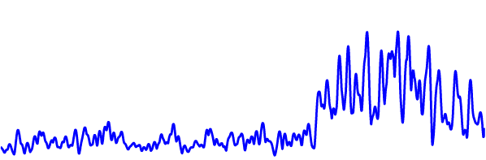
Walkthrough of the detection system
∆t₁ - ∆t
Driver
v.s.
non-Driver
Emit beep signal
Signal Detection
Relative Ranging
Location Classification
Emit beep signal
Record signal
Filtering
Beep signal
Filter out background noise
Noise mainly located below 15kHz
Beep signal frequency is above 15kHz
STFT Filter
Moving window size m: 32 samples
Signal after Filtering

Slide 14
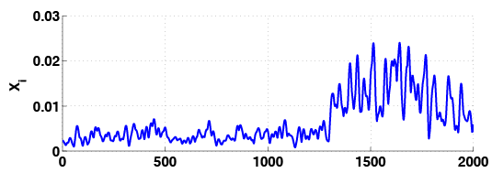
Walkthrough of the detection system
∆t₁ - ∆t
Driver
v.s.
non-Driver
Emit beep signal
Record signal
Filtering
Signal Detection
Relative Ranging
Location Classification
Estimate Noise Mean and standard deviation: (μ , σ)
Robust window
W
Change-point detection
Identifying the first arriving beep signal that deviates from the noise
Threshold t_{d}
Threshold t_{d:}
Based on noise: μ + 3•σ
99.7% confidence level of noise
Signal Detected
Robust window W:
Reduce false detection
40 samples
Signal Detection

Slide 15
Walkthrough of the detection system
∆t₁ - ∆t
Driver
v.s.
non-Driver
∆t₁ - ∆t
Emit beep signal
Record signal
Filtering
Signal Detection
Relative Ranging
Location Classification
∆t₁ - ∆t
Time difference ∆t1:
Measured by sample counting
∆t: Predefined fixed time interval between two beep sounds
∆t_{1:} Calculated time difference of arrival based on signal detection
∆t₁ - ∆t: Relative ranging -> cell phone to two speakers

Slide 16
Walkthrough of the detection system
Driver
v.s.
non-Driver
∆t₁ - ∆t
Driver
v.s.
non-Driver
Emit beep signal
Record signal
Filtering
Signal Detection
Relative Ranging
Location Classification
Driver v.s. Passenger
With two-channel audio system:
∆t₁ - ∆t > 0 => Left Seats
∆t₁ - ∆t < 0 => Right Seats
With four-channel audio system: relative ranging from the 3rd or/and 4th channels: ∆t₂
∆t₂ - ∆t > 0 => Front Seats
∆t₂ - ∆t < 0 => Rear Seats

Slide 17
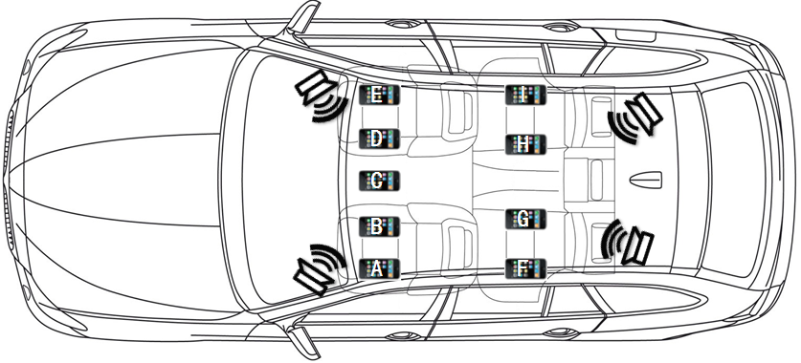
Experimental Scenarios
Testing positions
Different number of occupants
Different noise conditions
  Highway Driving
    60MPH + music playing + w/o window opened
    Phones at front seats only
  Stationary
    Varying background noise: idling engine + conversation
Driver’s Control
Area

Slide 18
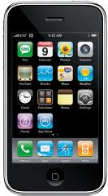
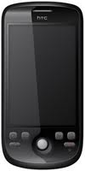
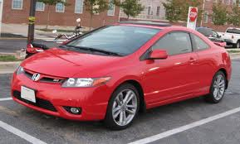
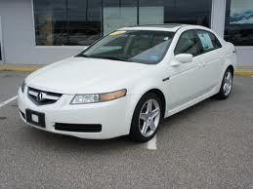
Phones and Cars
Phones
Cars
Bluetooth radio
16-bit 44.1kHz sampling rate
192 RAM
528MHz MSM7200 processor
Bluetooth radio
16-bit 44.1kHz sampling rate
256 RAM
600 MHz Cortex A8processor
ADP2
Iphone 3G
Bluetooth radio
Two channel audio system
two front and two rear speakers
Interior dimension
  Car I: 175 x 183 cm
  Car II: 185x 203cm
Honda Civic Si Coupe
Acura sedan

Slide 19
Results: Driver v.s. Passenger Phone use
Results
4 channel, all seats
2 channel, front seats

Slide 20
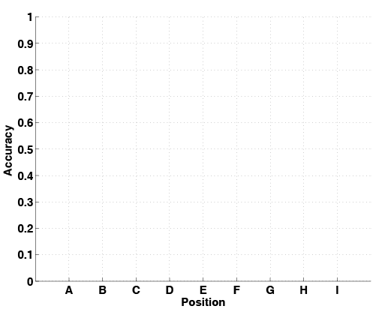
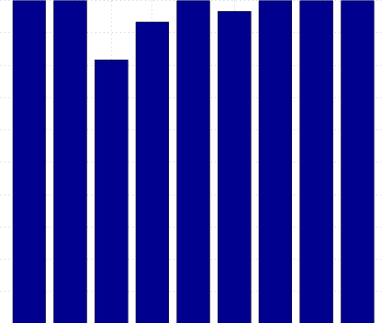
Results: Accuracy at Each Seat
Cup-holder v.s. co-driver left

Slide 21
Conclusions
Limitations
  Phone is muffled by bag or winter coat
  Driver places the phone on an empty passenger seat
  Probabilistic nature of our approach – not intend for enforcement actions
Enabled a first generation system of detecting driver phone use through a smartphone app
  Practical today in all cars with built-in Bluetooth
  Leveraging car speakers – without additional hardware
  Computationally feasible on off-the-shelf smartphones
Validated the generality of our approach with two kinds of phones and in two different cars
  Classification accuracy of over 90%, and around 95% with some calibrations

Slide 22
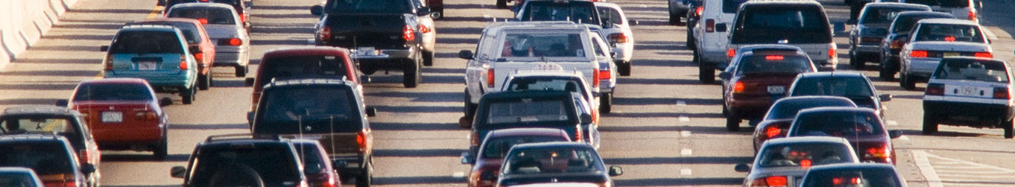
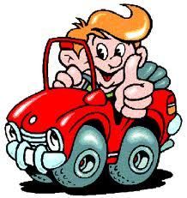
DRIVE
SAFELY
TALK & TEXT LATER
Thank You!
&
Questions
http://personal.stevens.edu/~ychen6/
yingying.chen@stevens.edu

