Slide 1
3.4: Bridges and Switches
유소망
2015011158

Slide 2
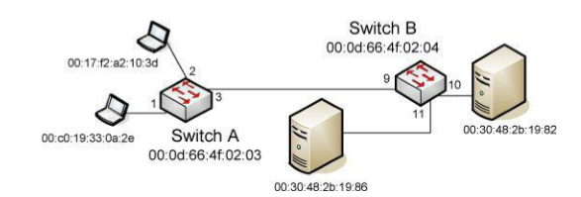
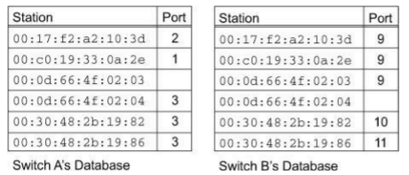
MAC learning
Each switch port has a number for reference,
and each station (including each switch) has its own MAC address.
Filtering databases on switches A and B are created over time
(“learned”) by observing the source address on frames seen on switch
ports.

Slide 3
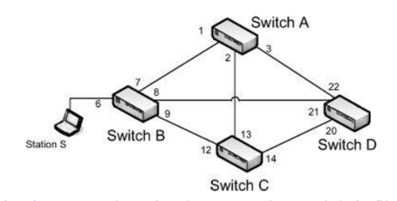
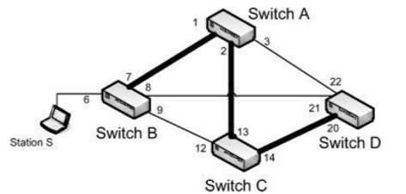
3.4.1. Spanning Tree Protocol (STP)
Motivation)
If simple flooding were used in forwarding frames through this network, broadcast storm would occur (Amplification)
Spanning tree
  a collection of all of the nodes and some of the edges of a graph such that there is a path or route from any node to any other node, but there are no loops.
There can be many spanning trees on a graph. STP finds one of them for the graph formed by bridges as nodes and links as edges.
looping is avoided because there is only one path between any two stations.
The spanning tree is formed and maintained by bridges using a distributed algorithm running in each bridge.

Slide 4
3.4.1. Spanning Tree Protocol (STP)
such changes could affect the operation of the spanning tree, so the STP adapts to these changes.
  Situation where bridges are turned off and on, interface cards are replaced, or MAC addresses are changed
Bridge Protocol Data Units (BPDUs): These frames are used for forming and maintaining the spanning tree.
The tree is “grown” from a bridge elected by the others and known as the “root bridge.”
Determining which spanning tree might be the best to use for forwarding frames depends on a set of costs that can be associated with each link and the location of the root bridge.

Slide 5
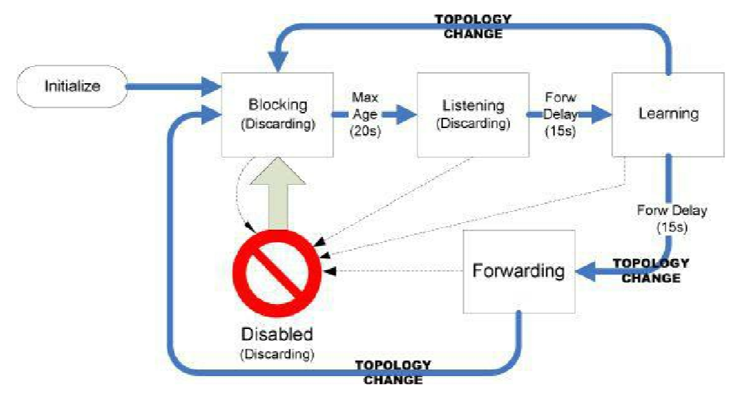
3.4.1.1. Port States and Roles
Normal transitions for port on the spanning tree : 파란 화살표
Changes due to administrative configuration : 점선 화살표
Blocking state
  addresses, forward frames, transmit BPDUs를 학습하지 않음
  하지만 port가 listening state로 전환되고 root로 가는 path에 포함될 경우에 대비해서 받은 BPDUs 모니터함
listening state
  포트가 BPDU를 받을 수 있지만, address나 forward date는 학습하지 않음
Forwanding delay 15초가 지나면, port는 learning state가 됨.
  Forward data 를 제외한 나머지 prodedure를 모두 수행할 수 있음
Forwarding state로 들어가서 frame들을 forward하기 전에 다시 forwarding delay를 가짐

Slide 6
3.4.1.1. Port States and Roles
each port’s role
  Root port : ports at the end of an edge on the spanning tree headed toward the root.
  Designated port : ports in the forwarding state acting as the port on the leastcost path to the root from the attached segment.
  Alternate port : other ports on an attached segment that could also reach the root but at higher cost.
  Backup port : port connected to the same segment as a designated port on the same bridge.

Slide 7
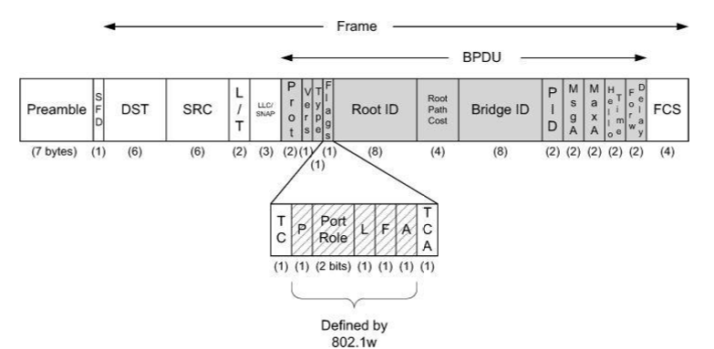
3.4.1.2. BPDU Structure (1)
To determine the links in the spanning tree, STP uses BPDUs
프로토콜 (protocol) ID : 항상 0
버전 (version) : BPDU의 버전
  depending on whether STP or RSTP is in use
타입 (type) : BPDU 종류
플래그 (flag) : 토폴로지 변화
  TC(Topology Change), TCA (Topology Change Acknowledgment)
루트 브리지 (root brigde) ID : 루트 스위치의 ID

Slide 8
3.4.1.2. BPDU Structure (2)
패스 코스트 (path cost) : 루트 스위치까지의 경로 값.
브리지 (bridge) ID : 루트 스위치로 가는 경로상, 직전 스위치의 스위치 ID
The PID field is the port identifier and gives the number of the port from which the frame was sent appended to a 1-byte configurable Priority field (default 0x80).
The Message A (MsgA) field : 루트 스위치가 현 BPDU를 만들고 경과된 시간
  hop count
The Maximum Age (MaxA) field : BPDU 정보를 저장하는 시간 (default: 20s).
  Should this time pass on a root port without receipt of another BPDU, the root bridge is declared “dead” and the bridge starts the root bridge election process over again.
The Hello Time field : BPDU 전송 주기
The Forward Delay (Forw Delay) field : 리스닝 상태와 러닝 상태에 머무르는 기간
  All of the age and time fields are given in units of 1/256s.

Slide 9
3.4.1.3. Building the Spanning Tree
The root bridge is discovered as the bridge in the network with the smallest identifier
When a bridge initializes, it assumes itself to be the root bridge and sends configuration BPDUs with the Root ID field matching its own bridge ID
if it detects a bridge with a smaller ID, it ceases sending its own frames and instead adopts the frame it received containing the smaller ID to be the basis for further BPDUs it sends
The port where the BPDU with the smaller root ID was received is then marked as the root port
The remaining ports are placed in either blocked or forwarding states.

Slide 10
3.4.1.4. Topology Changes
basic database aging mechanism : aging timers can take a long time to delete incorrect entries
어떤 bridge가 connectivity change (e.g., a link goes down)를 발견
parent bridges 에게 topology change notification (TCN) BPDUs 를 root 방향으로 보냄
topology change가 알려지면, root bridge는 다음 periodic configuration messages에 TC bit field를 설정해서 blocking 되거나 forwarding state인 port 방향으로 보냄
5 min으로 일반적으로 권해지는 aging time보다 감소

Slide 11
3.4.1.6. Rapid Spanning Tree Protocol (RSTP)
Problems with STP
  Topology 변화가 특정 시간안에 BPDU받지 못하는 것으로 감지됨
RSTP
  각 port 상태의 monitor와 failure의 indication이 즉시 Topology change indication을 유도함
  Discarding(disabled, blocking, and listening states), learning, and forwarding states 3가지로 줄임
어떤 switch라도 Topology change를 감지하면 BPDUs를 보내고, 어떤 switch라도 topology change를 감지한 BPDUs 받으면 즉시 filtering database를 확인함
  Instead of waiting for the topology change to migrate to the root bridge and back followed by the forwarding delay wait time, entries are cleared immediately.

Slide 12
3.4.1.6. Rapid Spanning Tree Protocol (RSTP)
RSTP makes a distinction between edge ports (those attached only to end stations) and normal spanning tree ports and also between point-to-point links and shared links.
  Edge ports and ports on point-to-point links do not ordinarily form loops, so they are permitted to skip the listening and learning states and move directly to the forwarding state
BPDUs are sent periodically by all bridges as “keepalives” to determine if connections to neighbors are operating properly.
  three times the hello interval
When a topology change is detected, the notifying bridge sends BPDUs with the TC bit field set, not only to the root but also to all other bridges.

Slide 13
3.4.2. 802.1ak: Multiple Registration Protocol (MRP)
bridged LAN 환경의 station 사이에 attribute를 등록하는 공통의 방법을 제공
GVRP에서 MVRP로 옮겨간 이유는 STP recalculation를 피하기 위함
  MVRP
    어떤 end station이 VLAN의 member로 등록되면, 그에 붙은 switch에 이 정보과 교환되고, 이 switch들은 VLAN의 다른 switch들에게 propagate함
    이런 방식은 STP를 통해 spanning tree recalculation 유도하지 않고 스위치들이 station VLAN IDs에 기반한 filtering tables늘리게 한다.
MMRP는 station이 group MAC addresses (multicast addresses)를 등록하게 하는 방법
  이 정보는 switch들이 multicast traffic을 보낼 port를 설정하기 위해 사용됨
  이 방법이 없다면, switch들은 모든 multicast traffic을 broadcast해야함

