Slide 1
8.4. ICMP Query/ Informational Messages
Aiyanyo Titi
2015021433

Slide 2
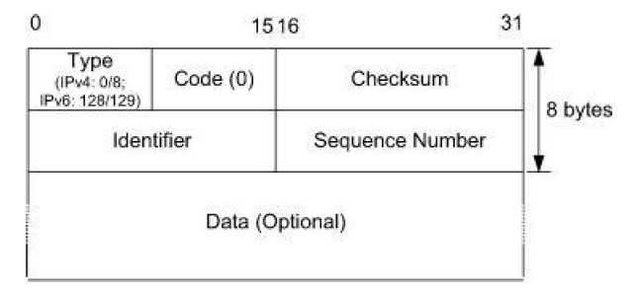
Echo Request/Reply (ping) (ICMPv4 Types 0/8, ICMPv6 Types 129/128)
IPv4 and IPv6 supports an analogous function, typically run on a command line as “ping” and “ping6.”
  This feature utilizes ICMPv6 type 128 for an outbound ping6, or “echo request”
  ICMPv6 type 129 serves as the “echo reply” message.
  A device tests its ability to communicate with another by sending it an Echo Request message and waiting for an Echo Reply in response.
Notes:
It can be done by a host or router to test reachability

Slide 3
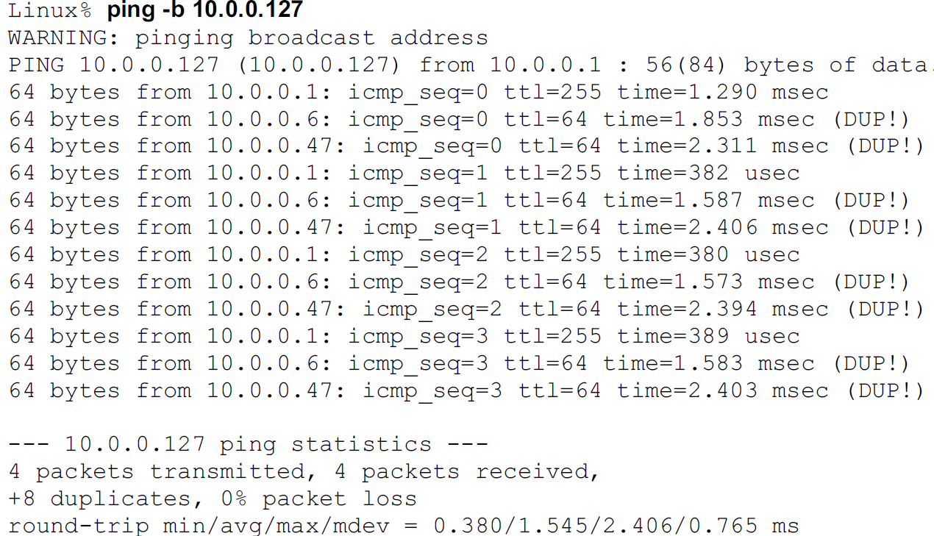
Ping
Pings sends a ICMP message to a remote host and lets you determine if that host is responding
  On UNIX, the process ID of the sending process is typically placed in the Identifier field
  The Sequence number starts at o, and it increases every time a new echo message is sent.
  The (DUP!) notation indicates that an Echo Reply has been received containing a Sequence Number field identical to a previously received one.
  Round trip time is calculated at the host based on the sequence number
Notes:
Incase a request drops, it sends multiple requests and expects them to reply.
The packets not received are considered as packet loss
TTL values are different (255 and 64), suggesting that different kinds of computers are responding.

Slide 4
Ping contd
The ping program also typically includes a copy of the local time in the optional data area of outgoing echo requests. This time, along with the rest of the contents of the data area, is returned in an Echo Response message.
It notes the current time when a response is received and subtracts the time in the reply from the current time, giving an estimate of the RTT to reach the host that was “pinged.”
Because only the original sender’s notion of the current time is used, this feature does not require any synchronization between the clocks at the sender and receiver.

Slide 5
8.4.2. Router Discovery: Router Solicitation and Advertisement (ICMPv4 Types 9, 10)
Routers send Router Advertisement messages both on a regular basis
Or a host that is starting up can prompt a router using Router Solicitation messages to the link-local scope all-routers multicast address (ff02::2)
  If already configured with a unicast address, RS is sent with a unicast source address
  Otherwise, it is sent with an unspecified source address (::)
Notes:
The implications of this are clear: a host cannot really use an internetwork until it knows the identity of at least one local router, and the method by which that router is to be used. In IPv4, a technique known as router discovery was invented, which provides a means by which a host can locate a router and learn important parameters related to the operation of the local network. The router discovery function has been incorporated into the Neighbor Discovery (ND) protocol. On the home network, home agents maintain the list of global addresses of all home agents on the home network by listening to each other’s Router Advertisement messages.

Slide 6
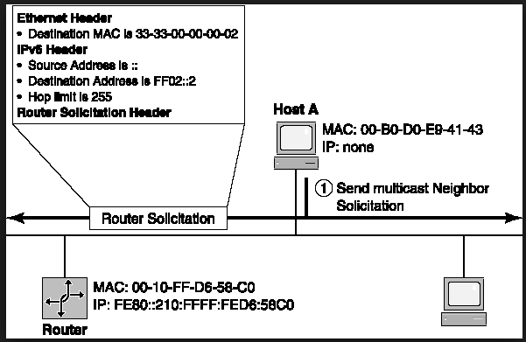
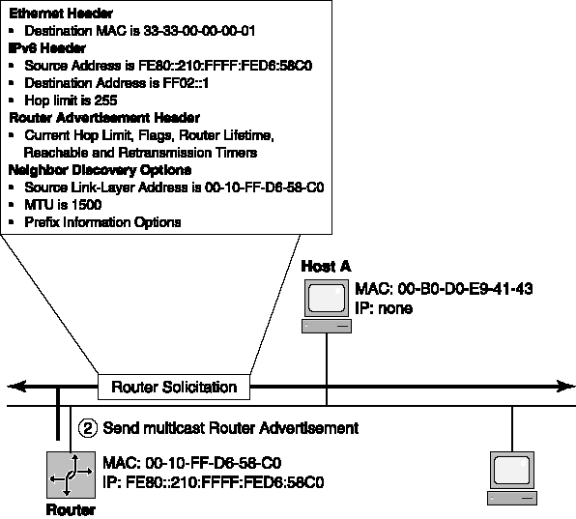
8.4.2. Router Discovery: Router Solicitation and Advertisement (ICMPv4 Types 9, 10)
Router Solicitation
Router Advertisement
Notes:
Host A send RS to address ff02::2
Responses with a RA message containing the configuration parameters and local link prefixes
When it receives the message it gives the available gateway

Slide 7
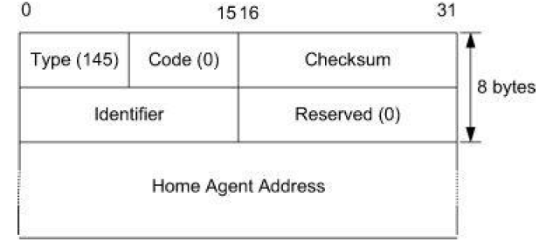
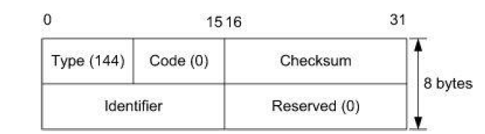
8.4.3. Home Agent Address Discovery Request/Reply (ICMPv6 Types 144/145)
MIPv6 Home Agent Discovery Request
MIPv6 Home Agent Discovery Reply
The Request message contains an identifier that is returned in the response. It is sent to the Home Agents anycast address for the mobile node’s home prefix.
The MIPv6 Home Agent Address Discovery Reply message contains
the identifier from the corresponding request and one or more addresses of a home
agent willing to forward packets for the mobile node.
Notes:
Two of the ICMPv6 messages are used for dynamic home agent address discovery, Another two are used for renumbering and mobile configuration.
The request message does not contain a Home Address option, since this message may be sent before the first home registration is completed. A mobile node cannot use its home address before home registration is completed.

Slide 8
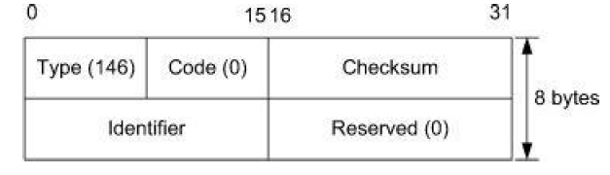
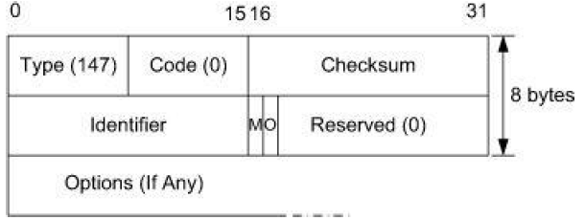
8.4.4. Mobile Prefix Solicitation/Advertisement (ICMPv6 Types 146/147)
Mobile Prefix Solicitation
Mobile Prefix Advertisement
The MIPv6 Mobile Prefix Advertisement message. The Identifier field matches the corresponding field in the solicitation. The M (Managed) flag indicates that the address is provided by a stateful configuration mechanism. The O (Other) flag indicates that other information beyond the address is supplied by stateful mechanisms.
The Mobile Prefix Solicitation message is used to solicit a routing prefix update from an HA when a node’s home address is about to become invalid.
Notes:
They are used to solicit/deliver the prefix information of a home network to a mobile node while the mobile node is away from home.
It is similar to a Router Solicitation message but is sent to a mobile node’s HA instead of to the local subnetwork.
The Mobile Prefix Advertisement message is designed to inform a traveling mobile node that its home prefix has changed.

Slide 9
8.4.5. Mobile IPv6 Fast Handover Messages (ICMPv6 Type 154)
It specifies methods for improving the IP-layer handoff latency when a mobile node moves from one network access point (AP) to another.
This is accomplished by predicting the routers and addressing information that will be used prior to the handoff taking place.
The protocol involves the discovery of so-called proxy routers , which behave like routers a mobile is likely to encounter after it is handed off to a new network.

Slide 10
8.4.6. Multicast Listener Query/Report/Done (ICMPv6 Types 130/131/132)
Multicast Listener Query (type value = 130) – enables the router to query for listeners:
  General query – enables the router to learn which multicast addresses have listeners.
  Multicast address specific query – determines whether a particular multicast address has any listeners
Multicast Listener Report (type value = 131) – enables a multicast listener to reply to a router query indicating its desire to receive so-addressed multicast packets
Multicast Listener Done (type value = 132) – allows a multicast listener to announce that it has finished listening to a given multicast addressed transmission. This message is send to the link-scoped all-routers multicast address, ff02::2.
Notes:
MLD feature enables a router to identify the presence of multicast listeners on its directly attached links, that is, nodes configured to listen on multicast addresses, as well as corresponding multicast address(es). Identification of multicast hosts and addresses enables the router to route and deliver multicast IPv6 packets accordingly. The router uses a link local IPv6 address as its source IPv6 address when sending MLD queries on a given link

Slide 11
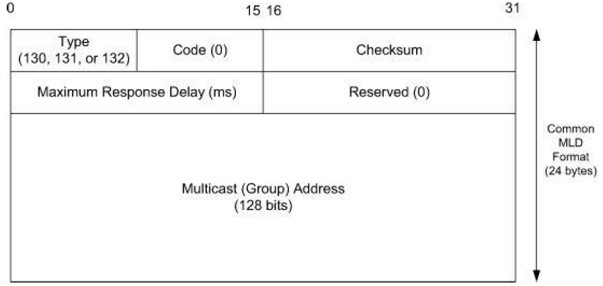
8.4.6. Multicast Listener Query/Report/Done (ICMPv6 Types 130/131/132)
The Maximum Response Time field, nonzero only in queries, gives the maximum number of milliseconds a host may delay sending a report in response to a query.
The Multicast Address field is 0 for general queries and the address for which the router is interested in reports otherwise.
Notes:
The main purpose of MLD is for multicast routers to learn the multicast addresses used by the hosts on each link to which they are mutually attached. MLDv2 extends this capability by allowing hosts to specify particular hosts from which they wish to (or not to) receive traffic.

Slide 12
8.4.7. Version 2 Multicast Listener Discovery (MLDv2) (ICMPv6 Type 143)
Multicast Listener Query
  General query and Multicast address specific query
  Multicast address and source specific query –determines whether a particular multicast address of a given source address(es) has any listeners.
Multicast Listener (v2) Report (type value = 143) – used by MLDv2 hosts to inform link-attached routers of its multicast listening state, for example, to which addresses it is listening or is not listening
Notes:
The first version is compatible with v2 and adds source filtering, that is enabling a multicast listener to express interest in multicast packets from a specific source IPv6 address. 4 MLD message type are defined

Slide 13
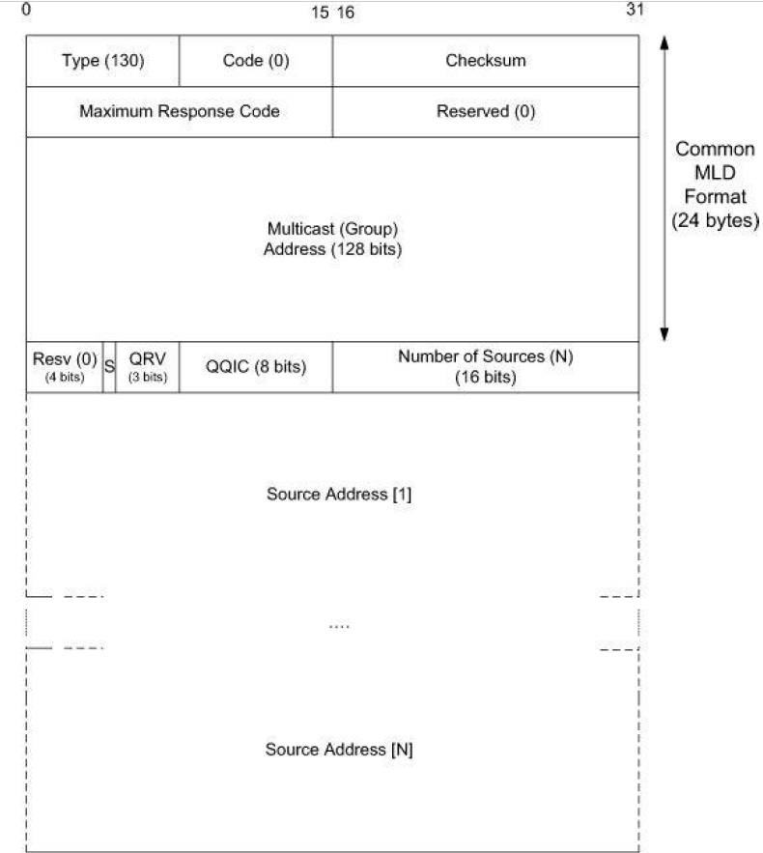
8.4.7. Version 2 Multicast Listener Discovery (MLDv2) (ICMPv6 Type 143)
The Maximum Response Code field specifies the maximum time allowed before sending an MLD Response message.
  The value of this field is special and therefore is interpreted slightly differently than in MLDv1: if it is less than 32,768, the maximum response delay is set equal to the value (in milliseconds) as in MLDv1. If the value is equal to or greater than 32,769, the field encodes a floating point number
The QRV (Querier Robustness Variable) field, if set, contains a value of no more than 7. If the sender’s internal QRV value exceeds 7, this field is set to 0.
The Number of Sources (N) field indicates the number of source addresses present in the query
Notes:
The first version is compatible with v2 and adds source filtering, that is enabling a multicast listener to express interest in multicast packets from a specific source IPv6 address. 4 MLD message type are defined

Slide 14
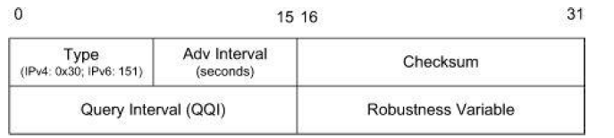
8.4.8. Multicast Router Discovery (MRD) (IGMP Types 48/49/50, ICMPv6 Types 151/152/153)
The multicast router discovery (MRD) process is defined to enable identification of routers actively engaged in multicast routing and to enable switches to determine which switch ports should be bridged in multicast communications. As such MRD packets are intended to be link-local with a hop limit of “1.”
The IP address of the sender is used to indicate to a receiver the router that is able to forward multicast traffic. The message is sent to the All Snoopers multicast address (IPv4, 224.0.0.106; IPv6, ff02::6a).

Slide 15
8.4.8. Multicast Router Discovery (MRD) (IGMP Types 48/49/50, ICMPv6 Types 151/152/153)
MRD for IPv6 utilizes three ICMPv6 message types:
  Multicast Router Advertisement (ICMPv6 type = 151) – a router periodically advertises or responds to solicitations using this message sent to the “All-Snoopers” multicast address (ff02::6a) to advertise its participation in multicast forwarding
  Multicast Router Solicitation (ICMPv6 type = 152) – enables a node to solicit a multicast router advertisement message for MRD
  Multicast Router Termination (ICMPv6 = 152) – sent by a router to indicate it is on longer engaged in multicast message forwarding.
Notes:
The Solicitation message induces a multicast router to send an Advertisement message on demand. Such messages are sent to the All Routers address: 224.0.0.2 for IPv4 and the link-local multicast address ff02::2 for IPv6. Termination messages are sent to the All Snoopers IP address to indicate that the sending router is no longer willing to forward multicast traffic.

