Slide 1
Ad hoc and Sensor Networks
Chapter 9: Localization & positioning
Holger Karl

Slide 2
Goals of this chapter
Means for a node to determine its physical position (with respect to some coordinate system) or symbolic location
Using the help of
  Anchor nodes that know their position
  Directly adjacent
  Over multiple hops
Using different means to determine distances/angles locally

Slide 3
Overview
Basic approaches
Trilateration
Multihop schemes

Slide 4
Localization & positioning
Determine physical position or logical location
  Coordinate system or symbolic reference
  Absolute or relative coordinates
Options
  Centralized or distributed computation
  Scale (indoors, outdoors, global, …)
  Sources of information
Metrics
  Accuracy (how close is an estimated position to the real position?)
  Precision (for repeated position determinations, how often is a given accuracy achieved?)
  Costs, energy consumption, …

Slide 5
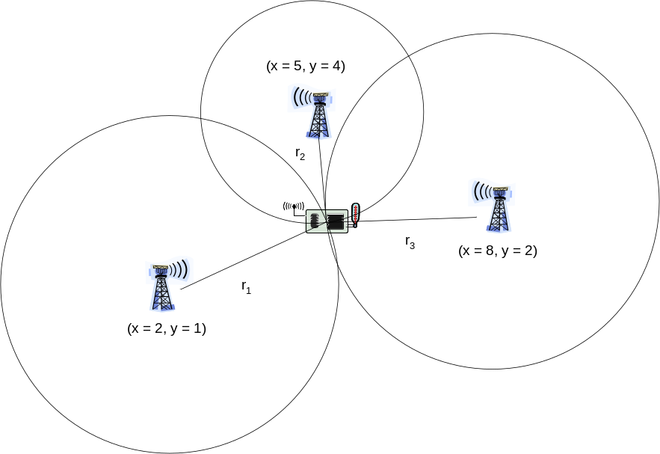
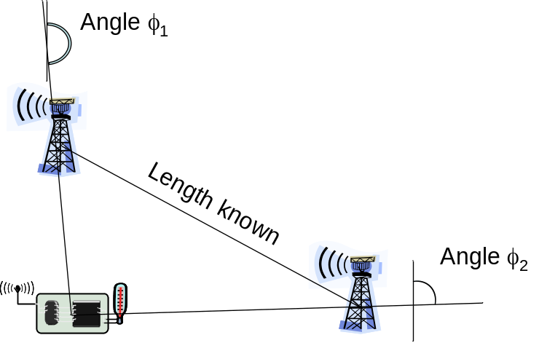
Main approaches (information sources)
Proximity
  Exploit finite range of wireless communication
  E.g.: easy to determine location
  in a room with infrared room
  number announcements
(Tri-/Multi-)lateration and angulation
  Use distance or angle estimates, simple geometry to compute position estimates
Scene analysis
  Radio environment has characteristic “signatures”
  Can be measured beforehand, stored, compared with current situation

Slide 6
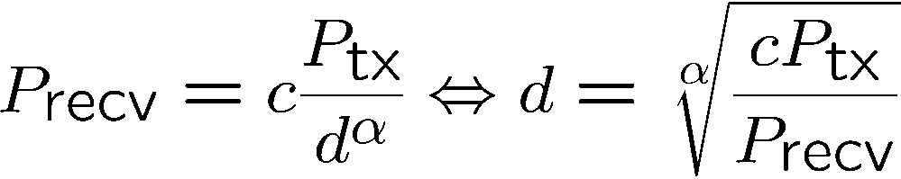
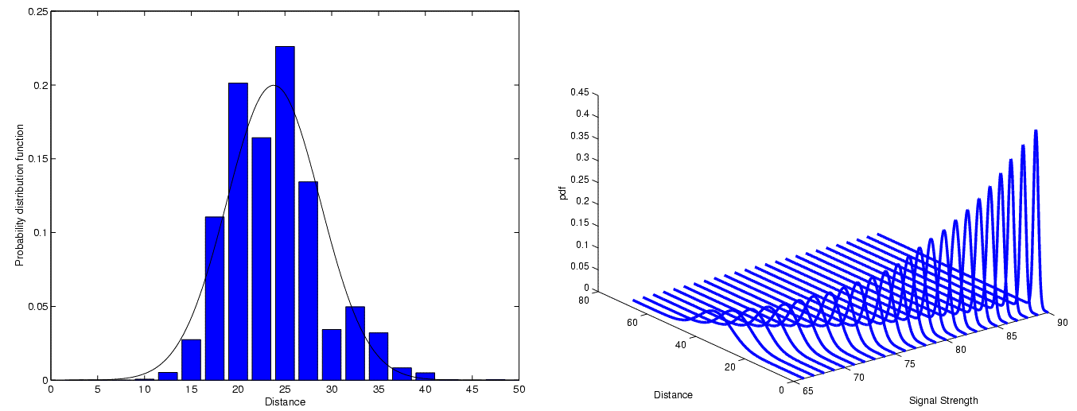
Estimating distances – RSSI
Received Signal Strength Indicator
  Send out signal of known strength, use received signal strength and path loss coefficient to estimate distance
  Problem: Highly error-prone process – Shown: PDF for a fixed RSSI
PDF
PDF
Distance
Distance
Signal strength

Slide 7
Estimating distances – other means
Time of arrival (ToA)
  Use time of transmission, propagation speed, time of arrival to compute distance
  Problem: Exact time synchronization
Time Difference of Arrival (TDoA)
  Use two different signals with different propagation speeds
  Example: ultrasound and radio signal
    Propagation time of radio negligible compared to ultrasound
  Compute difference between arrival times to compute distance
  Problem: Calibration, expensive/energy-intensive hardware

Slide 8
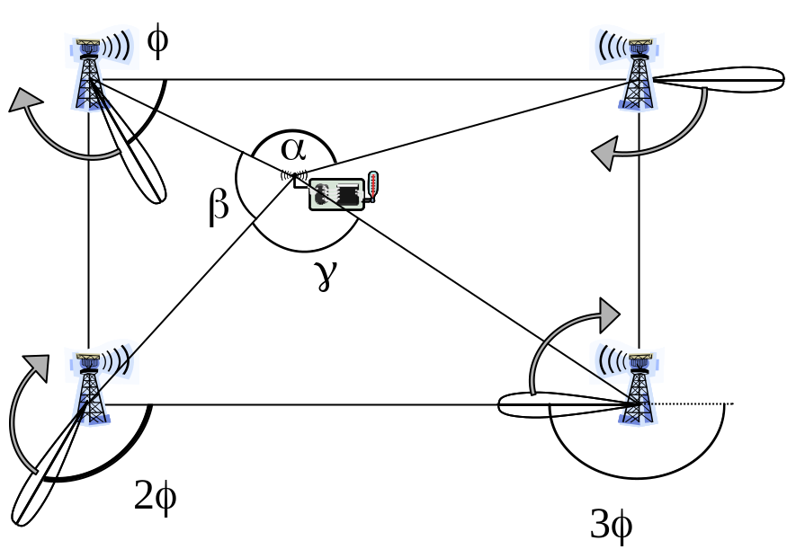
Determining angles
Directional antennas
  On the node
  Mechanically rotating or electrically “steerable”
  On several access points
    Rotating at different offsets
    Time between beacons allows to compute angles

Slide 9
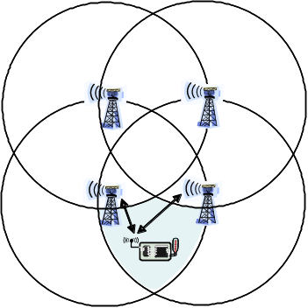
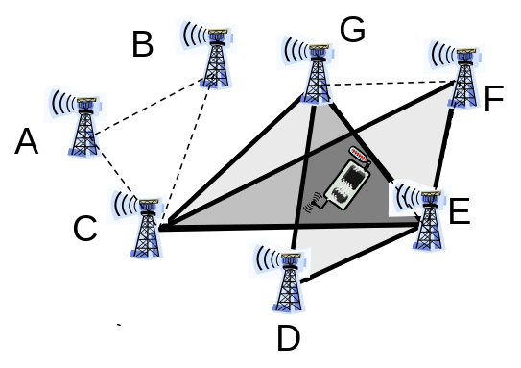
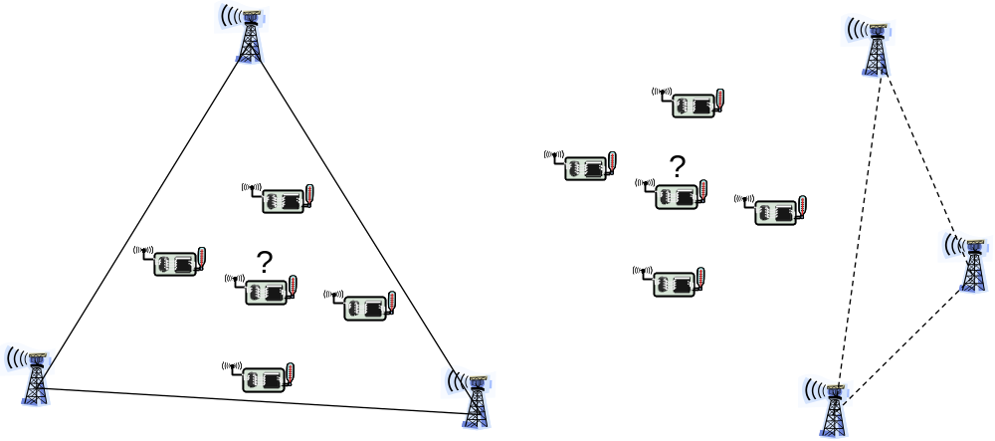
Some range-free, single-hop localization techniques
Overlapping connectivity: Position is estimated in the center of area where circles from which signal is heard/not heard overlap
Approximate point in triangle
  Determine triangles of anchor nodes where node is inside, overlap them
  Check whether inside a given triangle – move node or simulate movement by asking neighbors
  Only approximately correct

Slide 10
Overview
Basic approaches
Trilateration
Multihop schemes

Slide 11


Trilateration
Assuming distances to three points with known location are exactly given
Solve system of equations (Pythagoras!)
  (x_{i},y_{i}) : coordinates of anchor point i, r_{i} distance to anchor i
  (x_{u}, y_{u}) : unknown coordinates of node
  Subtracting eq. 3 from 1 & 2:
  Rearranging terms gives a linear equation in (x_{u}, y_{u})!

Slide 12


Trilateration as matrix equation
Rewriting as a matrix equation:
Example: (x₁, y₁) = (2,1), (x₂, y₂) = (5,4), (x₃, y₃) = (8,2),
r₁ = 10^{0.5} , r₂ = 2, r₃ = 3
! (x_{u},y_{u}) = (5,2)

Slide 13
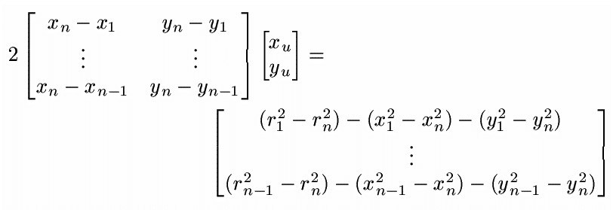

Trilateration with distance errors
What if only distance estimation r_{i}⁰ = r_{i} + ε_{i} available?
Use multiple anchors, overdetermined system of equations
Use (x_{u}, y_{u}) that minimize mean square error, i.e,

Slide 14


Minimize mean square error
Look at square of the of Euclidean norm expression (note that for all vectors v)
Look at derivative with respect to x, set it equal to 0:
  Normal equation
  Has unique solution (if A has full rank), which gives desired minimal mean square error
Essentially similar for angulation as well

Slide 15
Overview
Basic approaches
Trilateration
Multihop schemes

Slide 16
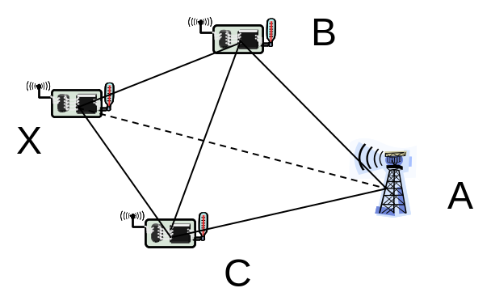
Multihop range estimation
How to estimate range to a node to which no direct radio communication exists?
  No RSSI, TDoA, …
  But: Multihop communication is possible
Idea 1: Count number of hops, assume length of one hop is known (DV-Hop)
  Start by counting hops between anchors, divide known distance
Idea 2: If range estimates between neighbors exist, use them to improve total length of route estimation in previous method (DV-Distance)

Slide 17
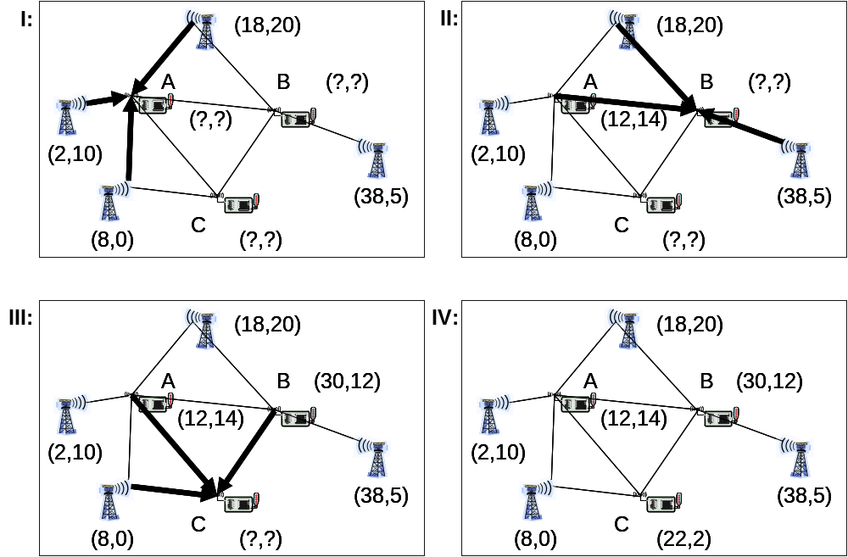
Iterative multilateration
Assume some nodes can hear at least three anchors (to perform triangulation), but not all
Idea: let more and more nodes compute position estimates, spread position knowledge in the network
  Problem: Errors accumulate

Slide 18
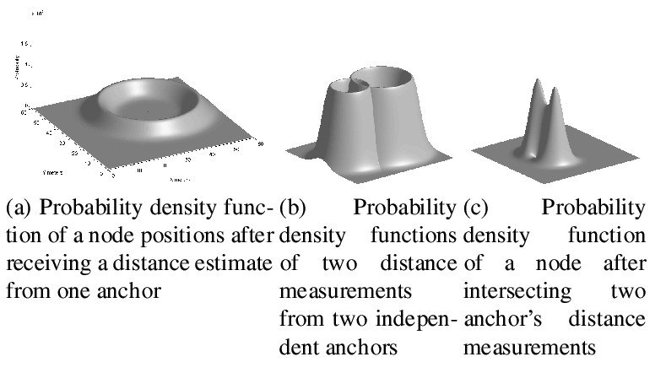
Probabilistic position description
Similar idea to previous one, but accept problem that position of nodes is only probabilistically known
  Represent this probability explicitly, use it to compute probabilities for further nodes

Slide 19
Conclusions
Determining location or position is a vitally important function in WSN, but fraught with many errors and shortcomings
  Range estimates often not sufficiently accurate
  Many anchors are needed for acceptable results
  Anchors might need external position sources (GPS)
  Multilateration problematic (convergence, accuracy)

