Slide 1


SmartLight:
Light-weight 3D Indoor Localization
Using a Single LED Lamp
Song Liu, Tian He
University of Minnesota Twin Cities
Presented by Yongseok Jeon

Slide 2
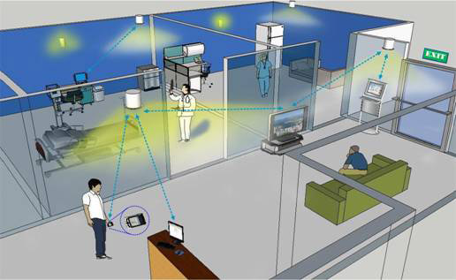
Motivation
Indoor localization
  Locate objects or people inside a building
  Used for a broad range of applications
    Ex. robot localization, object tracking, UAV indoor navigation
Fig 1. Example of indoor localization

Slide 3
Motivation
Most of existing indoor localization systems are analog-based
  It can achieve high accuracy with careful calibration in a static environment
    Ex. Time of Fight (ToF), Angle of Arrival (AoA), Received Signal Strength (RSS), etc.
  They suffer performance degradation in dynamic environments
  Analog-based approaches rely on
    The accuracy of model parameters
    The measurements of analog metrics
    Careful system calibration in a controlled environment

Slide 4
Motivation
Digital approaches
  Make binary decisions on the existence of a signal/observation
  Compared to analog approach,
    Robust to noise
    Requiring minimum calibration overhead
    More reliable

Slide 5
SmartLight
SmartLight
  A digital 3D indoor localization approach based on LED light
  Exploiting light splitting properties of a convex lens to binary decision
  Asymmetry design
    Shift all the complexity into the transmitter (single LED lamp)
    Minimize the complexity of the receiver (light sensor)

Slide 6
SmartLight
Digital localization
  Robustness against various factors
    Environmental noise
    Fluctuation of light source intensity
    Receiver orientation
    Disturbance along light propagation paths
Concurrent localization
  Single sender can locate multiple receivers simultaneously
Low-Cost localization
  Prototype system with a COTS projector and cheap light sensor

Slide 7
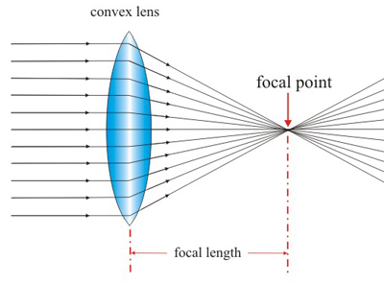
Background
Converging(convex) lens
  Transparent material that refracts light rays to form an image
A indicator of how strongly the lens converges light
Fig 2. Convex lens

Slide 8
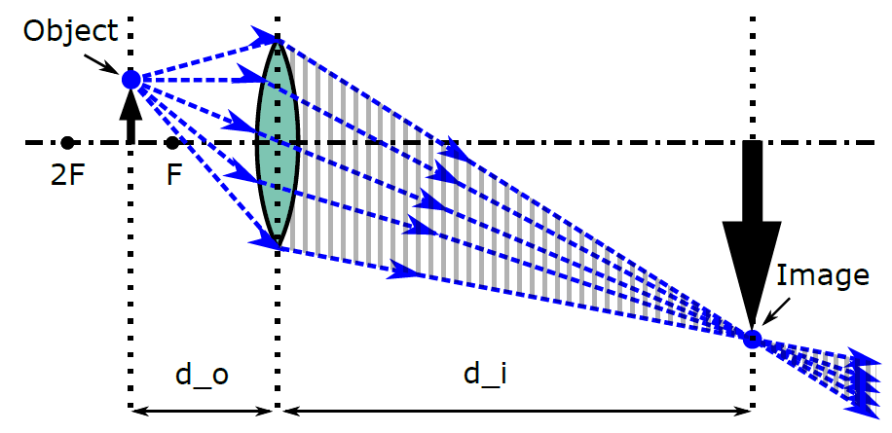
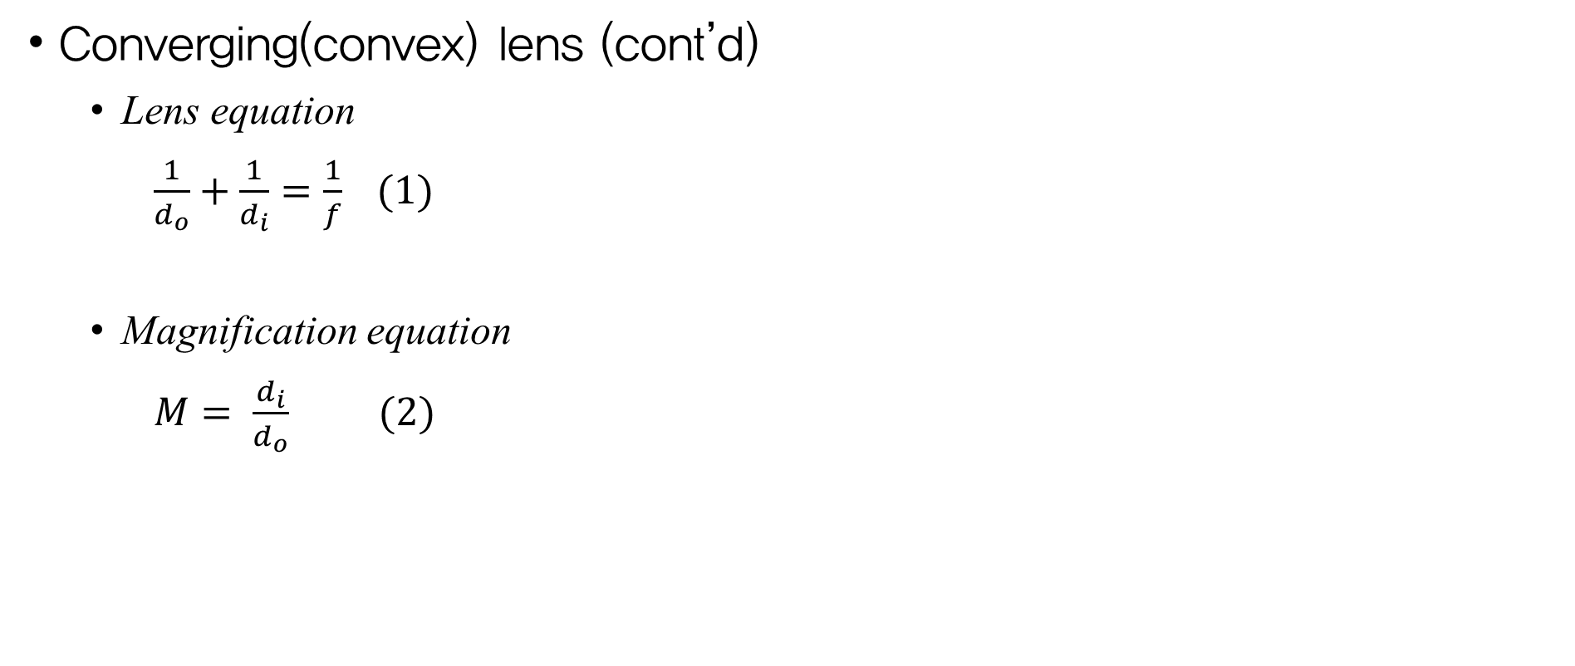
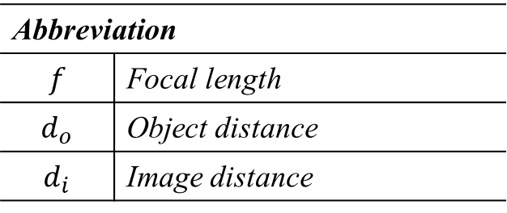
Background
Converging(convex) lens (cont’d)
  Lens equation
  $\frac{1}{d_{o}}+\frac{1}{d_{i}}=\frac{1}{f} (1)$
  Magnification equation
  $M= \frac{d_{i}}{d_{o}} (2)$
Fig 3. Light ray diagram of image formation
Abbreviation
$$f$$ | Focal length
$$d_{o}$$ | Object distance
$$d_{i}$$ | Image distance

Slide 9
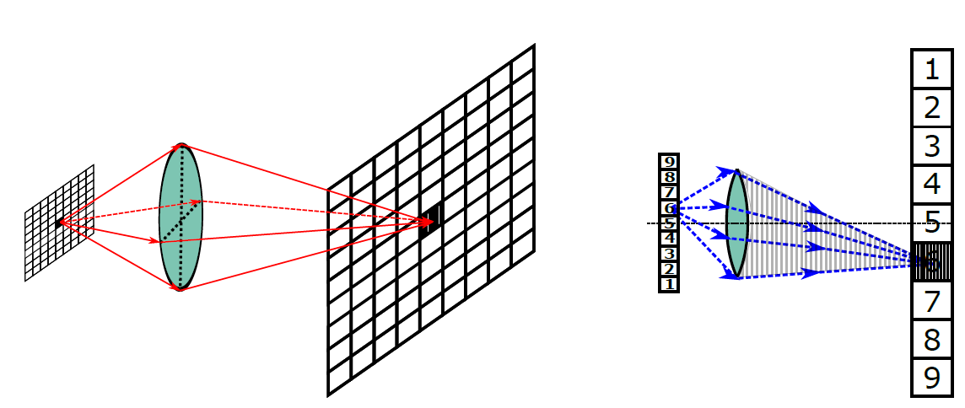
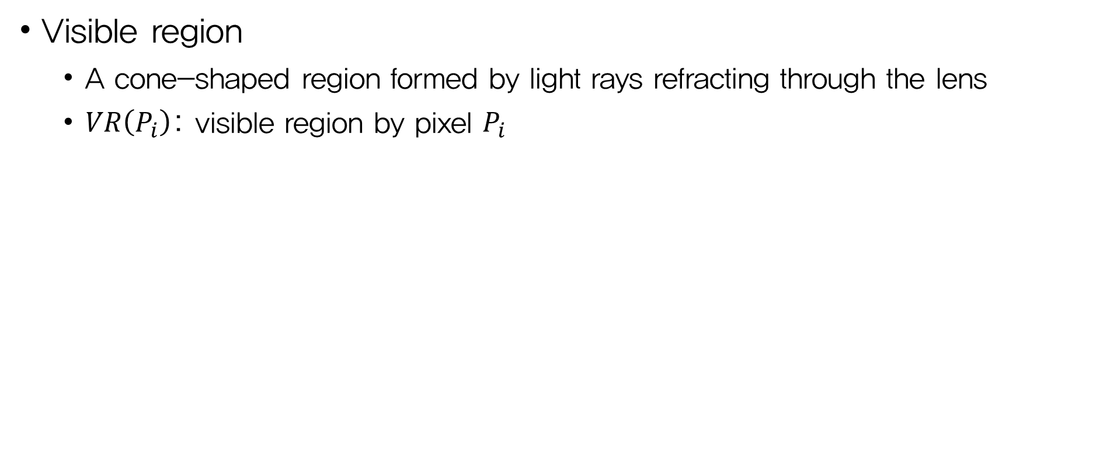
Background
Visible region
  A cone-shaped region formed by light rays refracting through the lens
  $VR\left(P_{i}\right)$: visible region by pixel $P_{i}$
Circular shape
Fig 4. 3D and 2D view of the visible region of a pixel on a light emitting object

Slide 10
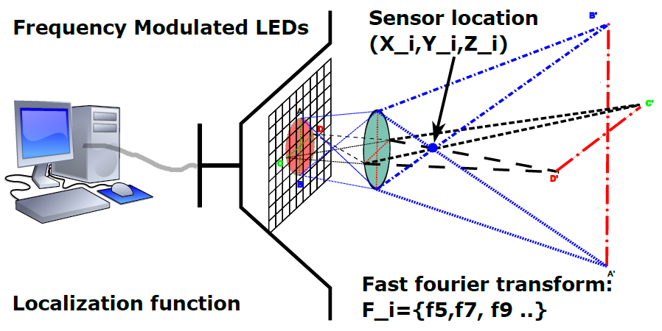
Basic Design
System setup
  SmartLight consists of
    SmartLight device
    Light sensors
Fig 5. Hardware setup of the system

Slide 11
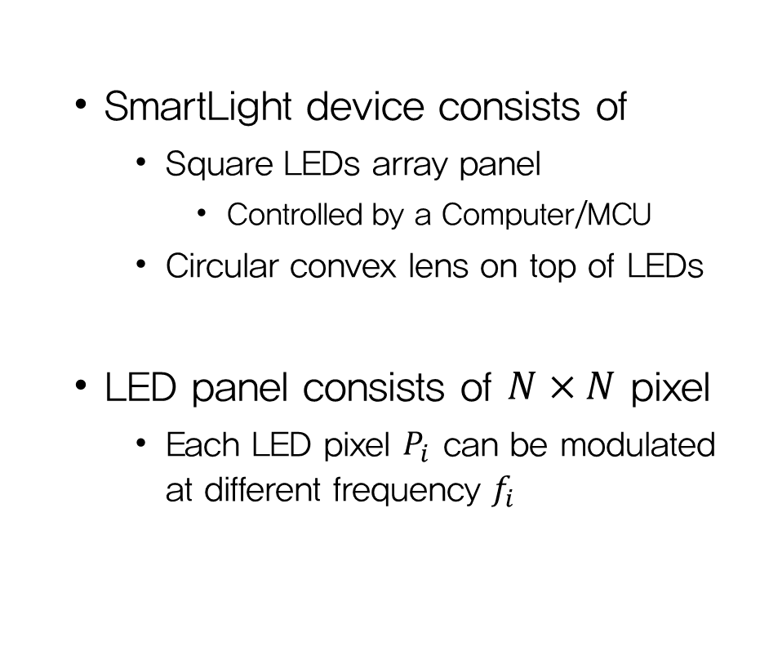
Basic Design
System setup
  SmartLight device consists of
    Square LEDs array panel
      Controlled by a Computer/MCU
    Circular convex lens on top of LEDs
  LED panel consists of $N×N$ pixel
    Each LED pixel $P_{i}$ can be modulated at different frequency $f_{i}$
Fig 5. Hardware setup of the system

Slide 12
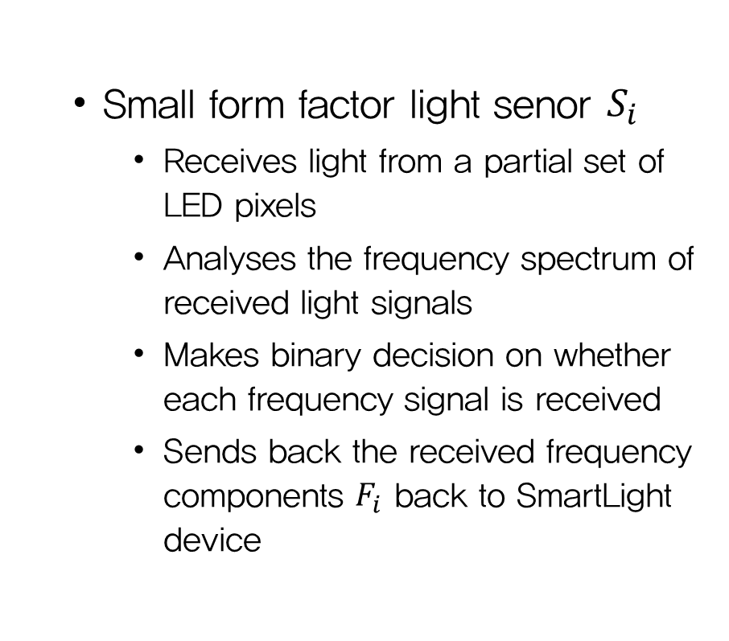
Basic Design
System setup (cont’d)
  Small form factor light senor $S_{i}$
    Receives light from a partial set of
    LED pixels
    Analyses the frequency spectrum of
    received light signals
    Makes binary decision on whether
    each frequency signal is received
    Sends back the received frequency
    components $F_{i}$ back to SmartLight
    device
Fig 5. Hardware setup of the system

Slide 13
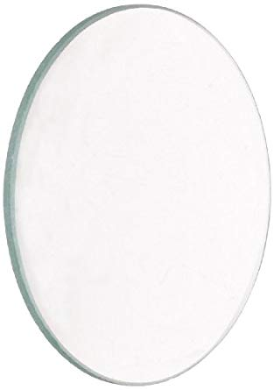
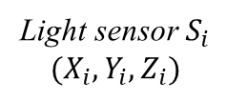
Basic Design
Coordinate system
  3D Cartesian coordinate system
  with the origin at the center of the lens
    X-axis: the upward direction
    Y-axis: the horizontal right direction
    Z-axis: the perpendicular direction away
    from the lens
X-axis
Y-axis
Light sensor $S_{i}$
$$(X_{i}, Y_{i}, Z_{i})$$
Z-axis
Fig 6. Coordinate system of SmartLight

Slide 14
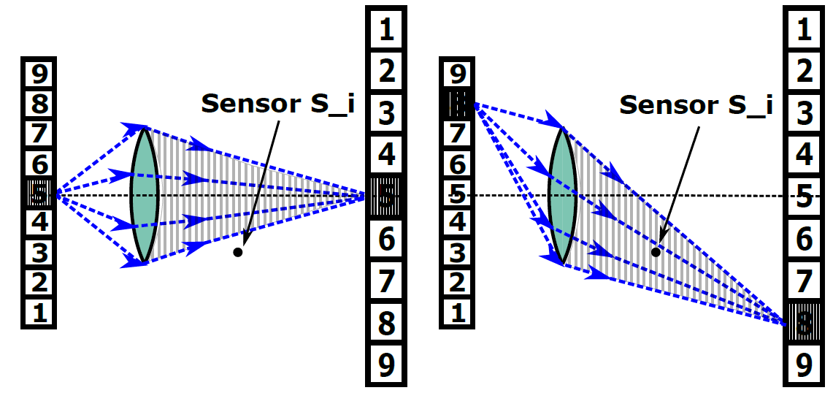
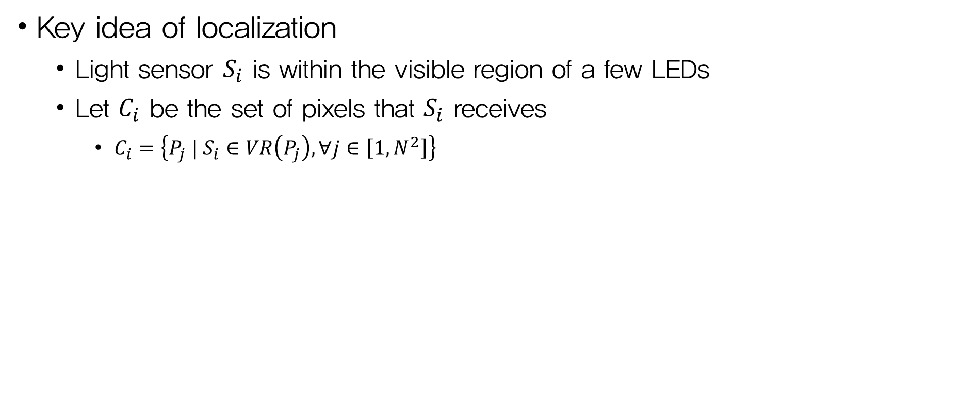
Basic Design
Key idea of localization
  Light sensor $S_{i}$ is within the visible region of a few LEDs
  Let $C_{i}$ be the set of pixels that $S_{i}$ receives
    $C_{i}=\left\{P_{j} | S_{i}∈VR\left(P_{j}\right), ∀j∈\left[1, N^{2}\right]\right\}$
Fig 7. A light sensor $S_{i}$ is within the visible region of LED 8 but outside of LED 5

Slide 15
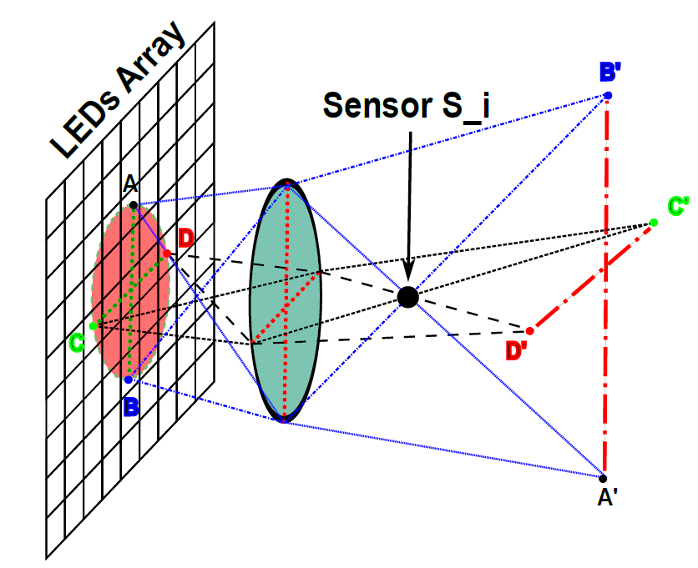
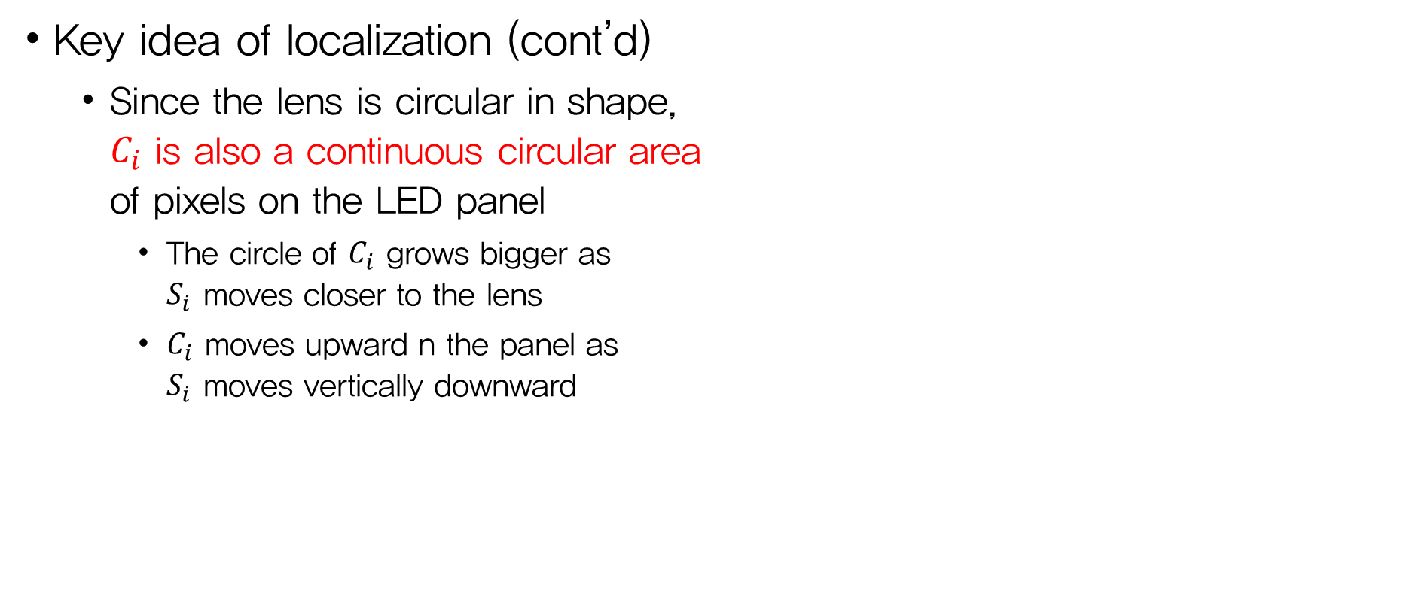
Basic Design
Key idea of localization (cont’d)
  Since the lens is circular in shape,
  $C_{i}$ is also a continuous circular area
  of pixels on the LED panel
    The circle of $C_{i}$ grows bigger as
    $S_{i}$ moves closer to the lens
    $C_{i}$ moves upward n the panel as
    $S_{i}$ moves vertically downward
Fig 8. A 3D view showing that $C_{i}$ is a circle of pixels

Slide 16
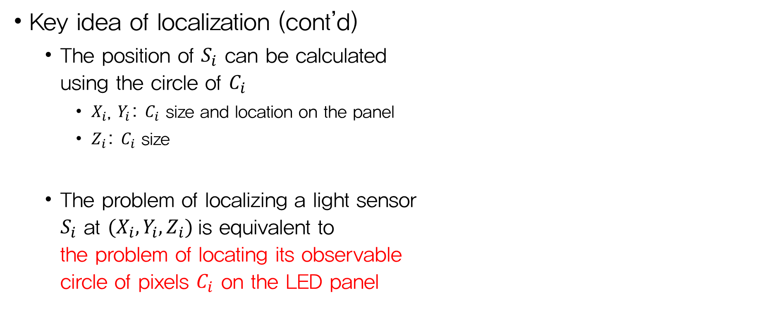
Basic Design
Key idea of localization (cont’d)
  The position of $S_{i}$ can be calculated
  using the circle of $C_{i}$
    $X_{i}$, $Y_{i}$: $C_{i}$ size and location on the panel
    $Z_{i}$: $C_{i}$ size
  The problem of localizing a light sensor
  $S_{i}$ at $(X_{i}, Y_{i}, Z_{i})$ is equivalent to
  the problem of locating its observable
  circle of pixels $C_{i}$ on the LED panel
Fig 8. A 3D view showing that $C_{i}$ is a circle of pixels

Slide 17
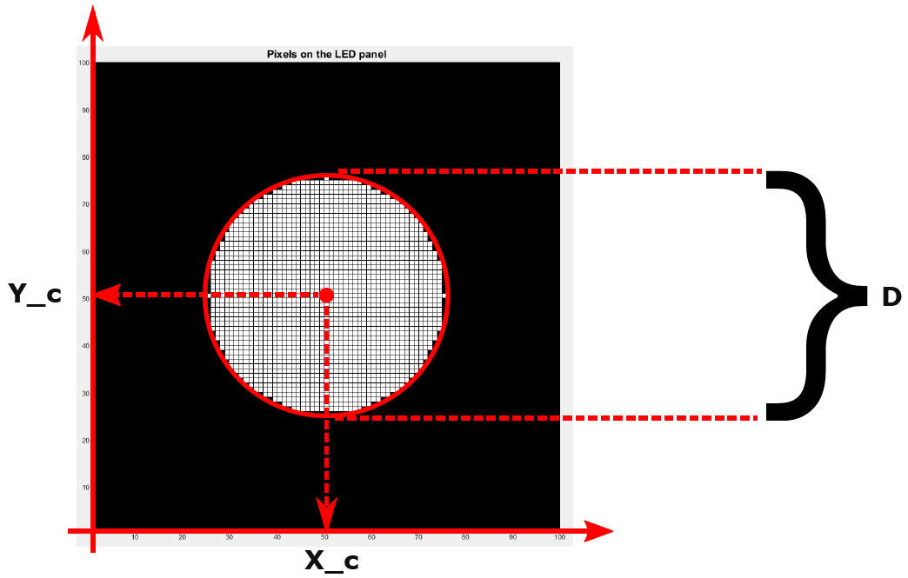
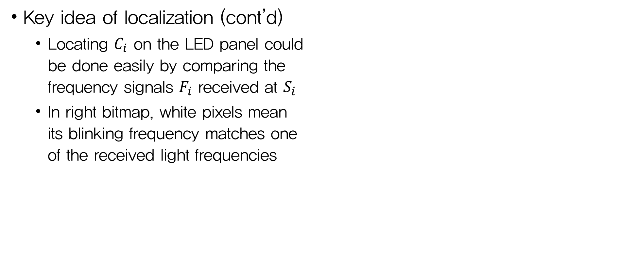

Basic Design
Key idea of localization (cont’d)
  Locating $C_{i}$ on the LED panel could
  be done easily by comparing the
  frequency signals $F_{i}$ received at $S_{i}$
  In right bitmap, white pixels mean
  its blinking frequency matches one
  of the received light frequencies
Fig 9. 2D bitmap graph to visualize $C_{i}$

Slide 18
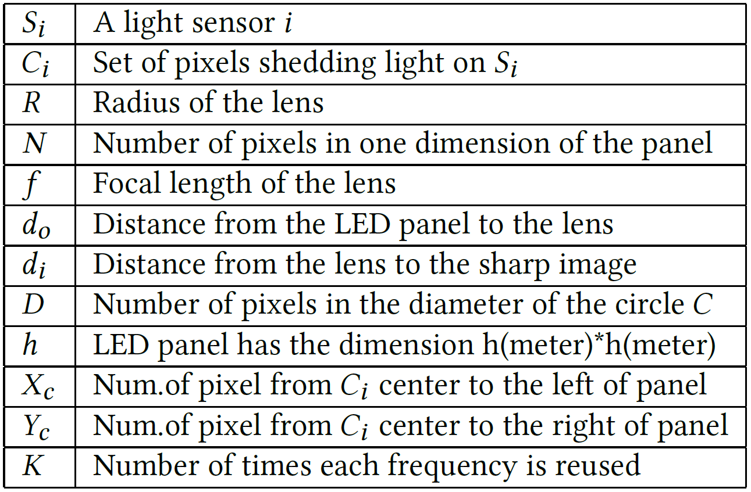
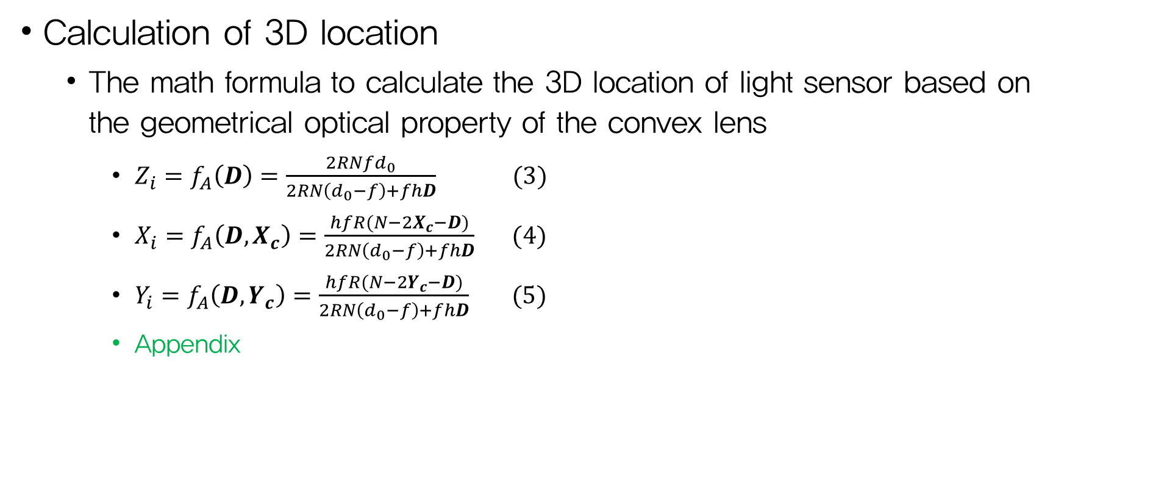
Basic Design
Calculation of 3D location
  The math formula to calculate the 3D location of light sensor based on
  the geometrical optical property of the convex lens
    $Z_{i}=f_{A}\left(D\right)=\frac{2{RNfd}_{0}}{2RN\left(d_{0}−f\right)+fhD} (3)$
    $X_{i}=f_{A}\left(D, X_{c}\right)=\frac{hfR(N−2X_{c}−D)}{2RN\left(d_{0}−f\right)+fhD} (4)$
    $Y_{i}=f_{A}\left(D, Y_{c}\right)=\frac{hfR(N−2Y_{c}−D)}{2RN\left(d_{0}−f\right)+fhD} (5)$
    Appendix
Variables
Table 1. Symbols used in Equ. 3, 4, 5

Slide 19
Advanced Design
Limitation of the basic design
  Using SmartLight in a large workspace
    A number of pixels and unique frequencies are needed
Reduce the required number of frequency!!
  To guarantee the system scalability and efficiency
  At the same time, reliability should be maintained

Slide 20
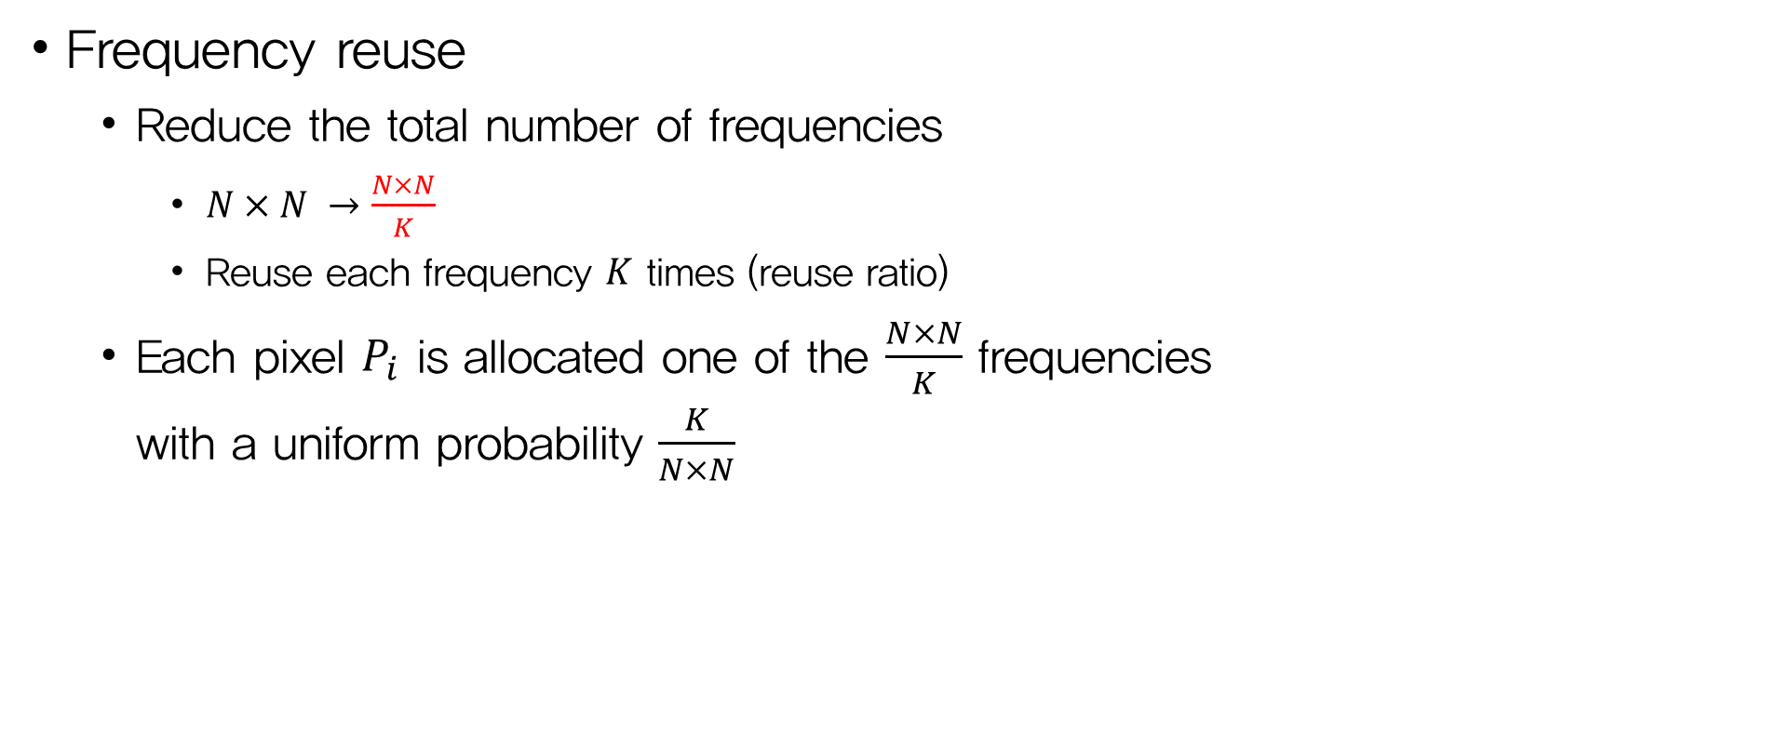
Advanced Design
Frequency reuse
  Reduce the total number of frequencies
    $N×N →\frac{N×N}{K}$
    Reuse each frequency $K$ times (reuse ratio)
  Each pixel $P_{i}$ is allocated one of the $\frac{N×N}{K}$ frequencies
  with a uniform probability $\frac{K}{N×N}$

Slide 21
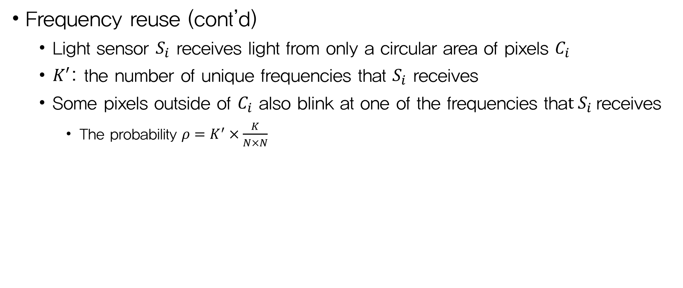
Advanced Design
Frequency reuse (cont’d)
  Light sensor $S_{i}$ receives light from only a circular area of pixels $C_{i}$
  $K′$: the number of unique frequencies that $S_{i}$ receives
  Some pixels outside of $C_{i}$ also blink at one of the frequencies that $S_{i}$receives
    The probability $ρ=K^{′}×\frac{K}{N×N}$

Slide 22
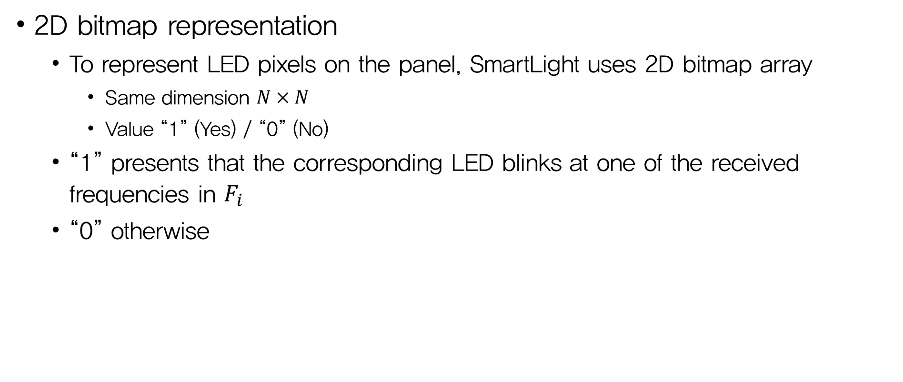
Advanced Design
2D bitmap representation
  To represent LED pixels on the panel, SmartLight uses 2D bitmap array
    Same dimension $N×N$
    Value “1” (Yes) / “0” (No)
  “1” presents that the corresponding LED blinks at one of the received frequencies in $F_{i}$
  “0” otherwise

Slide 23
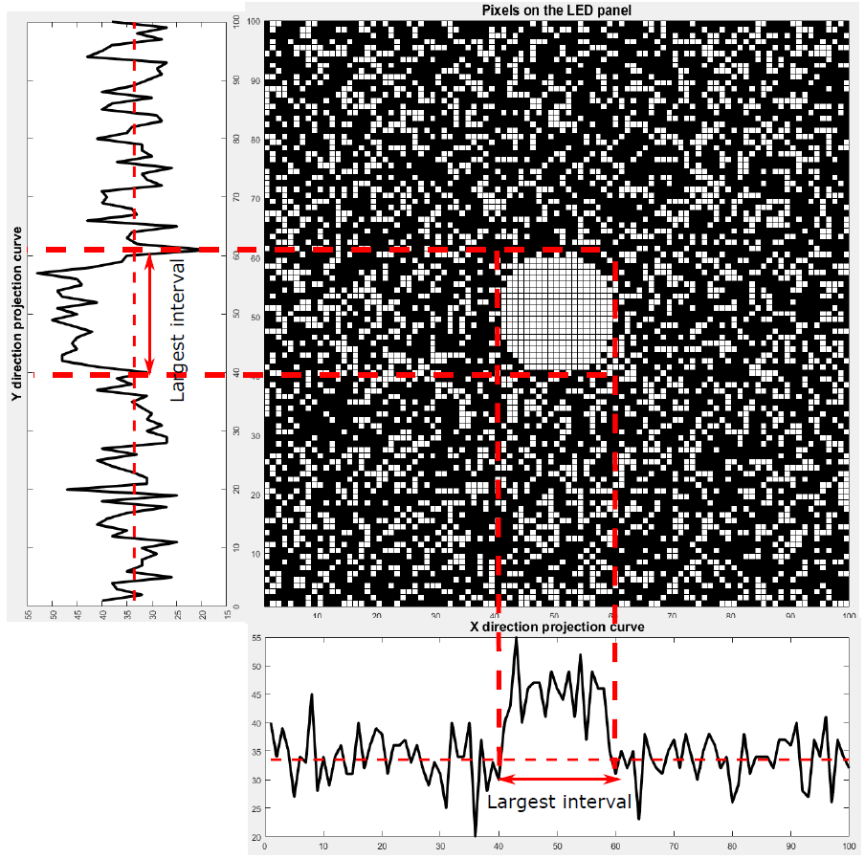
Fig 10. Projecting the 2D bitmap into the X and Y direction

Slide 24
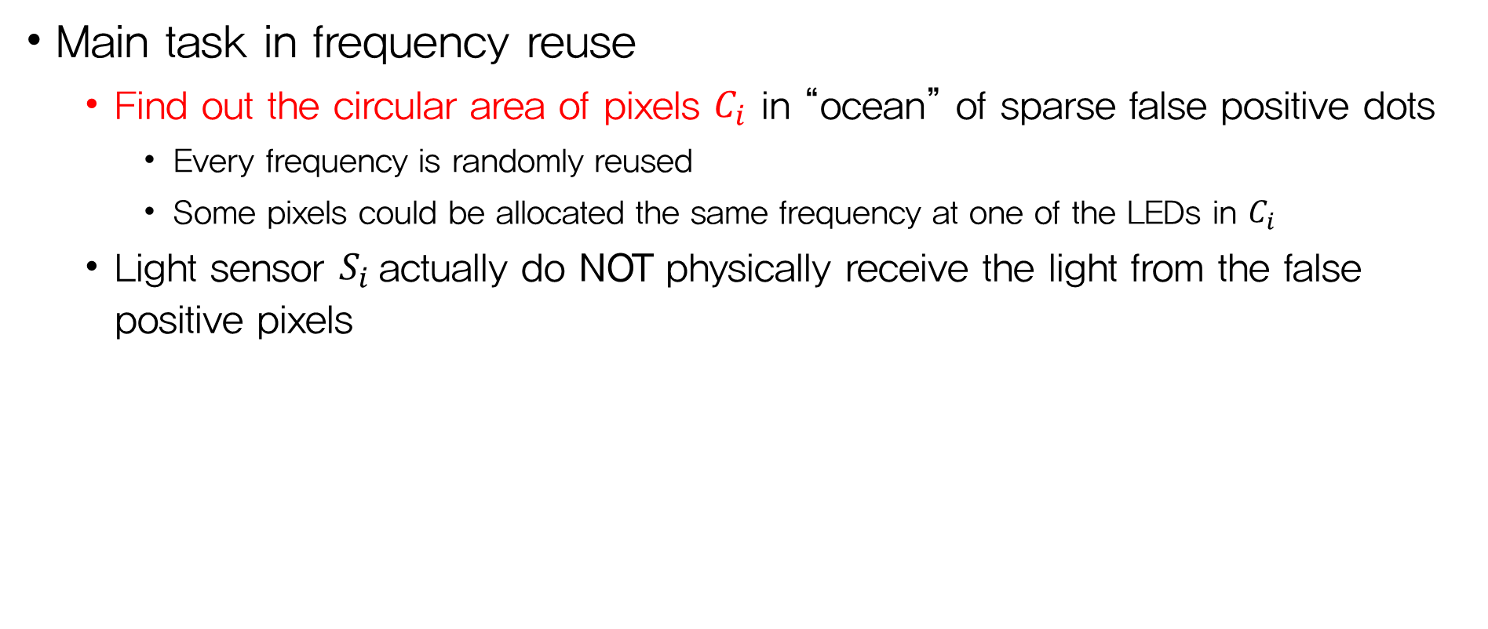
Advanced Design
Main task in frequency reuse
  Find out the circular area of pixels $C_{i}$ in “ocean” of sparse false positive dots
    Every frequency is randomly reused
    Some pixels could be allocated the same frequency at one of the LEDs in $C_{i}$
  Light sensor $S_{i}$actually do NOT physically receive the light from the false positive pixels

Slide 25
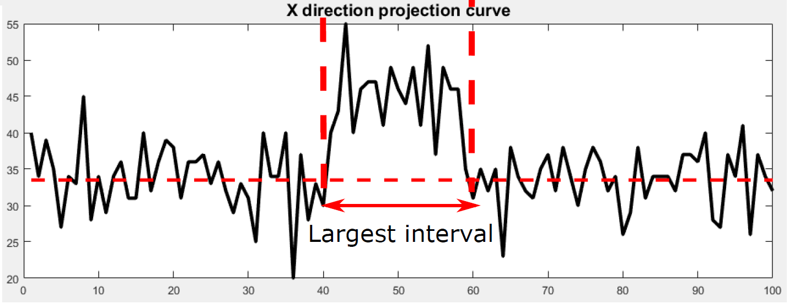
Advanced Design
Multi-directional projection
  2D problem of locating a circle into 1D problem of finding a peak
Fig 11. Projection curve about the X direction

Slide 26
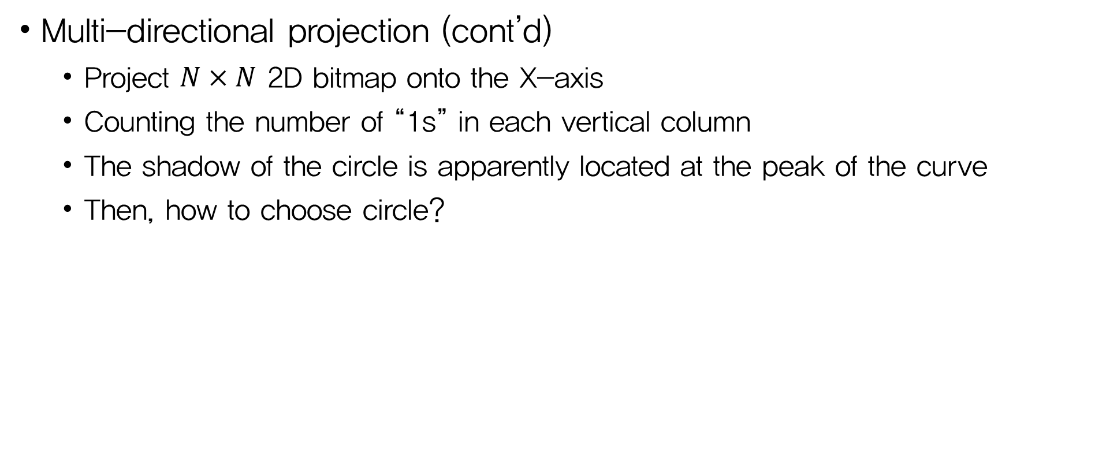
Advanced Design
Multi-directional projection (cont’d)
  Project $N×N$ 2D bitmap onto the X-axis
  Counting the number of “1s” in each vertical column
  The shadow of the circle is apparently located at the peak of the curve
  Then, how to choose circle?
Fig 11. Projection curve about the X direction

Slide 27
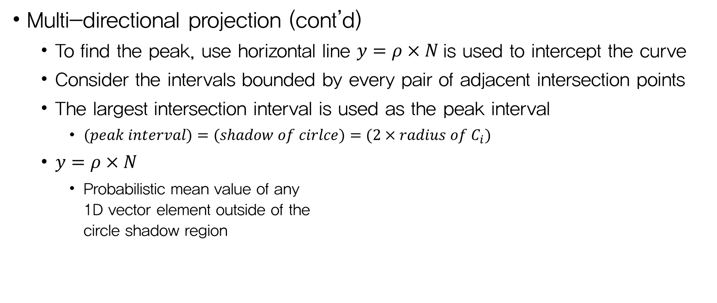
Advanced Design
Multi-directional projection (cont’d)
  To find the peak, use horizontal line $y=ρ×N$is used to intercept the curve
  Consider the intervals bounded by every pair of adjacent intersection points
  The largest intersection interval is used as the peak interval
    $(peak interval)=(shadow of cirlce)=(2×radius of C_{i})$
  $y=ρ×N$
    Probabilistic mean value of any
    1D vector element outside of the
    circle shadow region
Fig 11. Projection curve about the X direction

Slide 28
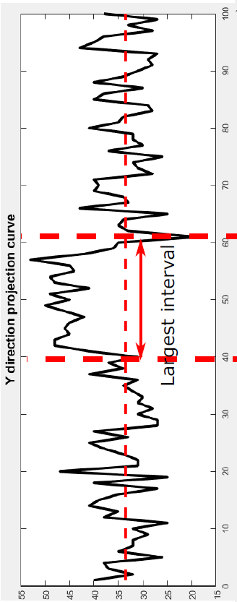
Advanced Design
Multi-directional projection (cont’d)
  Repeat the previous steps once more in the y-axis
Fig 12. Projection curve about the Y direction

Slide 29
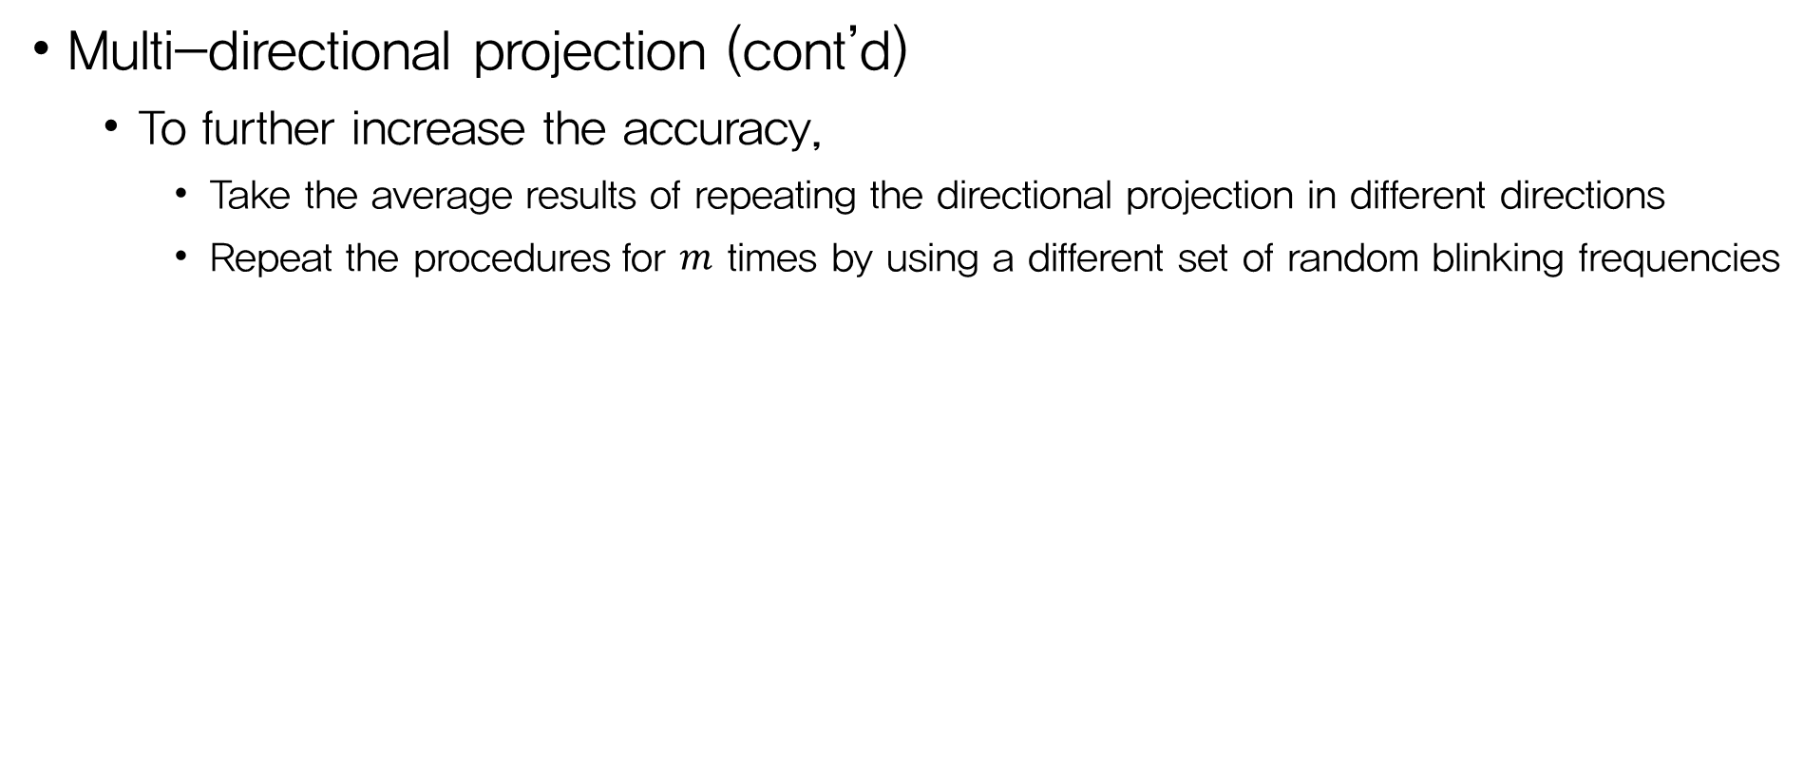
Advanced Design
Multi-directional projection (cont’d)
  To further increase the accuracy,
    Take the average results of repeating the directional projection in different directions
    Repeat the procedures for $m$ times by using a different set of random blinking frequencies

Slide 30
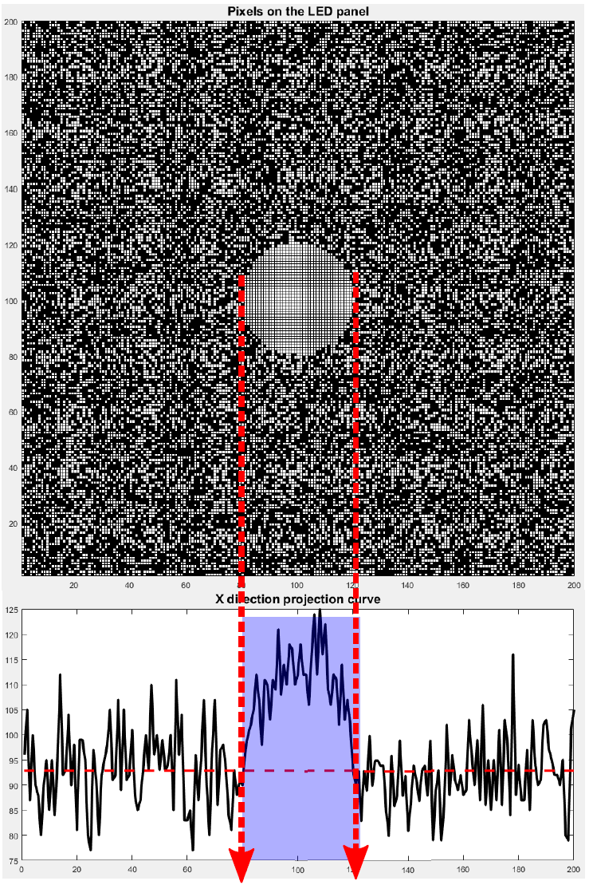
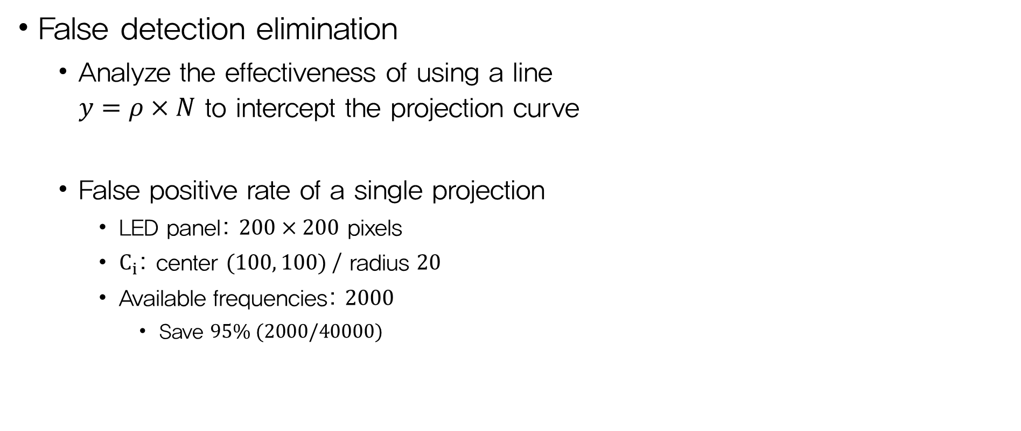

Advanced Design
False detection elimination
  Analyze the effectiveness of using a line
  $y=ρ×N$ to intercept the projection curve
  False positive rate of a single projection
    LED panel: $200×200$ pixels
    $C_{i}$: center $(100, 100)$/ radius $20$
    Available frequencies: $2000$
      Save $95\% (2000/40000)$
Fig 13. Circle $C_{i}$ and projection curve

Slide 31
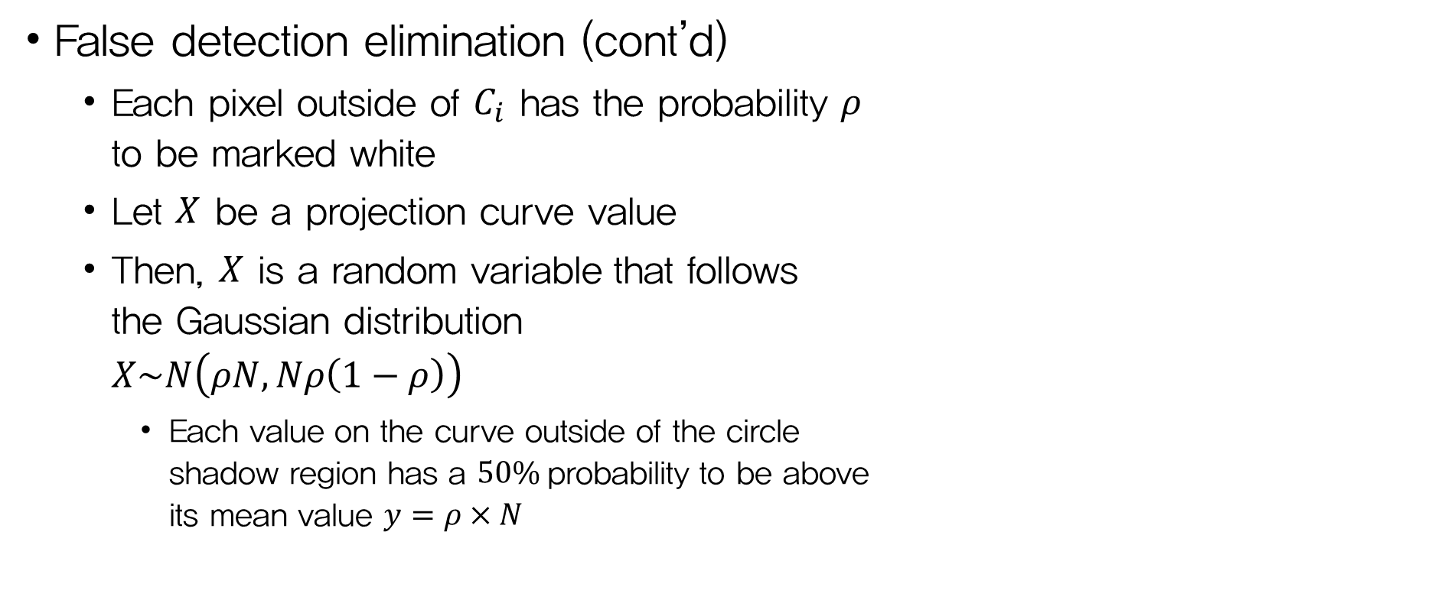
Advanced Design
False detection elimination (cont’d)
  Each pixel outside of $C_{i}$ has the probability $ρ$
  to be marked white
  Let $X$ be a projection curve value
  Then, $X$ is a random variable that follows
  the Gaussian distribution
  $X\sim N\left(ρN, Nρ\left(1−ρ\right)\right)$
    Each value on the curve outside of the circle
    shadow region has a $50\%$probability to be above
    its mean value $y=ρ×N$
Fig 13. Circle $C_{i}$ and projection curve

Slide 32
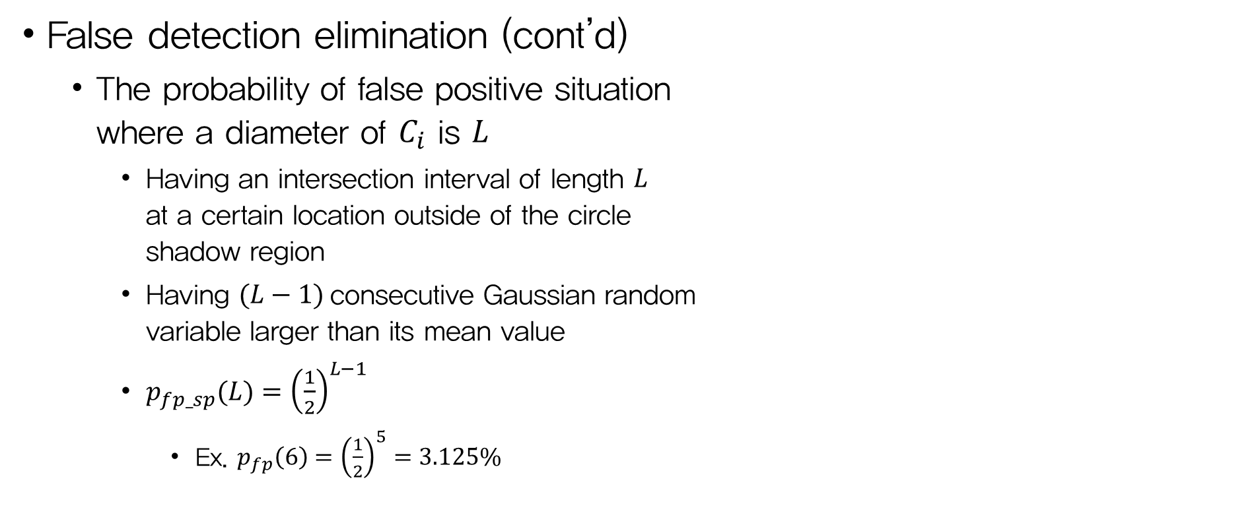
Advanced Design
False detection elimination (cont’d)
  The probability of false positive situation
  where a diameter of $C_{i}$ is $L$
    Having an intersection interval of length $L$
    at a certain location outside of the circle
    shadow region
    Having $(L−1)$consecutive Gaussian random
    variable larger than its mean value
    ${p_{fp_sp}(L)=\left(\frac{1}{2}\right)}^{L−1}$
      Ex. $p_{fp}\left(6\right)={\left(\frac{1}{2}\right)}^{5}=3.125\%$
Fig 13. Circle $C_{i}$ and projection curve

Slide 33
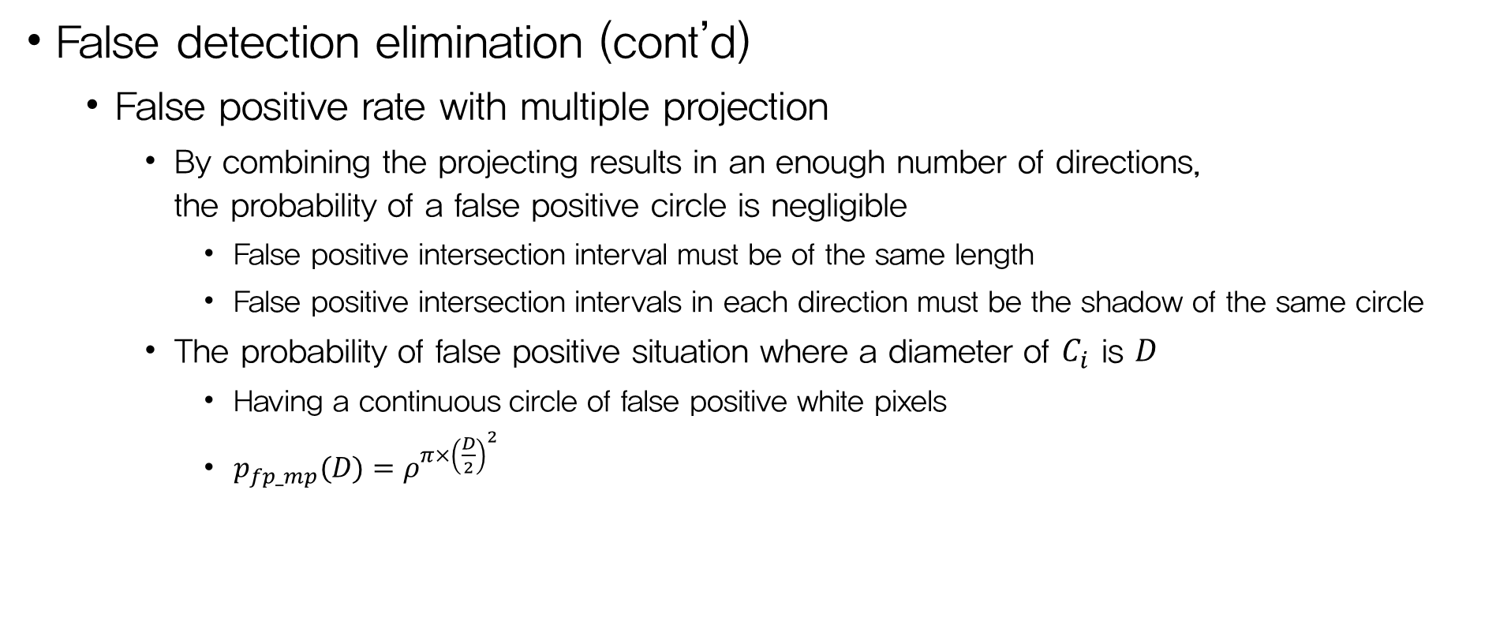
Advanced Design
False detection elimination (cont’d)
  False positive rate with multiple projection
    By combining the projecting results in an enough number of directions,
    the probability of a false positive circle is negligible
      False positive intersection interval must be of the same length
      False positive intersection intervals in each direction must be the shadow of the same circle
    The probability of false positive situation where a diameter of $C_{i}$ is $D$
      Having a continuous circle of false positive white pixels
      ${p_{fp_mp}(D)=ρ}^{π×{\left(\frac{D}{2}\right)}^{2}}$

Slide 34
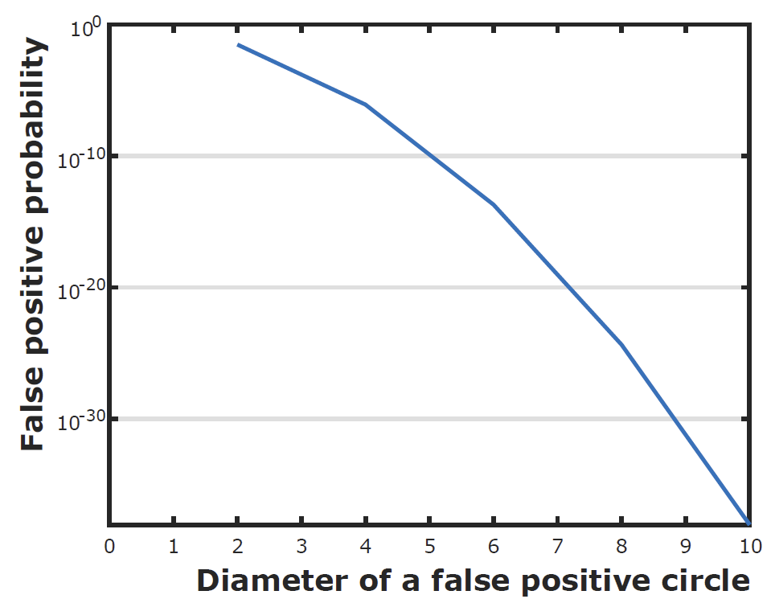
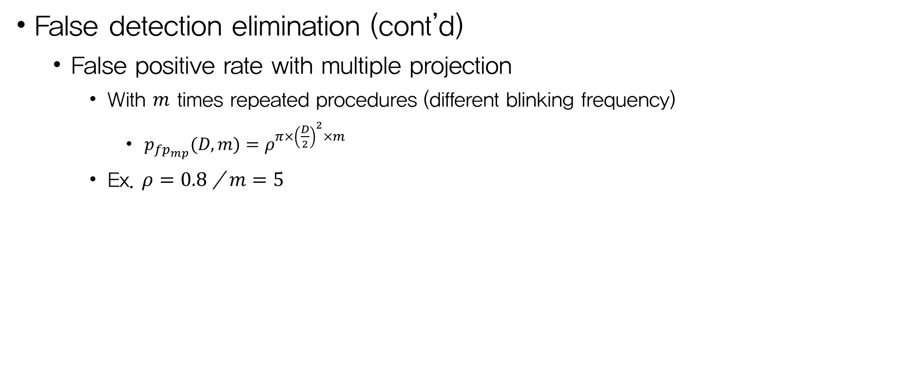
Advanced Design
False detection elimination (cont’d)
  False positive rate with multiple projection
    With $m$ times repeated procedures (different blinking frequency)
      ${p_{fp_{mp}}(D, m)=ρ}^{π×{\left(\frac{D}{2}\right)}^{2}×m}$
    Ex. $ρ=0.8$ / $m=5$
Fig 14. The probability of having a false positive circle

Slide 35
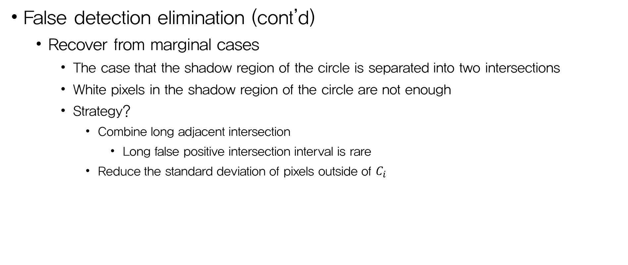
Advanced Design
False detection elimination (cont’d)
  Recover from marginal cases
    The case that the shadow region of the circle is separated into two intersections
    White pixels in the shadow region of the circle are not enough
    Strategy?
      Combine long adjacent intersection
        Long false positive intersection interval is rare
      Reduce the standard deviation of pixels outside of $C_{i}$

Slide 36
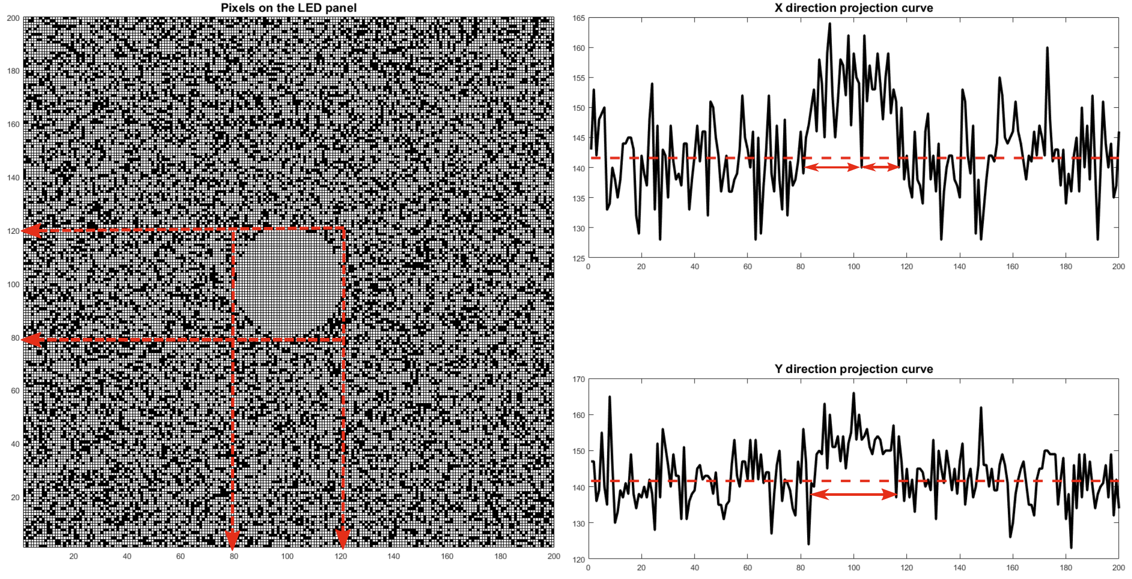
Fig 15. Example of marginal case, separation in projection curve

Slide 37
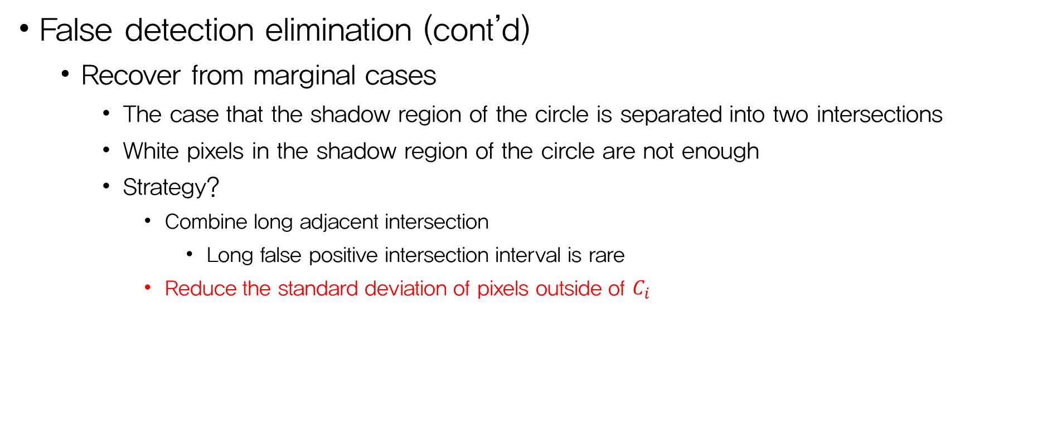
Advanced Design
False detection elimination (cont’d)
  Recover from marginal cases
    The case that the shadow region of the circle is separated into two intersections
    White pixels in the shadow region of the circle are not enough
    Strategy?
      Combine long adjacent intersection
        Long false positive intersection interval is rare
      Reduce the standard deviation of pixels outside of $C_{i}$

Slide 38
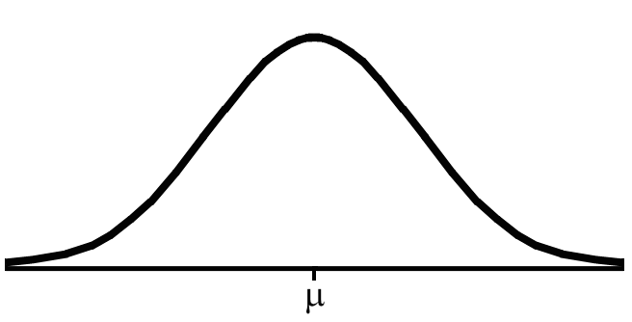
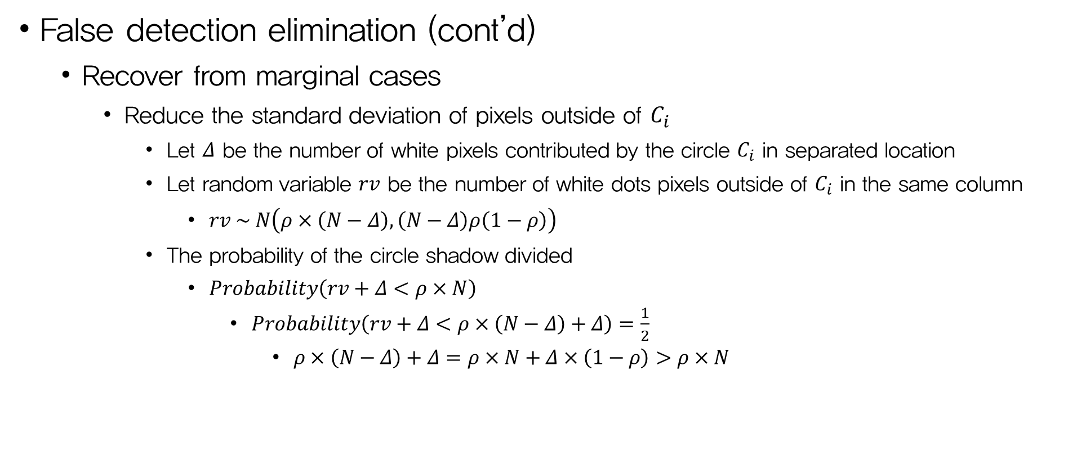



Advanced Design
False detection elimination (cont’d)
  Recover from marginal cases
    Reduce the standard deviation of pixels outside of $C_{i}$
      Let $Δ$ be the number of white pixels contributed by the circle $C_{i}$ in separated location
      Let random variable $rv$ be the number of white dots pixels outside of $C_{i}$ in the same column
        $rv \sim N\left(ρ×\left(N−Δ\right), \left(N−Δ\right)ρ\left(1−ρ\right)\right)$
      The probability of the circle shadow divided
        $Probability\left(rv+Δ<ρ×N\right)$
          $Probability\left(rv+Δ<ρ×\left(N−Δ\right)+Δ\right)=\frac{1}{2}$
            $ρ×\left(N−Δ\right)+Δ=ρ×N+Δ×\left(1−ρ\right)>ρ×N$
$$ρN$$
$$ρ\left(N−Δ\right)+Δ$$
Fig 16. CDF of random variable $rv+Δ$

Slide 40


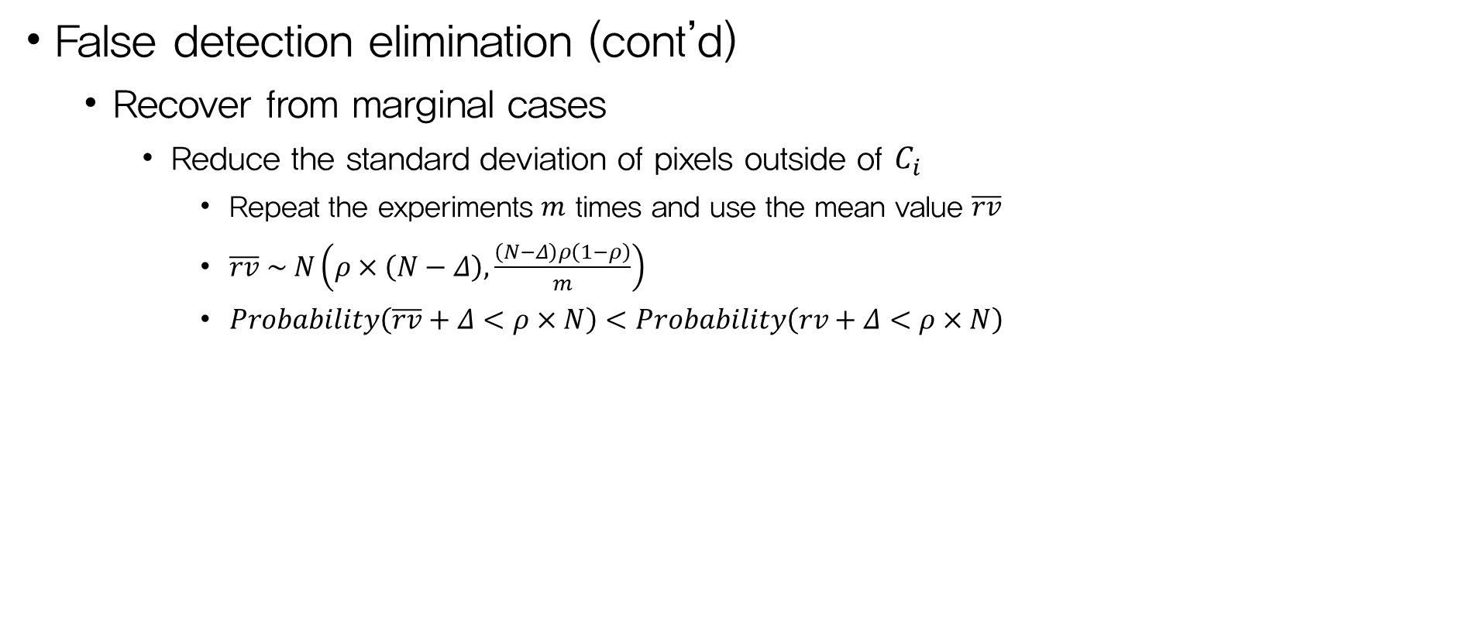


Advanced Design
False detection elimination (cont’d)
  Recover from marginal cases
    Reduce the standard deviation of pixels outside of $C_{i}$
      Repeat the experiments $m$ times and use the mean value $\overline{rv}$
      $\overline{rv} \sim N\left(ρ×\left(N−Δ\right),\frac{\left(N−Δ\right)ρ\left(1−ρ\right)}{m}\right)$
      $Probability\left(\overline{rv}+Δ<ρ×N\right)<Probability\left(rv+Δ<ρ×N\right)$
$$ρN$$
$$ρ\left(N−Δ\right)+Δ$$
Fig 16. CDF of random variable $rv+Δ$
$$ρN$$
$$ρ\left(N−Δ\right)+Δ$$
Fig 17. CDF of random variable $\overline{rv}+Δ$

Slide 41
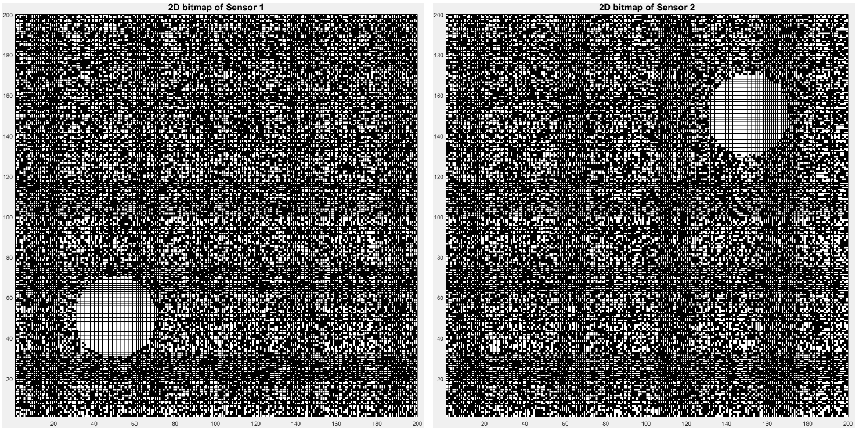
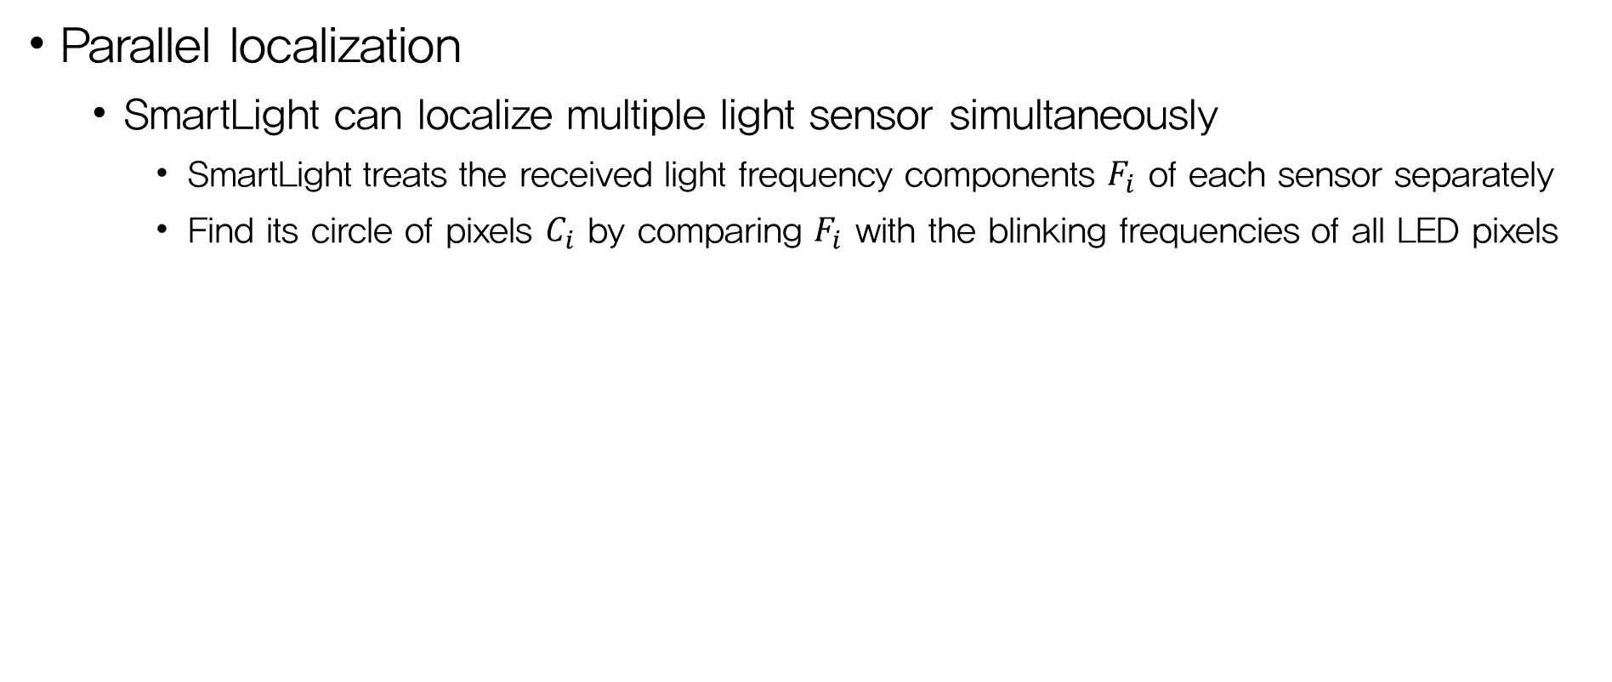
Advanced Design
Parallel localization
  SmartLight can localize multiple light sensor simultaneously
    SmartLight treats the received light frequency components $F_{i}$ of each sensor separately
    Find its circle of pixels $C_{i}$ by comparing $F_{i}$ with the blinking frequencies of all LED pixels
Fig 18. Parallelly localize two sensors simultaneously

Slide 42
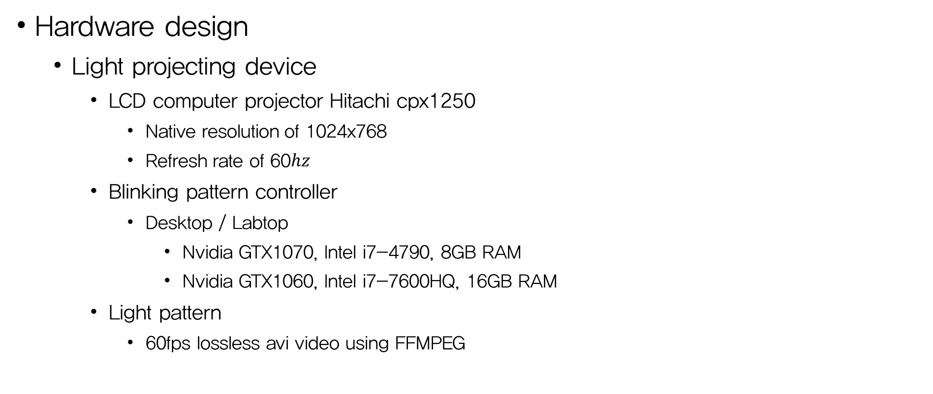
System Implementation
Hardware design
  Light projecting device
    LCD computer projector Hitachi cpx1250
      Native resolution of 1024x768
      Refresh rate of 60$hz$
    Blinking pattern controller
      Desktop / Labtop
        Nvidia GTX1070, Intel i7-4790, 8GB RAM
        Nvidia GTX1060, Intel i7-7600HQ, 16GB RAM
    Light pattern
      60fps lossless avi video using FFMPEG

Slide 43
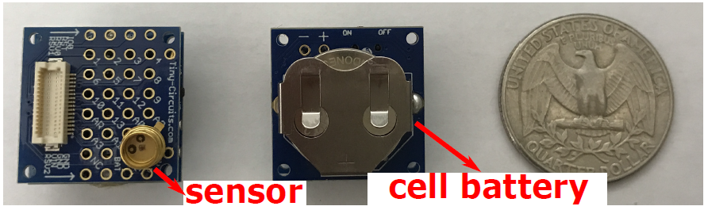
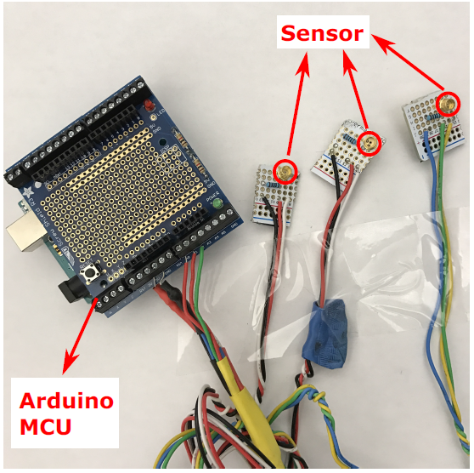
System Implementation
Hardware design (cont’d)
  Receiver end prototype
    Light sensor
      Honeywell SD3410-001 with 1K resistor
      to the 5V DV of Atmega328 MCU
      Wide sensitivity range and
      wide acceptance angle (-90’ ~ 90')
    Second version prototype is portable
Fig 20. 2nd version of prototype
Fig 19. 1st version prototype

Slide 44
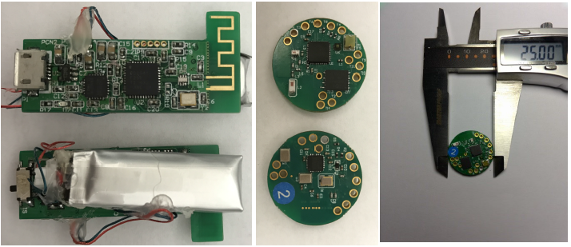
System Implementation
Commercialization effort
  Button-sized wearable device “SmartButton” (2nd version of commercialization)
  It can be attached non-intrusively on the human body
Fig 21. 1st (left) and 2nd (right) version of commercial receiver-end design

Slide 45

System Evaluation
Robustness against
  Environmental noise
  Fluctuation of the light source intensity
  Receiver orientation
  Disturbance along light propagation paths (reflection and attenuation)
Fine granularity and working distance
Impact of the reuse factor $K$, the number of pixels $N$

Slide 46



System Evaluation
Testbed setup
4.4m x 4m
4m x 4m
10 feet sliding track (3m)
$760×760$ screen pixels
Grouping every $10×10$
nearby screen pixels into
one square (grid)
$N×N = 76×76$
Total number of 172
non-repeating frequency
$K=76×76/172=33$
Fig 22. (a) Testbed environment in the Lab
(b) Testbed environment in an apartment

Slide 47


System Evaluation
Testbed setup (cont’d)
  Method for comparison
    Implementation of state-of-the-art
      Epsilon (NSDI’ 14)
      Spotlight
      Weighted average
      Coverage method (IPSN’ 14)
Fig 23. 3x3 LEDs Testbed (left) and testbed implementation of the
state of the art (right) for comparison

Slide 48


System Evaluation
Localization accuracy
  Among 5 methods, SmartLight is
  the only one that requires minimum
  device calibration
  SmartLight achieves performance
  with an average around $10cm$ and
  $90\%$error of $50cm$
    Algorithm problem
Fig 24. CDF of location error of different methods

Slide 49



System Evaluation
Accuracy granularity at different distances
  Error increase with Z-axis distance
    It is not mainly due to the lower SNR
    at further distances from the projector
    It mainly because testbed setup has
    a low granularity $N×N=76×76$ with
    the slow hardware
    If $N$ is large enough, the degradation
    in localization granularity at longer
    distances becomes barely unnoticeable
Fig 25. Testbed with $K=33, N=76$

Slide 50


System Evaluation
Accuracy granularity at different distances (cont’d)
  The number of screen LCD pixels in
  the circle of $C_{i}$ at different distances
  from the projector
    Ex. A receiver at a distance of $27.01cm$
    form the projector would see $155$ screen
    pixels
Fig 26. Ground truth of the number of pixels in diameter of $C_{i}$ at different distance

Slide 51



System Evaluation
$$Z_{i}=f_{A}\left(D\right)=\frac{2{RNfd}_{0}}{2RN\left(d_{0}−f\right)+fhD}$$
Accuracy granularity at different distances (cont’d)
  Ambiguity in Z-axis distance due to
  a low granularity of the grids
    From previous equations, the interval of
    $Z_{i}(D)−Z_{i}(D+1)$ increases as $D$ decreases
    The granularity of location would be further
    fine-grained as higher refresh rate and higher
    resolution projecting hardware are available
  X, Y-axis have similar problem
Fig 27. Granularity of error at different Z distances

Slide 52



System Evaluation
Simulation on the impact of $N$
  As $N$ increase, the projected grid
  have a finer granularity
  Location accuracy of SmartLight
  improves with increment of $N$
  Location error interval in estimating
  Z-axis distance to the projector
  from $76$ to $1000$
Fig 28. Simulation: $K=1$, increasing $N$

Slide 53




System Evaluation
Simulation on the impact of $K$
  $N=1000$
  Advanced design uses less than $2\%$($K=50$)
  of unique frequencies to achieve comparable
  performance in the basic design
  As $N$ further increases, the required percentage
  of unique frequencies further decrease
Fig 29. Simulation:$N=1000$, increasing $K$

Slide 54


System Evaluation
Impact of ambient noise
  SmartLight is resistant to random
  ambient noises in real life
    By making binary decisions
    on the existence of frequencies
    Not their absolute amplitude
  Experiments in Lab with overhead
  lights and in apartment at different
  times (distance: $30cm$)
    Ambient light has no noticeable impact
    on the performance of SmartLight
Fig 30. Impact of ambient light

Slide 55


System Evaluation
Impact of signal strength
  Compare the performance of five methods
  after the signal strength are unexpectedly
  reduced without recalibrated
    SmartLight and Spotlight’s “ON”-state light
    illuminance level are halved by using gray scale
    Other methods are halved its emitted power
    brightness ($660mA$ → $330mA$)
    SmartLight and Spotlight’s performance are
    relatively not impacted by the uncalibrated
    decrease on signal strength
Fig 31. Impact of uncalibrated signal strength change

Slide 56

System Evaluation
Impact of receiver orientation
  Received light signal strength is
  directly related to the incidence
  angle of light
  SmartLight's algorithm localizes
  the light sensitive area by modeling
  the traveling paths of light rays
  instead of the absolute RSS
  The amplitude of the received frequency
  might be different at different angles,
  but the binary decision on the received
  frequency remain the same
Fig 32. Impact of receiver orientation

Slide 57


System Evaluation
Impact of reflectors
  The reflectors are placed at a distance
  of $20cm$ near the receiver
    SmartLight and Spotlight performs stably
    with very little performance degradation
    Both approaches use convex lens to
    direct light rays so that there are less
    diffused light
    SmartLight’s algorithm can inherently
    tolerate some level of false positive pixels
Fig 33. Impact of common reflectors

Slide 58

System Evaluation
Impact of propagation disturbance
  Localization system based on analog
  approach incur error from making
  oversimplified assumption of signal
  propagation
  Digital approach should be highly
  robust to disturbances in signal
  propagation
  Emulate the disturbance by inserting
  a polarized film on optical path
    Two digital methods perform well
Fig 34. Impact of uncalibrated propagation disturbance

Slide 59
Conclusion
SmartLight
  A light-based 3D indoor localization design
  Highly robust and accurate model
    No in-situ signal strength attenuation & absolute signal strength
  Works well
    on low refresh rate projector implementation
    in various environments
    in various operational effects
  Indicates the potential of the digital localization can offer

Slide 60
Critique
+ Probabilistic analysis of design and algorithm
  Calculate the probability of false positive
+ Digital-based approach
  Robust system in even noisy environments
- Low cost (??)
  Performances of SmartLight rely on N or K
  Increment of N or K means increment of cost!!
- Irritating system (??)
  Converging light can interfere people’s action

Slide 61


Appendix
Converging(convex) lens
  Lens equation
  $\frac{1}{d_{o}}+\frac{1}{d_{i}}=\frac{1}{f} (1)$
  Magnification equation
  $M= \frac{d_{i}}{d_{o}} (2)$
Abbreviation
$$f$$ | Focal length
$$d_{o}$$ | Object distance
$$d_{i}$$ | Image distance

Slide 62

Appendix

Slide 63

Appendix
  $\left|AB\right|=\frac{D}{N}×h$
  $△MNS \sim △B′A’S$
    $\frac{Z_{i}}{d_{i}−Z_{i}}=\frac{\left|MN\right|}{\left|A’B’\right|}$
  $\frac{1}{d_{o}}+\frac{1}{d_{i}}=\frac{1}{f}$
    $d_{i}=\frac{{fd}_{o}}{d_{o}−f}$
  $M= \frac{d_{i}}{d_{o}}=\frac{f}{d_{o}−f}$
  $\left|A′B′\right|=M×\left|AB\right|=M×\frac{D}{N}×h$
  $=\frac{fDh}{N\left(d_{o}−f\right)}$

