Slide 1
IP Address Architecture
Chapter 4

Slide 2
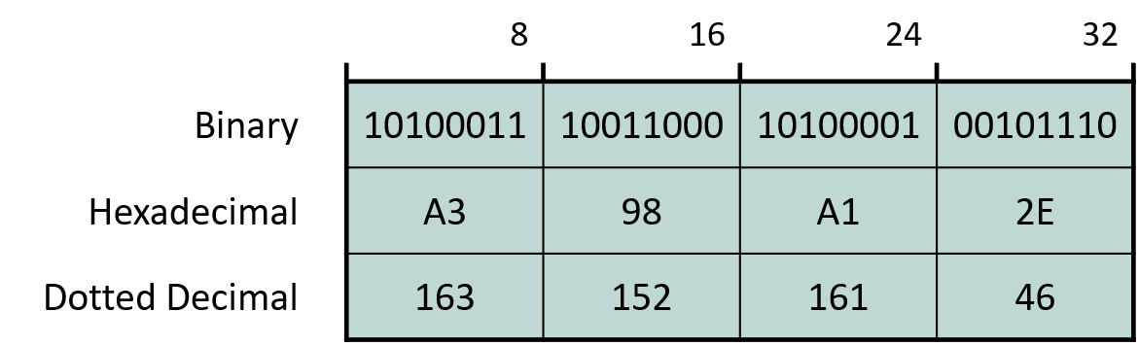
4.1 IP Address Notation and Types
IPv4: Dotted decimal notation
  For human readability
  Inside programs,it is converted back to 32 bits before use
IPv4 address types
  Unicast
  Multicast
  Broadcast

Slide 3
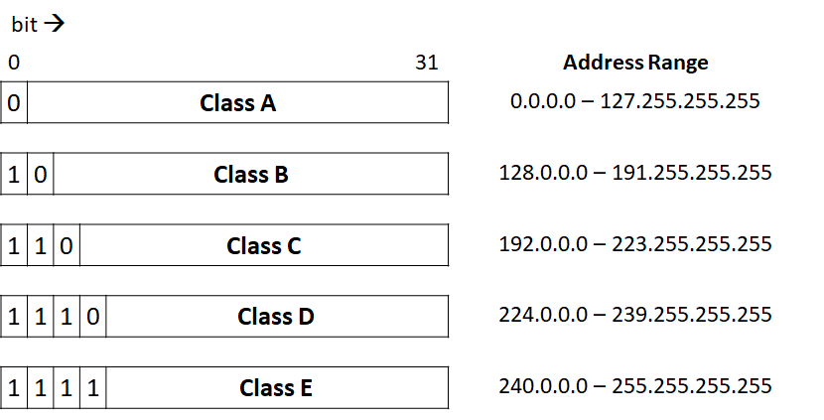
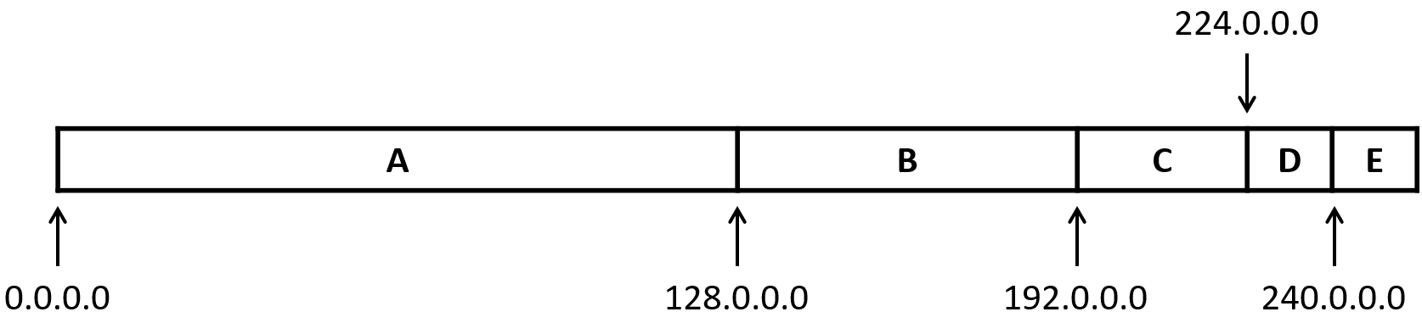
4.2 IP Address Space Structure
32 bits → 2³² addresses
Class (class)

Slide 4

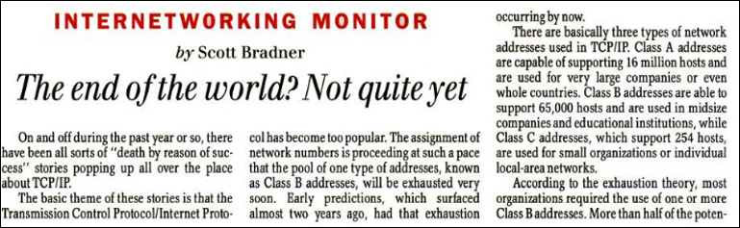
4.2 IP Address Space Structure
Class (class) Problem
  A, B, C class is the unit of address allocation
  1990's Goldilocks Problem occurs
    256 < X < 65536
    B class has only 2¹⁴ blocks
Now classless
  no longer the allocation unit

Slide 5
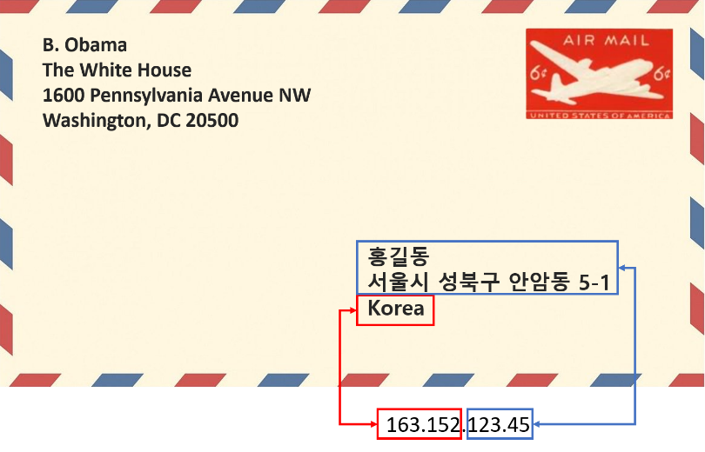
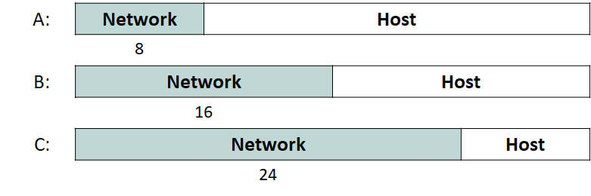
4.3 IP Unicast Address Structure
Reflects the Internet's structure (a loose federation of networks)
  An organization (e.g.: Korea University) a network number (ID) is assigned; host numbers managed internally
    163.152.XXX.XXX
  IP datagrams destined for Korea University IP 163.152alone routes to KU
    Inside KU, the host number delivers to the final interface

Slide 6
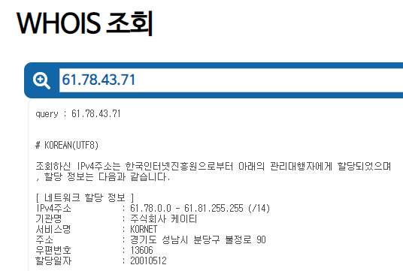
4.3 IP Unicast Address Structure
Classless Internet Reflected
  Now network ID ID length is flexible: Classless Inter-Domain Routing (CIDR)
    Note, CIDR notation (notation)must specify network IDlength explicitly
      163.152.0.0/16 (Korea University)
      61.78.0.0/14 (KT (partial))

Slide 7
4.4 IP address Aggregation (aggregation)
Classless Internet side effect: routing table explosion
  e.g.) 1 org: 222.0.0.0/24 ~ 222.0.31.0/24 → 32 class C entries
Solution: Aggregation (aggregation = super-netting = route summarization)
  Merge entries sharing the same ((outgoing interface, next hop)) into 1one entry
  e.g.) First 16bits + 00000000, 00000001, …, 00011110, 00011111 → 222.0.0.0/19
  Split entries when condition breaks
    More aggregated toward the core, disaggregated toward the edge

Slide 8
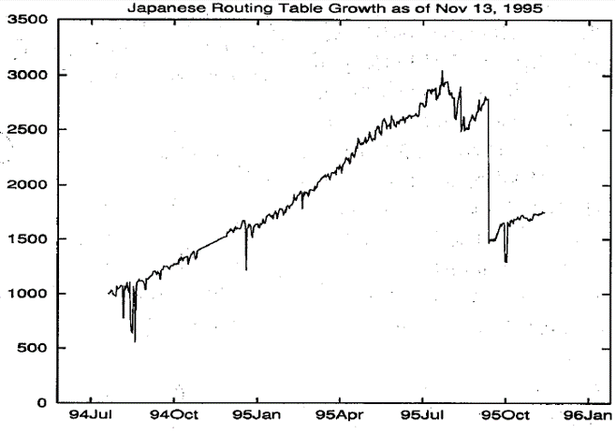
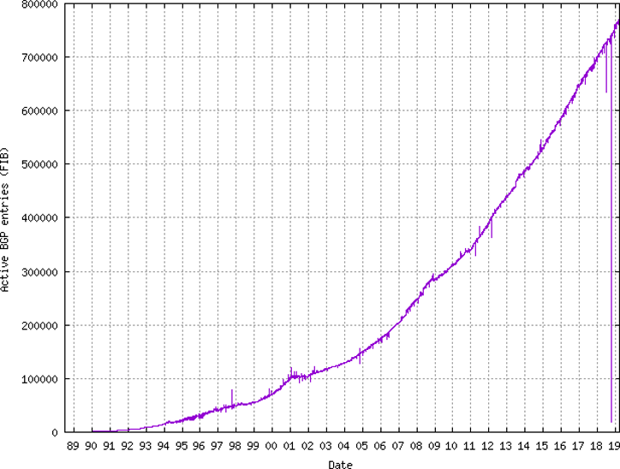
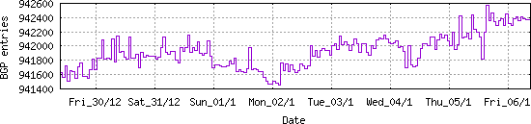
4.4 IP address aggregation (aggregation)
Japan Internet aggregation effect (1995 year-end) →
aggregation conditions
  Adjacent prefixs assigned to same region
    aggregation condition fails for many prefixes due to pre-CIDR allocation prefix
    e.g.: “Class C swamp”
Current BGP routing table size at the Internet core

Slide 9
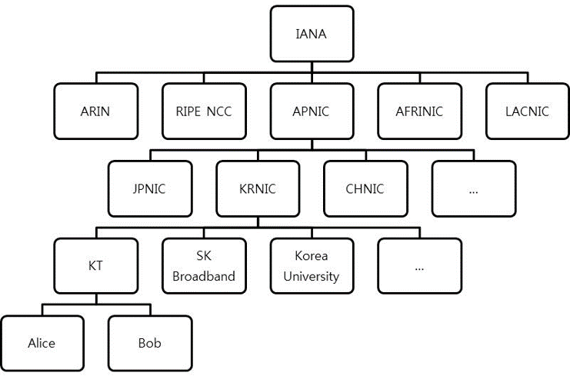
4.5 IP Address Distribution System
IP address ultimate owner: Internet Corporation for Assigned Names and Numbers (ICANN)
  Administrator: Internet Assigned Numbers Authority (IANA)
    Regional Network Information Center (NIC)
      National NIC: e.g.) KRNIC
        IP address-fee-paying company: e.g.) KT
          My computer
  80% Request new block from parent at 80% allocated
IPv4 address space fully exhausted
  2011131(IANA) → 2011415(APNIC)

Slide 10
4.5 IP Address Distribution System
IP Why doesn't address space exhaustion cause bigger problems??
  Network address translation (NAT): 16Ch.
    “NAT leads to IPv2ver”
    10.XXX.XXX.XXX, 192.168.XXX.XXX etc.
Long-term solution: IPv6
  Some IPv6 deployment has started
    e.g.) SKT mobile network internal routers, etc.

Slide 11
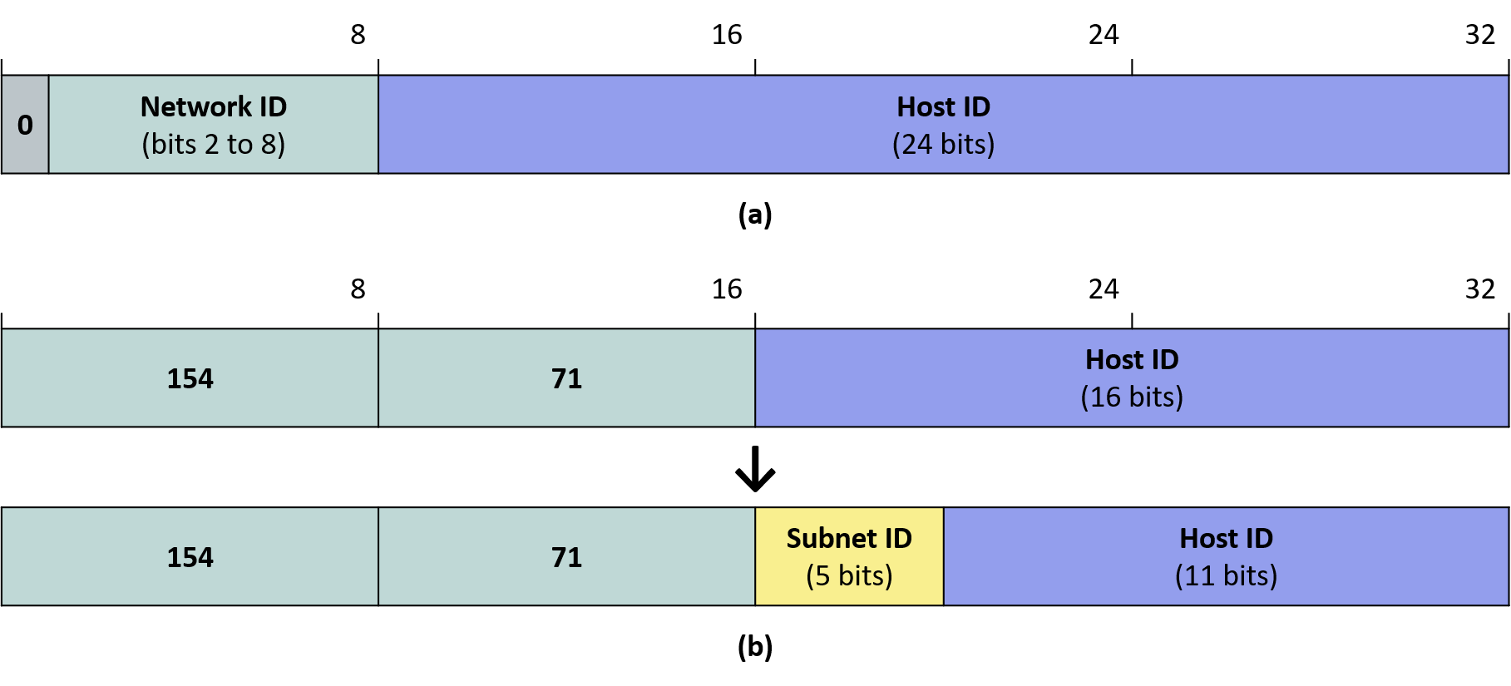
4.6 Subnet (subnet)
IPv4 address: host ID part is too long
  Network ID=“Korea”, host ID= “Hong Gil-dong”": how do we find "Hong Gil-dong"??
Solution: Introduce hierarchical address structure
  “Korea → Seoul → Seongbuk-gu → Anam-dong → 145→ Hong Gil-dong”
  host ID part is split for this purpose
  Subnetting
    Multiple level levels can be added
    Usually only 1 level level added: e.g.) Korea University
      163.152.161.1

Slide 12
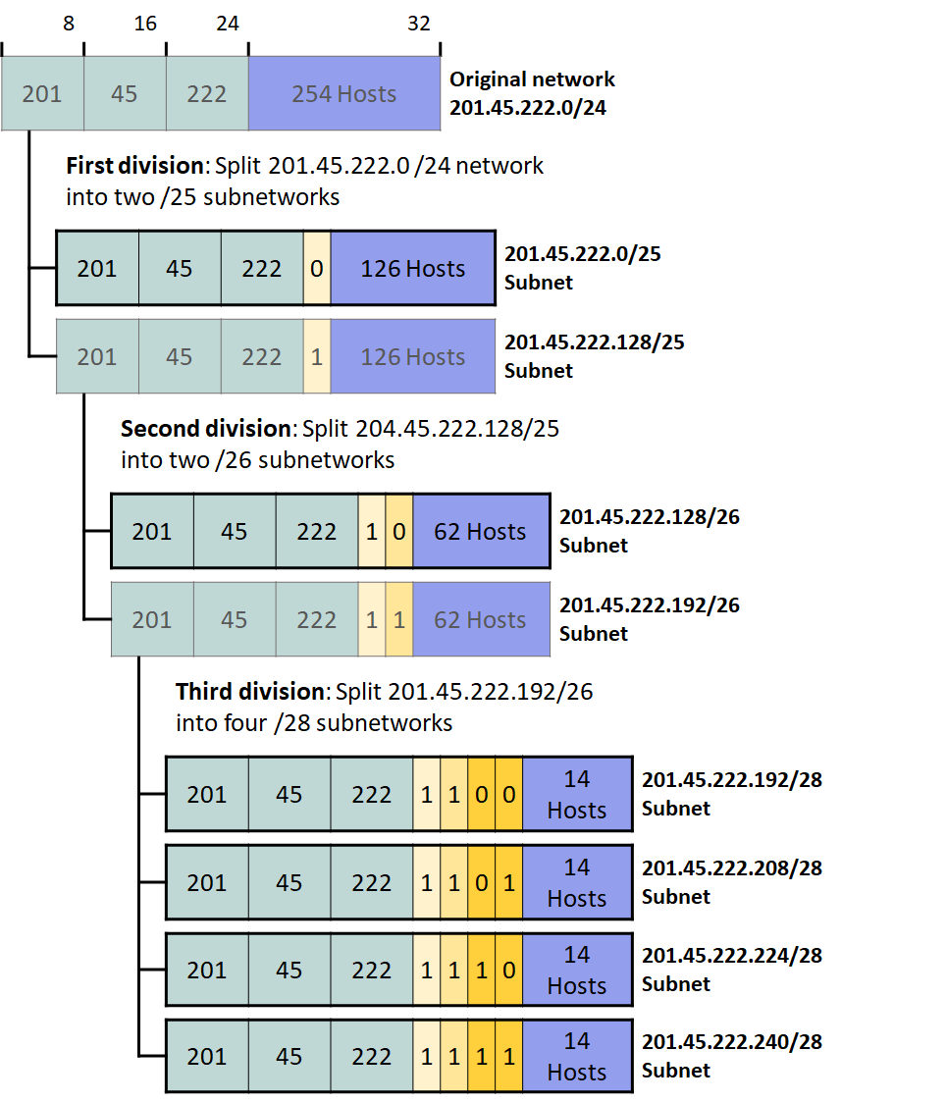
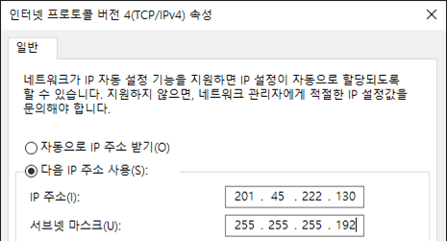
4.6 Subnet (subnet)
Subnet mask
  Network IDand Subnet ID position indication

Slide 13
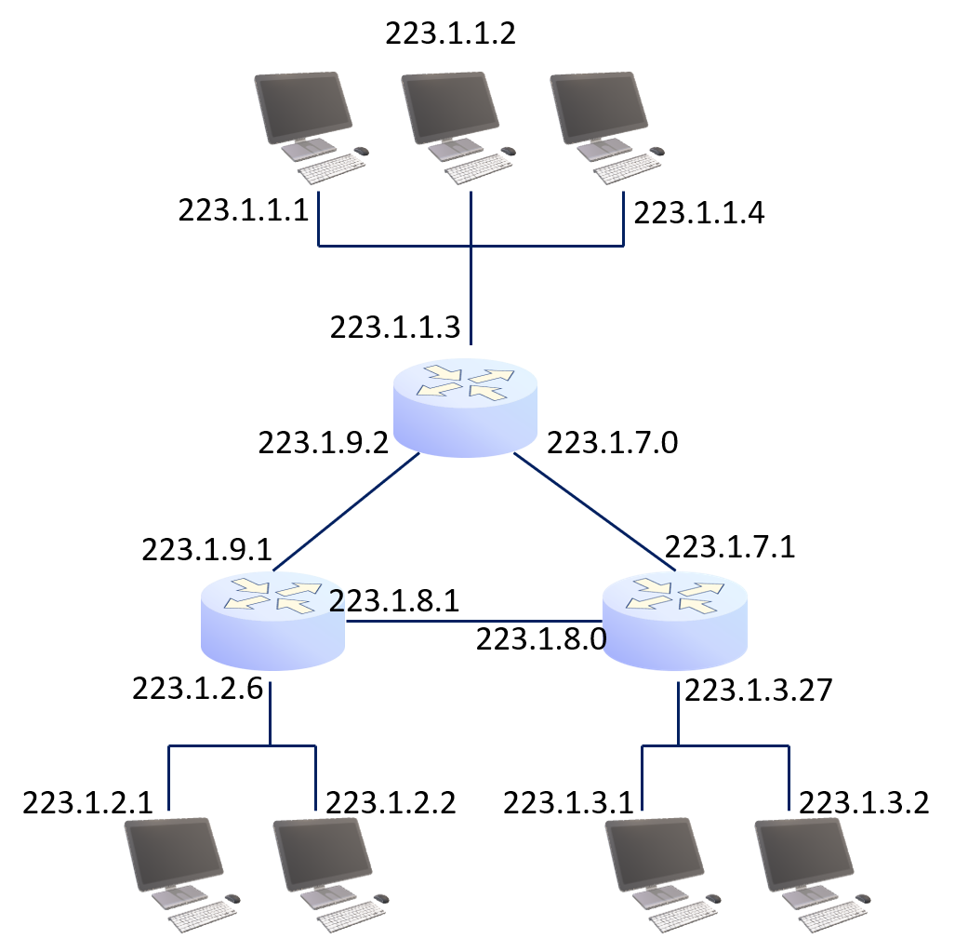
4.6 subnet (subnet)
subnet configuration example
  Typically, a LAN is one subnet
  Point-to-point (point-to-point) link is also one subnet

Slide 14
4.7 Multicast IP address
Set of interfaces receiving the same 1:N traffic: “multicast group”
  Unlike unicast, does not identify a specific interface, No owner
  Can theoretically span the entire globe
    In practice, scope is more limited
Cannot be used as IP source IP address
Different multicast groups may share the same IP address
  Separate solution needed

Slide 15
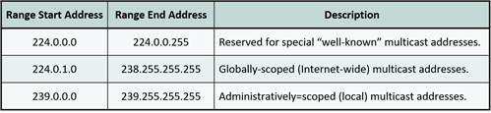
4.7 Multicast IP addresses
Three types of IPv4 multicast addresses

Slide 16
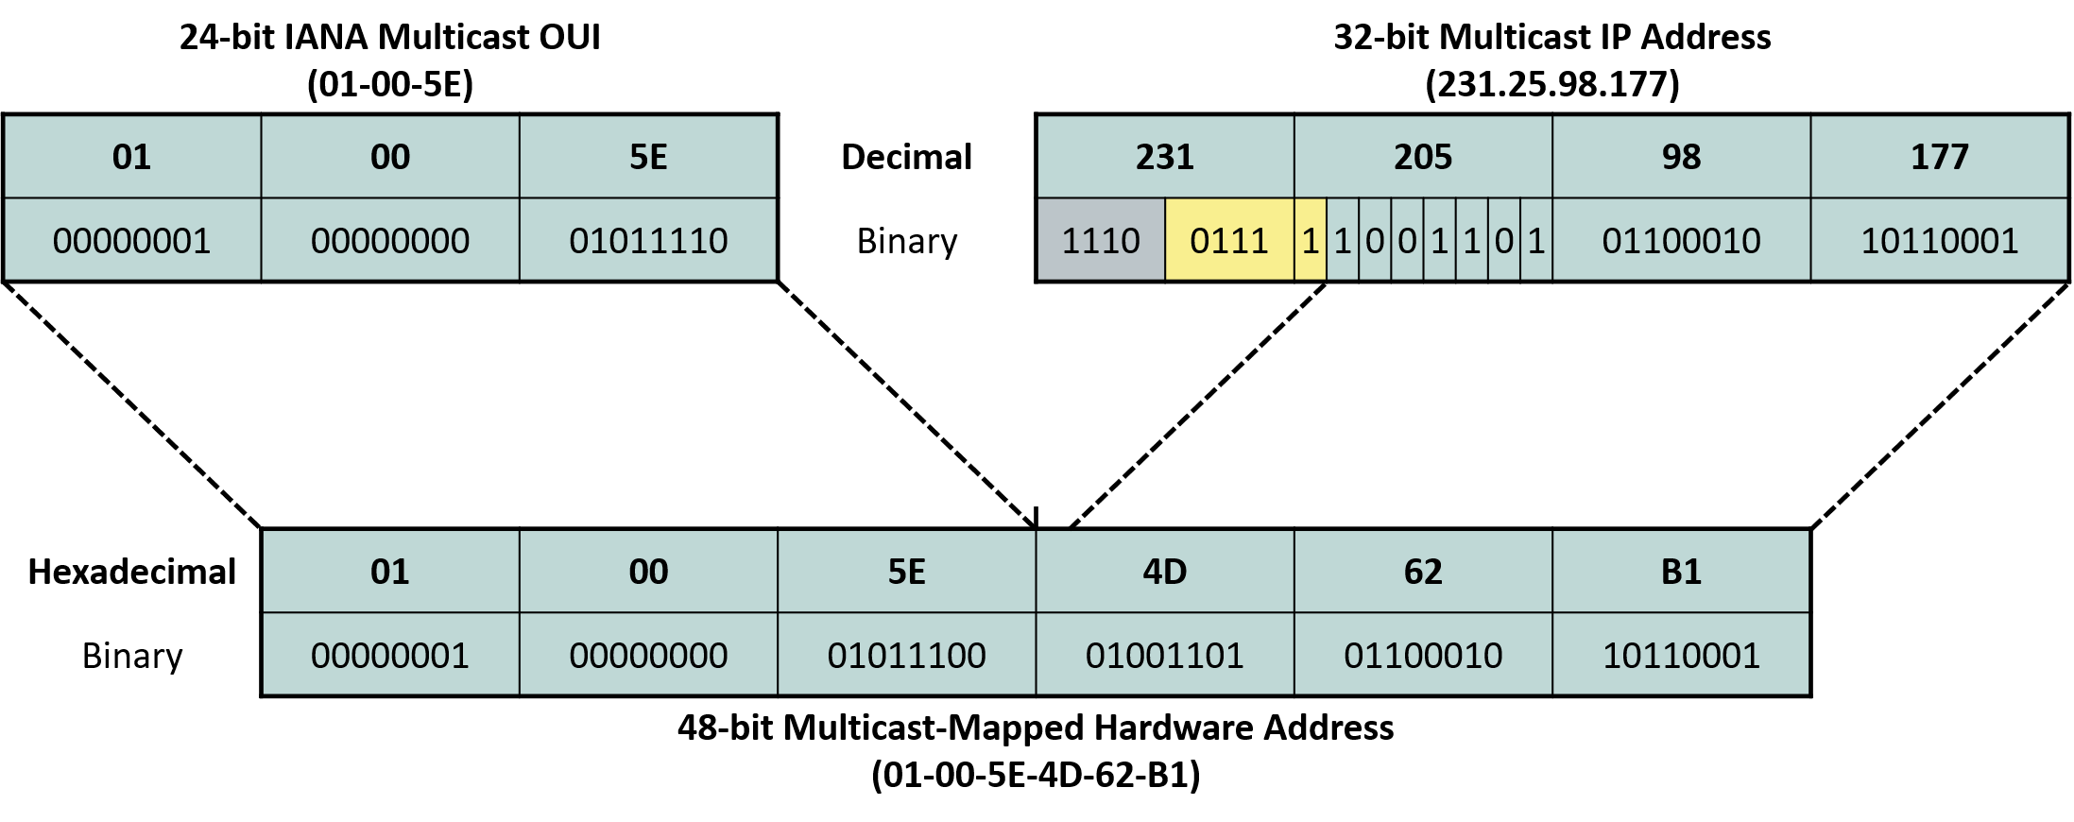
4.7 Multicast IP Address
ARP absent: Why?
Once at the last hop: fixed IP → MAC translation method used

Slide 17
4.7 Multicast IP Address
MAC address structure: OUI (3B) + interface address (3B)
  OUI's 8th bit: 0=unicast, 1=multicast
  IEEE sold IANA to OUI: 01-00-5e: of which ½ is used for IP IP multicast address mapping

Slide 18
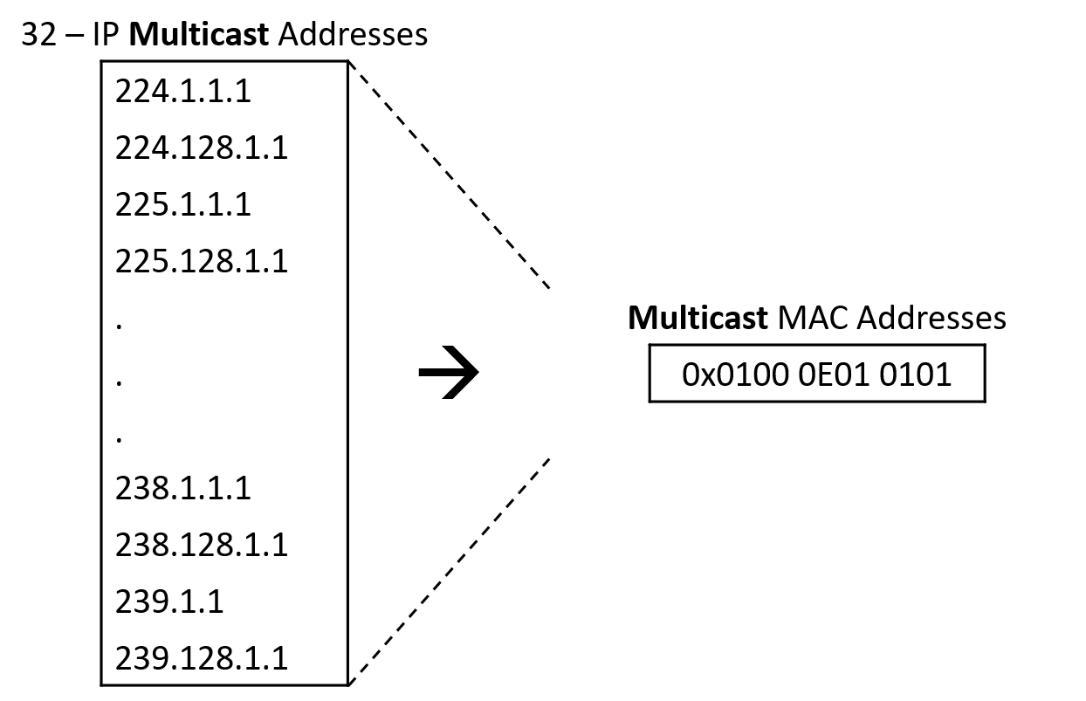
4.7 Multicast IP Address
2⁵:1 ambiguity problem
  HW: if 2⁵ match, pass up to IP
  IPcompares against “interface”that the "interface" has joined(join) group IP address list for filtering
    Join procedure: 12Ch.

Slide 19
4.8 broadcast IP Address
Two types
  Limited: 255.255.255.255
    “limited”: Cannot pass beyond current subnet
    ping –b 255.255.255.255 (Linux)
  Directed: Network ID + <broadcast range>
    Net-directed: e.g.) 163.152.255.255
    Subnet-directed: e.g.) 163.152.161.255
Subnet IDIf 8 bit boundary is not aligned, take care
  e.g.: 123.45.6.139/26
C:\Users\user>ping 255.255.255.255 Ping request: could not find host 255.255.255.255 . Check the name and try again.

Slide 20

4.8 broadcast IP Address
Broadcasting to a specific address of all subnets broadcast is not possible
  e.g.: 163.152.255.1
Directed broadcast is practically prohibited
  Smurf attack

Slide 21
4.9 Special IPv4 address
0.0.0.0: “this host”
  IP Can only be used as source address when no IP is assigned yet
Private (private) address: Valid only within a network(e.g.: KU)
  Three types: Class A=10.0.0.0/8, Class B=172.16.0.0/12, Class C=192.168.0.0/16
  Must use NAT for external communication (16Ch.)
Link-local (link local) address: 169.254.0.0/16

Slide 22

4.10 IPv6 Address
IPv4 Two approaches to address exhaustion
  NAT (short/medium-term, temporary)
  IPv6 (long-term, permanent) : 1994 development began
Address length: 32×4 = 128 bits
  4,300,000,000 addresses vs. 340,000,000,000,000,000,000,000,000,000,000,000,000 addresses
4cm
4cm

Slide 23
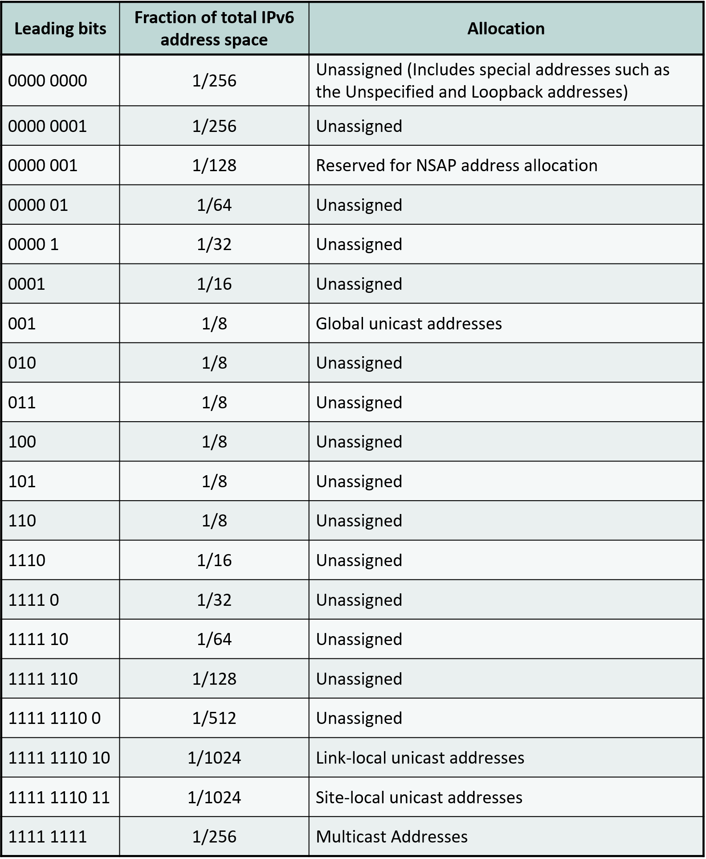
4.10 IPv6 Address
Types
  Unicast
    Global
    Link-local, site-local
  Multicast
    Broadcast included
      In any case, directed broadcast not supported
  Anycast (anycast)
    Structurally a Unicast address
    IP Multiple hosts share the same IP address

Slide 24
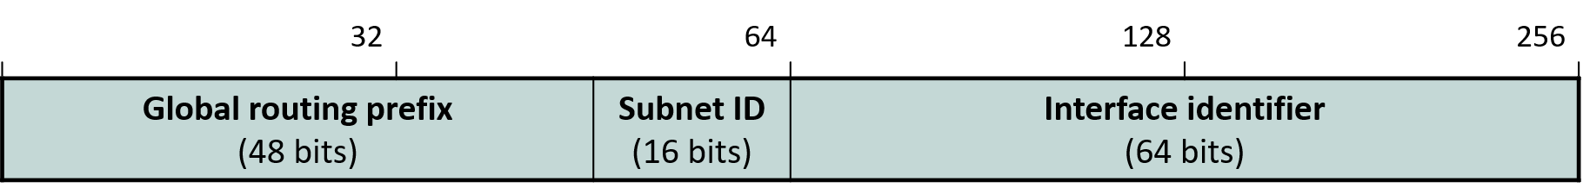
4.10 IPv6 address
Global unicast address
  Prefix(prefix) degrees of freedom = 45 bits: max 2⁴⁵ networks
  subnet ID ID space is explicitly defined
    16 bits supporting multiple level subnetting subnetting levels
  Interface ID
    Formerly the host ID

Slide 25
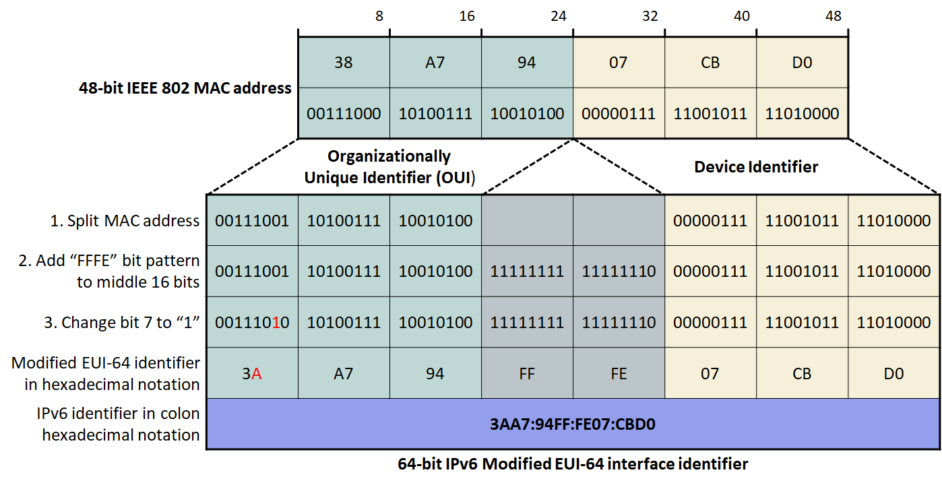
4.10 IPv6 Address
Interface ID generation methods2
  Random
    Better security/privacy
  Modified EUI-64
    Modified OUI + ff-fe + device ID
    Universal/local bit set to 1
      local

Slide 26
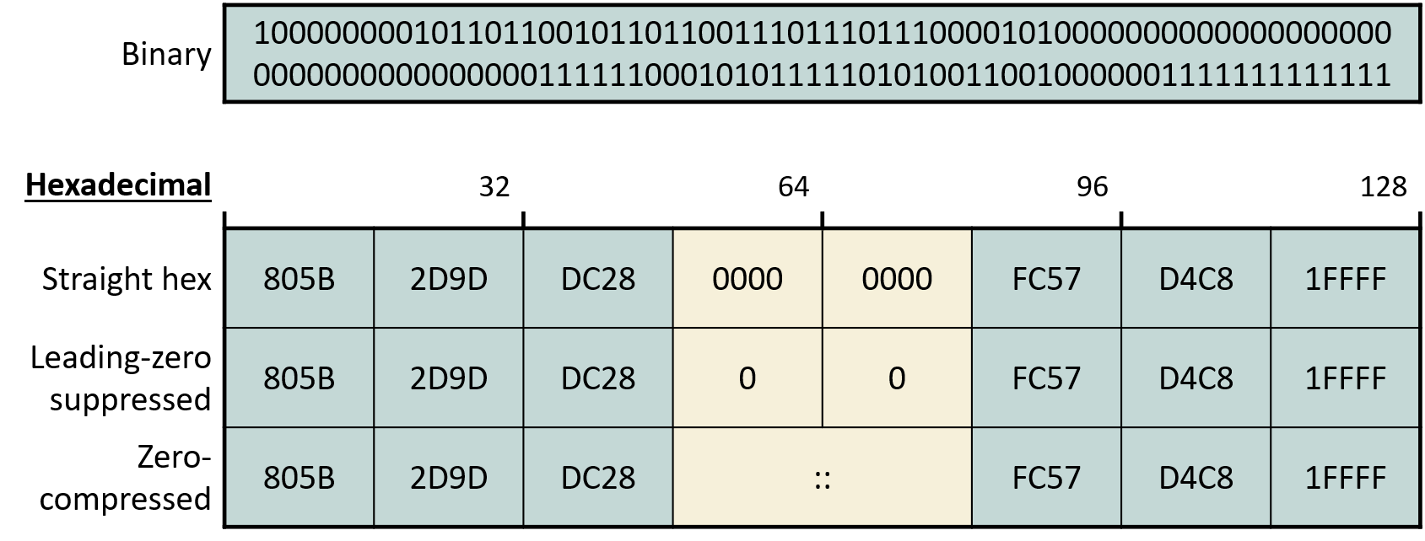
4.10 IPv6 Address
Colon-hexadecimal notation in use
  Leading-zero suppression
  Zero compression
    Consecutive 0000 as ::
    Can only be used once

Slide 27
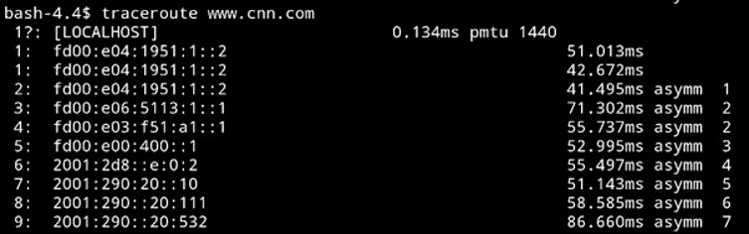
4.10 IPv6 Address
IPv6 real-world example ①: SK Telecom mobile network
  Run traceroute
    traceroute -4 forces IPv4 path
  Where does the SK Telecom internal network end??

Slide 28
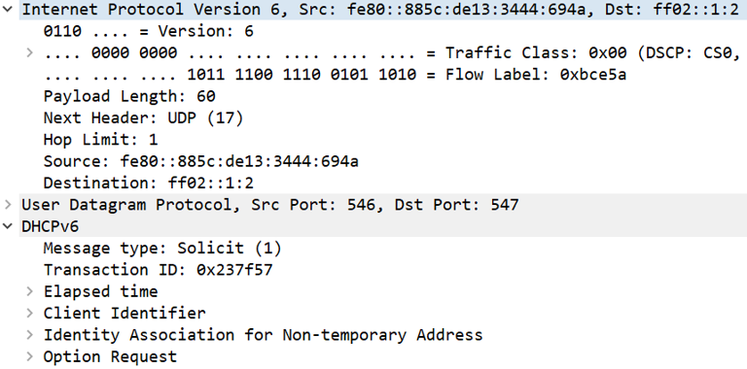
4.10 IPv6 Address
IPv6 real-world example : link-local address

Slide 29
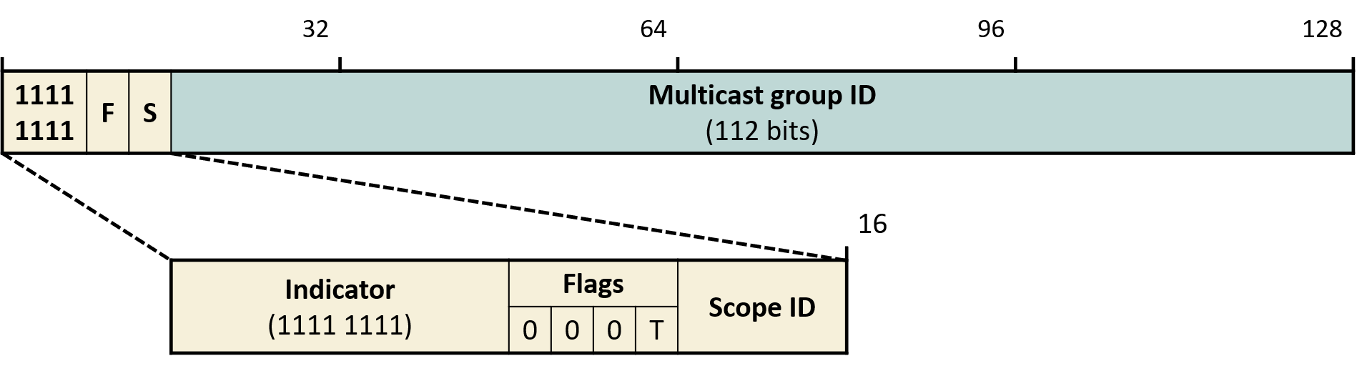
4.10 IPv6 address
IPv6 multicast address
  Flag T=1: IANA standardized address
    ff02::1 (all IPv6 interfaces), ff02::2 (all IPv6 router interfaces), ff02::5
    SNM address
  Scope ID
    1=node, 2=link, 14=global

Slide 30
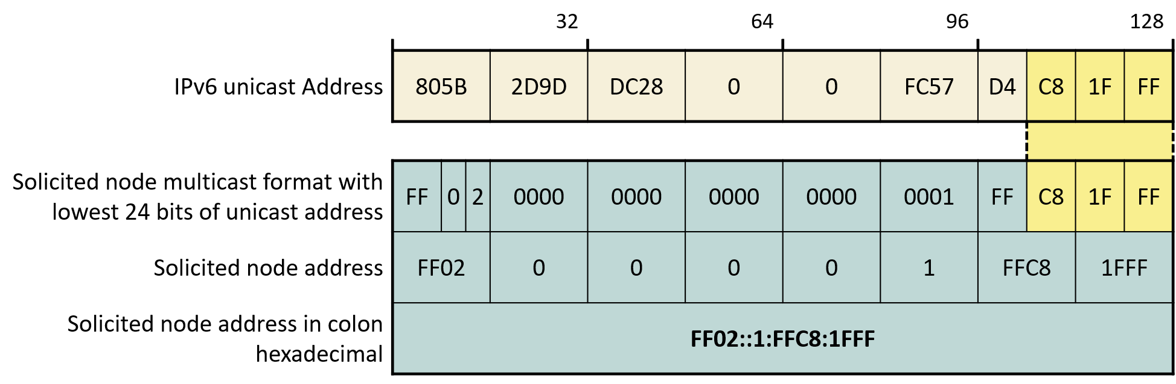
4.10 IPv6 address
Solicited-node multicast (SNM) address
  IPv6 uses ARP instead of Neighbor Discovery (ND)
    Broadcast(X) Multicast(O)
  ff02::1:ff + next-hop IPv6 address's last 3 bytes

Slide 31
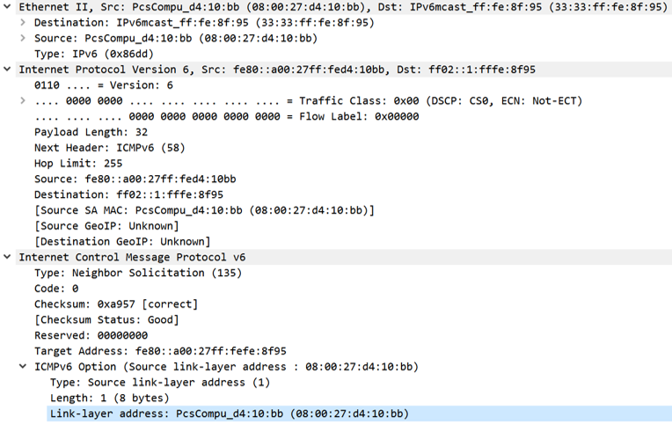
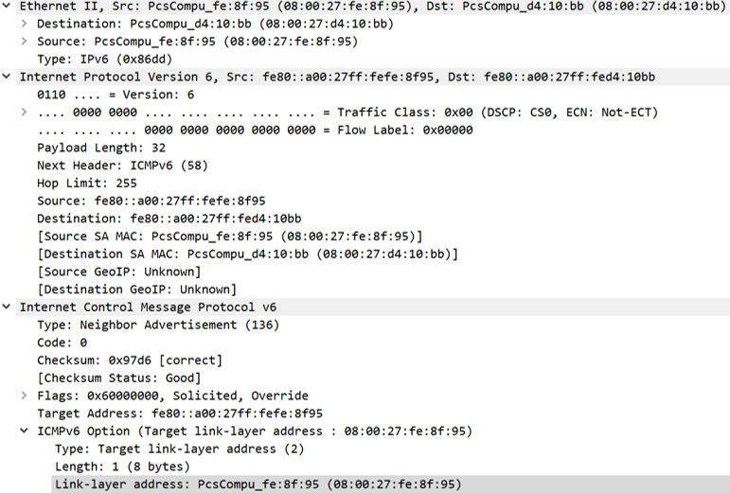
4.10 IPv6 Address
Neighbor Solicitation (NS)and Response
    ARP corresponds to request/reply

Slide 32
4.10 IPv6 Address
Neighbor Solicitation (NS)and Response
    ARP corresponds to request/reply

Slide 33
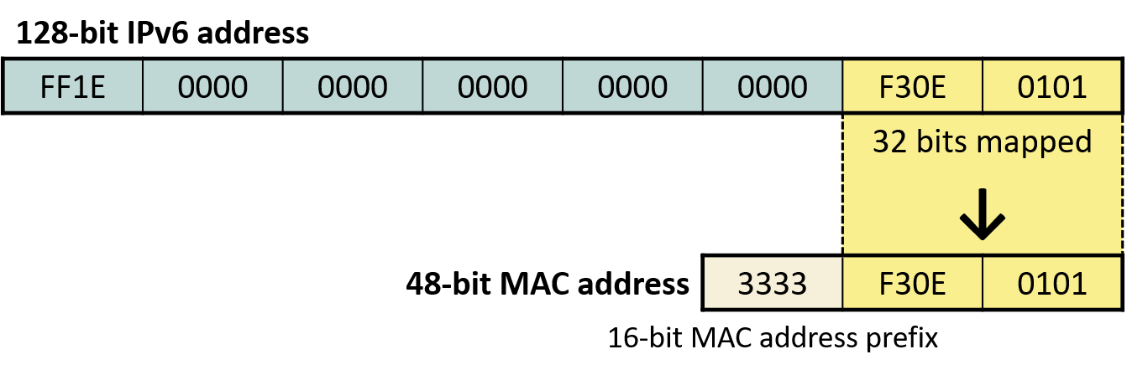
4.10 IPv6 Address
Multicast IPv6 → MAC mapping
Special addresses
  :: (unspecified)
  ::1 (local loopback)

