Slide 1
Section 7.3: Network Address Translation
유재정
2015010642

Slide 2
7.3 Network Address Translation
NAT is essentially a mechanism for allowing the same sets of IP addresses to be reused in different parts of the Internet.
The primary motivation for the creation of NAT was the limited and diminishing availability of IP address space.
NAT was introduced to solve two problems
  address depletion and concerns regarding the scalability of routing.
  NAT reduces the need for globally routable Internet addresses
The development and eventual widespread use of NAT has contributed to significantly slow the adoption of IPv6.
  Among its other benefits, IPv6 was intended to make NAT unnecessary.

Slide 3
7.3 Network Address Translation
NAT has several drawbacks
  Offering Internet-accessible services from the private side of a NAT requires special configuration
    Privately addressed systems are not directly reachable from the Internet
  Every packet in both directions of a connection or association must pass through the same NAT
    NAT must actively rewrite the addressing information in each packet
  Some application protocols such as FTP, SIP those that send IP addressing information inside the application-layer payload require a special application-layer gateway function that rewrites the application content
Despite their numerous problems, NATs are very widely used

Slide 4
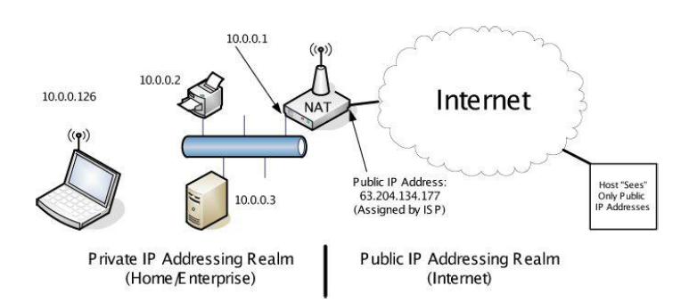
7.3 Network Address Translation
A NAT works by rewriting the identifying information in packets transiting through a router
  NAT involves rewriting the source IP address of packets as they are forwarded in one direction and the destination IP addresses of packets traveling in the reverse direction

Slide 5
7.3.1. Traditional NAT: Basic NAT and NAPT
Traditional NAT includes both basic NAT and Network Address Port Translation (NAPT)
Basic NAT performs rewriting of IP addresses only
  A private address is rewritten to be a public address
  it does not help to dramatically reduce the need for IP addresses
NAPT involves using the transport-layer identifiers
  differentiates which host on the private side of the NAT is associated with a particular packet
There are three IPv4 address ranges reserved for use with private addressing realms
  10.0.0.0/8, 172.16.0.0/12, and 192.168.0.0/16.

Slide 6
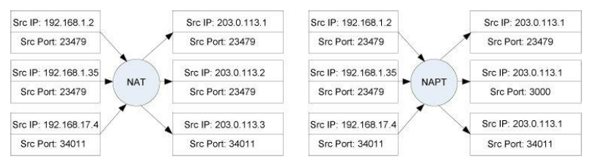
7.3.1. Traditional NAT: Basic NAT and NAPT

Slide 7
7.3.1. Traditional NAT: Basic NAT and NAPT
NAT provides some degree of security similar to that of a firewall
  All systems on the private side of the NAT cannot be reached from the Internet
    a NAT (especially a NAPT) “hides” the number and configuration of internal addresses from the outside
  Communications between hosts in the private addressing realm and those in the public realm can be facilitated only with participation from the NAT

Slide 8
7.3.1.1. NAT and TCP
TCP uses an IP address and port number to identify each end of a connection, and establishes the connection by three-way handshake
  Each unique TCP connection is identified by two IP addresses and two port numbers.
When The NAT receives the first SYN packet, it notices that the incoming packet is a new connection
  In addition to forwarding the packet, the NAT creates internal state to remember the fact that a new connection is being handled by the NAT (called a NAT session)
This state includes an entry (called a NAT mapping) containing the source port number and IP address of the client.
  By matching the destination port number on the received datagram against the appropriate NAT mapping, the NAT is able to ascertain the internal IP address of the client

Slide 9
7.3.1.1. NAT and TCP
Session state is removed if FINs are exchanged
  Even NAT must also remove mappings thought to have “gone dead” because of a lack of traffic
Most NATs include a simplified version of the TCP connection establishment procedures and can distinguish between connection success and failure
  If no ACK is seen before the timer expires, the session state is cleared by a connection timer
  If clients receive an ACK, the NAT realizes that the connection is still active, and does not delete the session.

Slide 10
7.3.1.1. NAT and TCP
One of the tricky problems for a TCP NAT is handling peer-to-peer applications operating on hosts residing on the private sides of multiple NATs
  Some of these applications use a simultaneous open whereby each end of the connection acts as a client and sends SYN packets more or less simultaneously
    TCP is able to handle this case by responding with SYN + ACK packets
    But many existing NATs do not handle it properly
NAT should handle all valid TCP packet exchanges, and simultaneous opens in particular
  Inbound SYN for a connection about which the NAT knows nothing should be silently discarded
  If the incoming external SYN is dropped, the internal SYN has time to establish a NAT mapping for the same connection represented by the external SYN.

Slide 11
7.3.1.2. NAT and UDP
TCP, UDP, ICMP above IP packets can be fragmented.
  Each of fragments is treated as an independent datagram.
  Fragment other than the first one does not contain the port number information needed by NAPT to operate properly.
Fragments cannot be handled properly by simple NATs or NAPTs.
For more discussion for this, we will see again in Chapter 10

Slide 12
7.3.1.4. NAT and ICMP
ICMP provides status information about IP packets
  Detailed in Chapter 8
ICMP has two categories of messages: error and informational
  When an ICMP error message passes through a NAT, the IP addresses in the included “offending datagram” need to be rewritten by the NAT in order for them to make sense to the end client (called ICMP fix-up).
  For informational messages including a Query ID field, NAT can recognize outgoing informational requests and set a timer in anticipation of a returning response.

Slide 13
7.3.1.6. NAT and Multicast
NATs can be configured to support multicast traffic
To support multicast traffic a NAT is augmented with an IGMP proxy
  Detailed in Chapter 9
Destination IP addresses and port numbers of packets traveling from a host on the outside to the inside of NAT are not modified.
For traffic flowing from inside to outside, the source addresses and port numbers may be modified according to the same behaviors as with unicast UDP.

Slide 14
7.3.1.7. NAT and IPv6
To many protocol designers, NAT arose as a necessary but undesirable that has added a tremendous amount of complexity to the design of every other protocol.
Local Network Protection (LNP) can be better than NAT
  LNP represents a collection of techniques with IPv6 that match or exceed the properties of NATs.
    Saving address space
    Firewall-like functionality
    Topology hiding
    privacy

Slide 15
7.3.1.7. NAT and IPv6
Unique Local IPv6 Unicast Addresses (ULAs) can be used with an experimental version of IPv6-to-IPv6 prefix translation called NPTv6
  It translate IPv6 addresses to IPv6 addresses based on their prefix
NPTv6 does not have to modify the data in a packet beyond the network layer and does not require access to transport layer port numbers in order to operate properly.
However, applications that require access to a NAT’s external address must still use a NAT traversal method

Slide 16
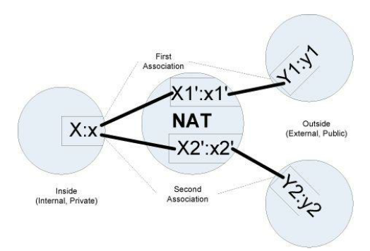
7.3.2. Address and Port Translation Behavior
The inside host uses IP address:port (X:x)
  For ICMP, the query ID is used instead of the port number
  X can be private IPv4 address
Destination address:port (Y1:y1, Y2:y2)

Slide 17
7.3.2. Address and Port Translation Behavior
NAT establishes mappings X1’:x1 and X2’:x2’
  In most cases, X1´ equals X2´ because most sites use only a single globally routable IP address.
The mapping is said to be reused if x1´ equals x2´ called port preservation

Slide 18
7.3.2. Address and Port Translation Behavior
NAT may have several external addresses available to use.
  The set of addresses is typically called the NAT pool or NAT address pool.
  NAT address pools are distinct from the DHCP address pools.
When a single host behind the NAT opens multiple simultaneous connections, is each assigned the same external IP address (called address pairing) or not?
  NAT’s IP address pooling behavior is said to be arbitrary if there is no restriction on which external address is used for any association.
  It is said to be paired if NAT implements address pairing.
  For NATs with only a single external address, this is obviously not a problem.

Slide 19
7.3.3. Filtering Behavior
When a NAT creates a binding for a TCP connection, UDP association, or various forms of ICMP traffic,
  it establishes the address and port mappings
  it also determines its filtering behavior for the returning traffic if it acts as a firewall
Several filtering behaviors are used.
  Endpoint independent: Allows any packets for X1:x1 as long as any X1’:x1’ exists
  Address dependent: Allows packets for X1:x1 from Y1:y1 as long as X1 has previously contacted Y1
  Address and port dependent: Allows packets for X1:x1 from Y1:y1 as long as X1 has previously contacted Y1:y1
    For all common transports such as TCP and UDP, Address and port dependent is required

Slide 20
7.3.4. Servers behind NATs
One of the most obvious problems with NATs is that a system wishing to provide a service from behind a NAT is not directly reachable from the outside.
  NAT is acting as the Internet Router
  Private IP address is not routable through the Internet.
NAT must arrange to properly rewrite and forward the appropriate traffic to the server so that it can operate.
  Called port forwarding
Port forwarding typically requires static configuration of the NAT with the address of the server and the associated port number whose traffic should be forwarded.
  With port forwarding, incoming traffic to a NAT is forwarded to a specific configured destination behind the NAT.

Slide 21
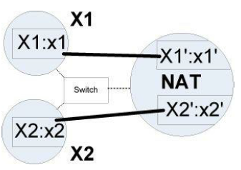
7.3.5. Hairpinning and NAT Loopback
When a client wishes to reach a server and both reside on the same, private side of the same NAT, NAT supports so-called hairpinning or NAT loopback
For some cases that X1 knows only the public address information, X2´:x2´, NAT notices the existence of the mapping between X2´:x2´ and X2:x2 and forwards the packet to X2:x2.

Slide 22
7.3.6. NAT Editors
Like FTP which is application-layer protocols carrying transport-layer or lower-layer information such as IP addresses, the NAT also has to modify application payload
  Considerable work may be required
    Such as sequence number modification
NATs with this capability are sometimes called NAT editors.
  Detailed in Chapter 15

Slide 23
7.3.7. Service Provider NAT (SPNAT) and Service Provider IPv6 Transition
Service provider NAT (SPNAT), carrier-grade NAT (CGN), or largescale NAT (LSN)
  To move NATs from the customer premises into the ISP.
However, moving the NAT function from customer to ISP raises security concerns
SPNAT can help with the IPv4 address depletion problem, but IPv6 is viewed as the ultimate solution.

