Slide 1
Ad hoc and Sensor Networks
Chapter 6: Link layer protocols
Holger Karl

Slide 2
Goals of this chapter – Link layer tasks in general
Framing – group bit sequence into packets/frames
  Important: format, size
Error control – make sure that the sent bits arrive and no other
  Forward and backward error control
Flow control – ensure that a fast sender does not overrun its slow(er) receiver
Link management – discovery and manage links to neighbors
  Do not use a neighbor at any cost, only if link is good enough
! Understand the issues involved in turning the radio communication between two neighboring nodes into a somewhat reliable link

Slide 3
Overview
Error control
Framing
Link management

Slide 4
Error control
Error control has to ensure that data transport is
  Error-free – deliver exactly the sent bits/packets
  In-sequence – deliver them in the original order
  Duplicate-free – and at most once
  Loss-free – and at least once
Causes: fading, interference, loss of bit synchronization, …
  Results in bit errors, bursty, sometimes heavy-tailed runs (see physical layer chapter)
  In wireless, sometimes quite high average bit error rates – 10⁻² … 10⁻⁴ possible!
Approaches
  Backward error control – ARQ
  Forward error control – FEC

Slide 5
Backward error control – ARQ
Basic procedure (a quick recap)
  Put header information around the payload
  Compute a checksum and add it to the packet
    Typically: Cyclic redundancy check (CRC), quick, low overhead, low residual error rate
  Provide feedback from receiver to sender
    Send positive or negative acknowledgement
  Sender uses timer to detect that acknowledgements have not arrived
    Assumes packet has not arrived
    Optimal timer setting?
  If sender infers that a packet has not been received correctly, sender can retransmit it
    What is maximum number of retransmission attempts? If bounded, at best a semi-reliable protocols results

Slide 6
Standard ARQ protocols
Alternating bit – at most one packet outstanding, single bit sequence number
Go-back N – send up to N packets, if a packet has not been acknowledged when timer goes off, retransmit all unacknowledged packets
Selective Repeat – when timer goes off, only send that particular packet

Slide 7
How to use acknowledgements
Be careful about ACKs from different layers
  A MAC ACK (e.g., S-MAC) does not necessarily imply buffer space in the link layer
  On the other hand, having both MAC and link layer ACKs is a waste
Do not (necessarily) acknowledge every packet – use cumulative ACKs
  Tradeoff against buffer space
  Tradeoff against number of negative ACKs to send

Slide 8
When to retransmit
Assuming sender has decided to retransmit a packet – when to do so?
  In a BSC channel, any time is as good as any
  In fading channels, try to avoid bad channel states – postpone transmissions
  Instead (e.g.): send a packet to another node if in queue (exploit multi-user diversity)
How long to wait?
  Example solution: Probing protocol
  Idea: reflect channel state by two protocol modes, “normal” and “probing”
  When error occurs, go from normal to probing mode
  In probing mode, periodically send short packets (acknowledged by receiver) – when successful, go to normal mode

Slide 9
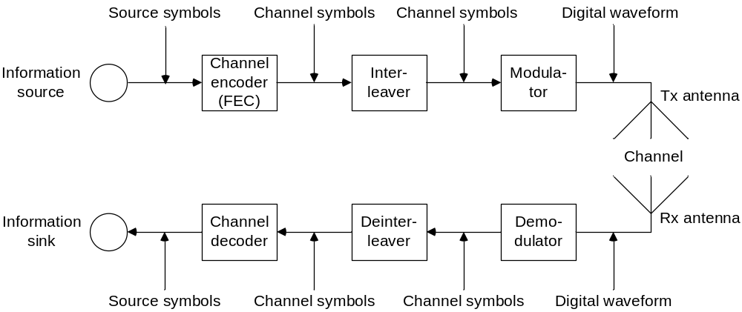
Forward error control
Idea: Endow symbols in a packet with additional redundancy to withstand a limited amount of random permutations
  Additionally: interleaving – change order of symbols to withstand burst errors

Slide 10
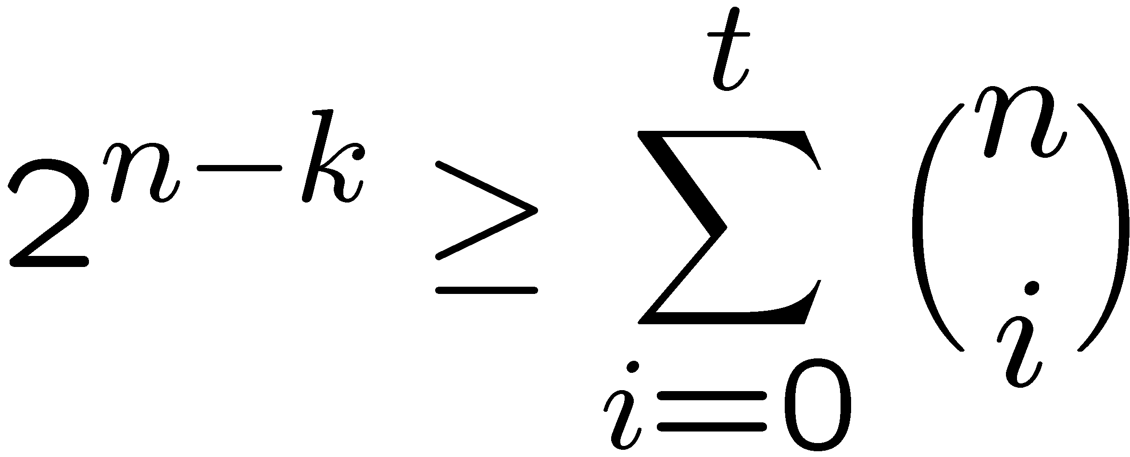
Block-coded FEC
Level of redundancy: blocks of symbols
  Block: k p-ary source symbols (not necessarily just bits)
  Encoded into n q-ary channel symbols
Injective mapping (code) of p^{k} source symbols ! q^{n} channel symbols
Code rate: (k ld p) / (n ld q)
  When p=q=2: k/n is code rate
For p=q=2: Hamming bound – code can correct up to t bit errors only if
  Codes for (n,k,t) do not always exist

Slide 11
Popular block codes
Popular examples
  Reed-Solomon codes (RS)
  Bose-Chaudhuri-Hocquenghem codes (BCH)
Energy consumption
  E.g., BCH encoding: negligible overhead (linear-feedback shift register)
  BCH decoding: depends on block length and Hamming distance (n, t as on last slide)
  Similar for RS codes

Slide 12
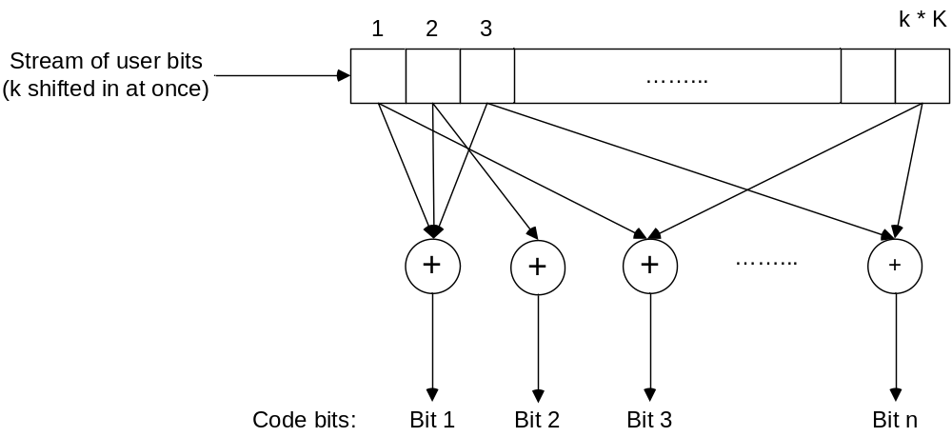
Convolutional codes
Code rate: ratio of k user bits mapped onto n coded bits
Constraint length K determines coding gain
Energy
  Encoding: cheap
  Decoding: Viterbi algorithm, energy & memory depends exponentially (!) on constraint length

Slide 13
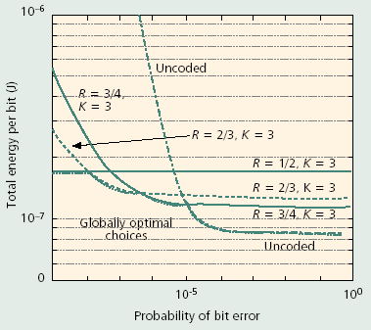
Energy consumption of convolutional codes
Tradeoff between coding energy and reduced transmission power (coding gain)
Overall: block codes tend to be more energy-efficient
RESIDUAL bit error prob.!

Slide 14
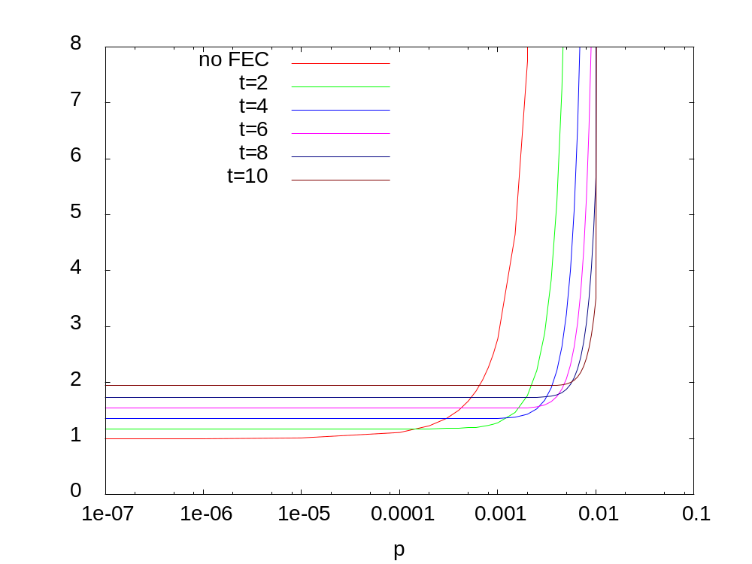
Comparison: FEC vs. ARQ
t: error correction capacity
FEC
  Constant overhead for each packet
  Not (easily) possible to adapt to changing channel characteristics
ARQ
  Overhead only when errors occurred (expect for ACK, always needed)
Both schemes have their uses ! hybrid schemes
Relative energy consumption
BCH + unlimited number of retransmissions

Slide 15
Power control on a link level
Further controllable parameter: transmission power
  Higher power, lower error rates – less FEC/ARQ necessary
  Lower power, higher error rates – higher FEC necessary
Tradeoff!

Slide 16
Overview
Error control
Framing
Link management

Slide 17
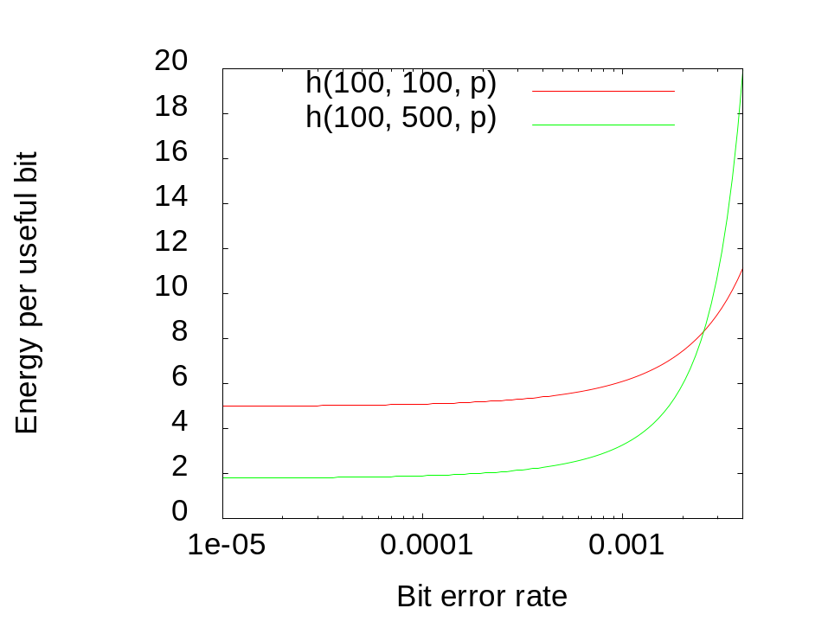
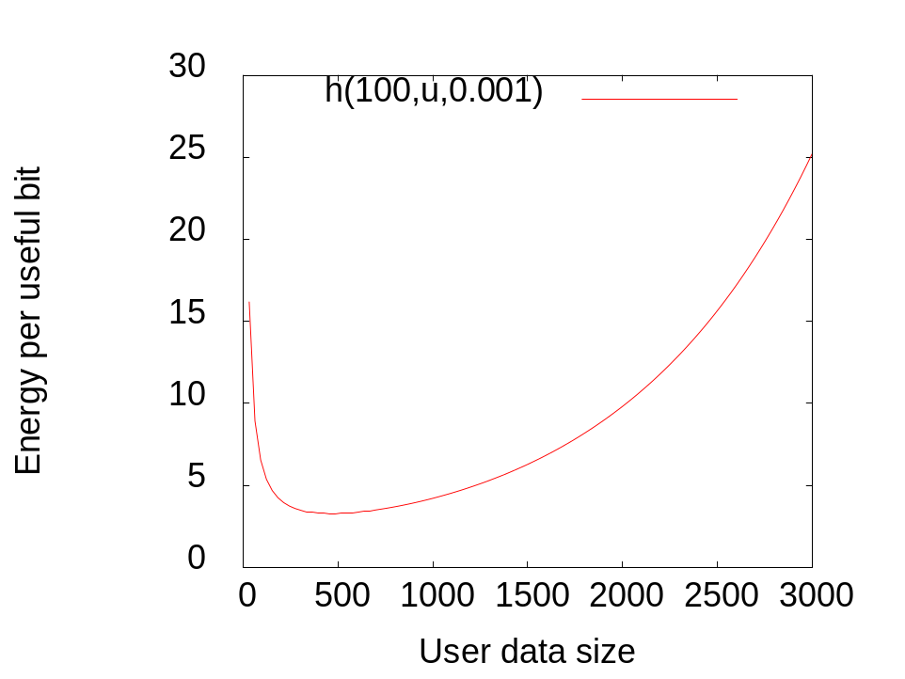
Frame, packet size
Small packets: low packet error rate, high packetization overhead
Large packets: high packet error rate, low overhead
Depends on bit error rate, energy consumption per transmitted bit
Notation: h(overhead, payload size, BER)

Slide 18
Dynamically adapt frame length
For known bit error rate (BER), optimal frame length is easy to determine
Problem: how to estimate BER?
  Collect channel state information at the receiver (RSSI, FEC decoder information, …)
  Example: Use number of attempts T required to transmit the last M packets as an estimator of the packet error rate (assuming a BSC)
    Details: homework assignment
Second problem: how long are observations valid/how should they be aged?
  Only recent past is – if anything at all – somewhat credible

Slide 19
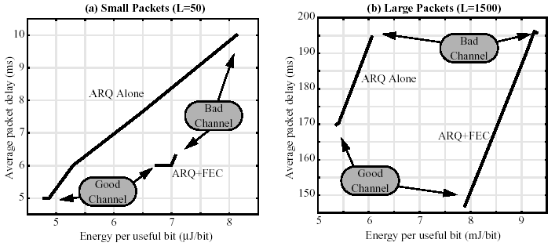
Putting it together: ARQ, FEC, frame length optimization
Applying ARQ, FEC (both block and convolutional codes), frame length optimization to a Rayleigh fading channel
  Channel modeled as Gilbert-Elliot

Slide 20
Overview
Error control
Framing
Link management

Slide 21
Link management
Goal: decide to which neighbors that are more or less reachable a link should be established
  Problem: communication quality fluctuates, far away neighbors can be costly to talk to, error-prone, quality can only be estimated
Establish a neighborhood table for each node
  Partially automatically constructed by MAC protocols

Slide 22
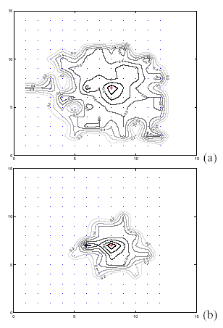
Link quality characteristics
Expected: simple, circular shape of “region of communication” – not realistic
Instead:
  Correlation between distance and loss rate is weak; iso-loss-lines are not circular but irregular
  Asymmetric links are relatively frequent (up to 15%)
  Significant short-term PER variations even for stationary nodes

Slide 23
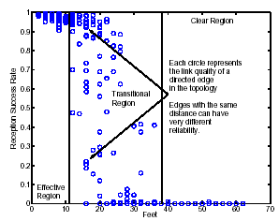
Three regions of communication
Effective region: PER consistently < 10%
Transitional region: anything in between, with large variation for nodes at same distance
Poor region: PER well beyond 90%

Slide 24
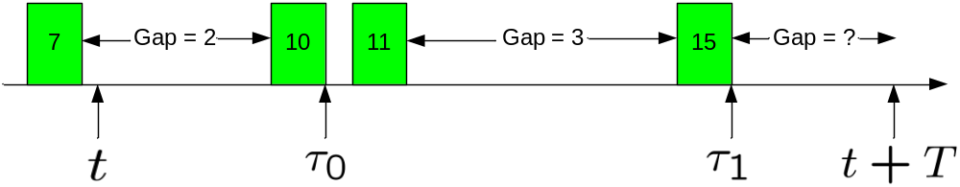
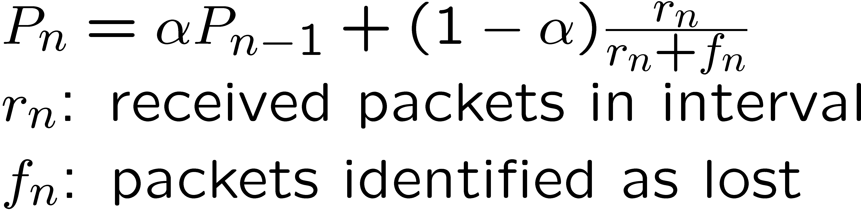
Link quality estimation
How to estimate, on-line, in the field, the actual link quality?
Requirements
  Precision – estimator should give the statistically correct result
  Agility – estimator should react quickly to changes
  Stability – estimator should not be influenced by short aberrations
  Efficiency – Active or passive estimator
Example:
WMEWMA
only estimates
at fixed intervals

Slide 25
Conclusion
Link layer combines traditional mechanisms
  Framing, packet synchronization, flow control
with relatively specific issues
  Careful choice of error control mechanisms – tradeoffs between FEC & ARQ & transmission power & packet size …
  Link estimation and characterization

