Slide 1
12.2~12.3
최호열
2015021524

Slide 2
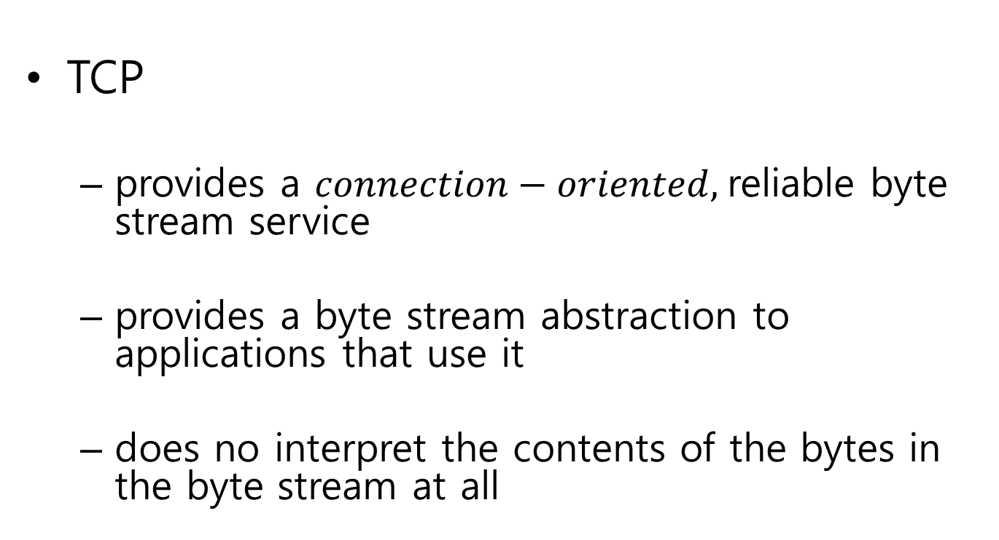
12.1 The TCP Service Model
TCP
  provides a $connection−oriented,$reliable byte stream service
  provides a byte stream abstraction to applications that use it
  does no interpret the contents of the bytes in the byte stream at all

Slide 3
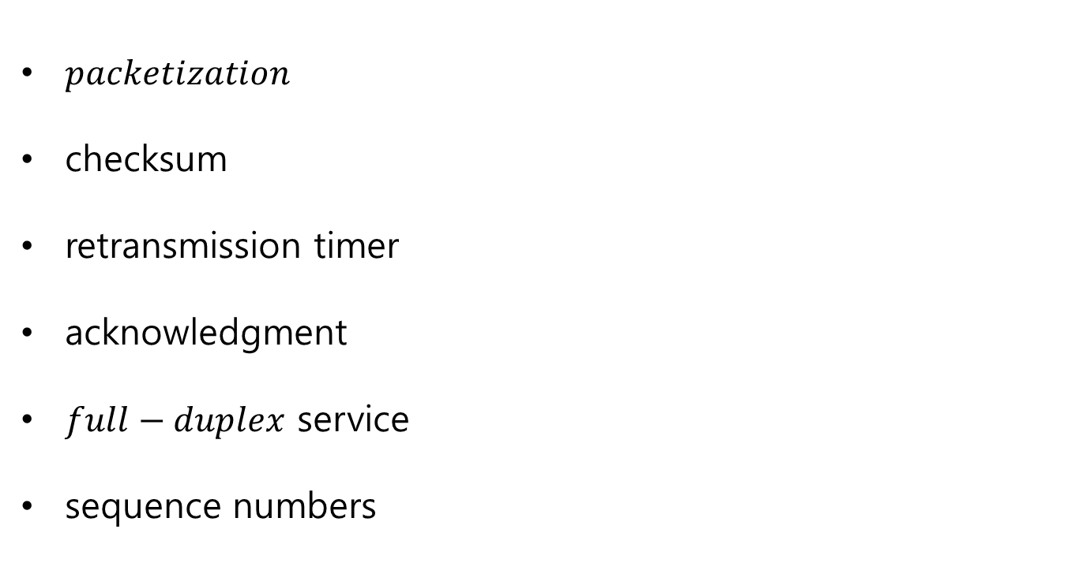
12.2.2 Reliability in TCP
$packetization$
checksum
retransmission timer
acknowledgment
$full−duplex$ service
sequence numbers

Slide 4
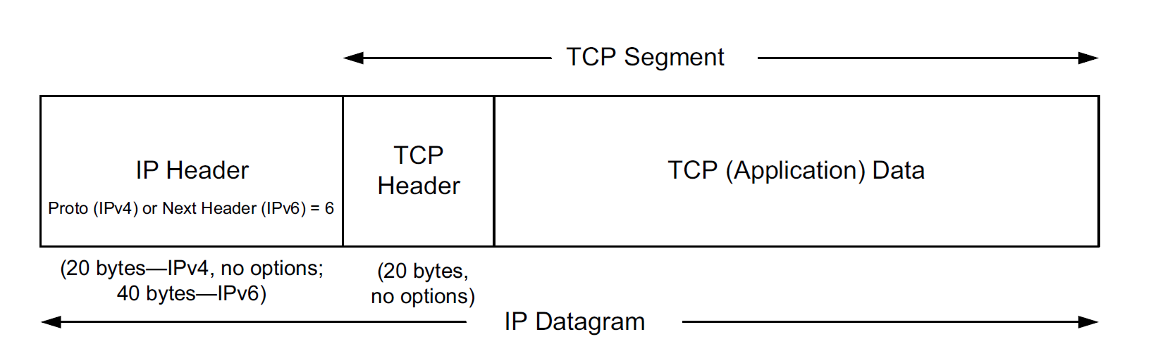
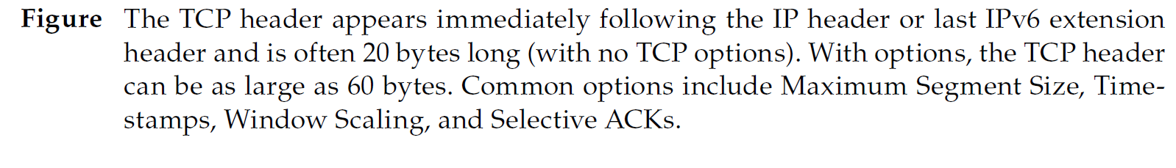
12.3 TCP Header and Encapsulation

Slide 5
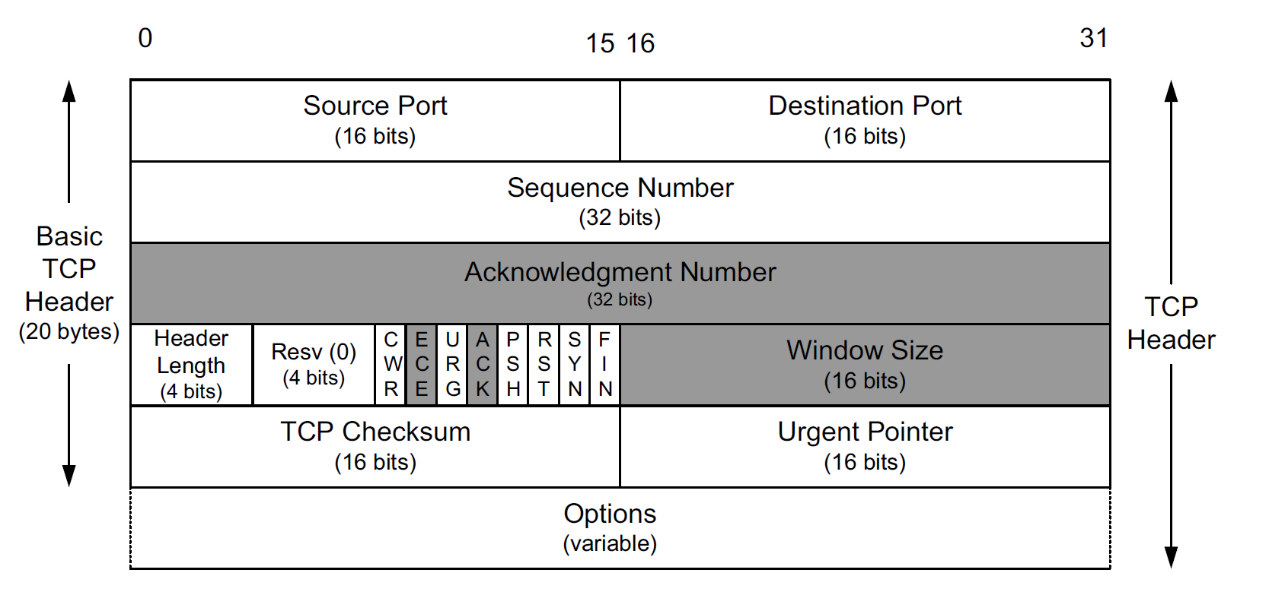

12.3 TCP Header and Encapsulation

Slide 6
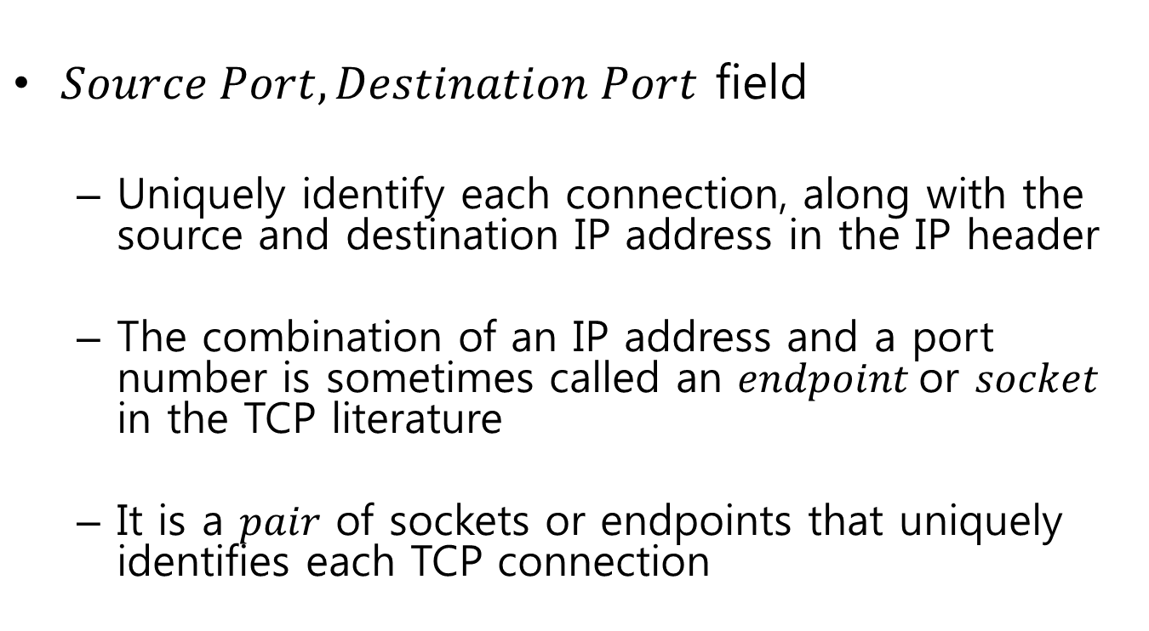
12.3 TCP Header and Encapsulation
$Source Port, Destination Port$ field
  Uniquely identify each connection, along with the source and destination IP address in the IP header
  The combination of an IP address and a port number is sometimes called an $endpoint$or $socket$ in the TCP literature
  It is a $pair$ of sockets or endpoints that uniquely identifies each TCP connection

Slide 7
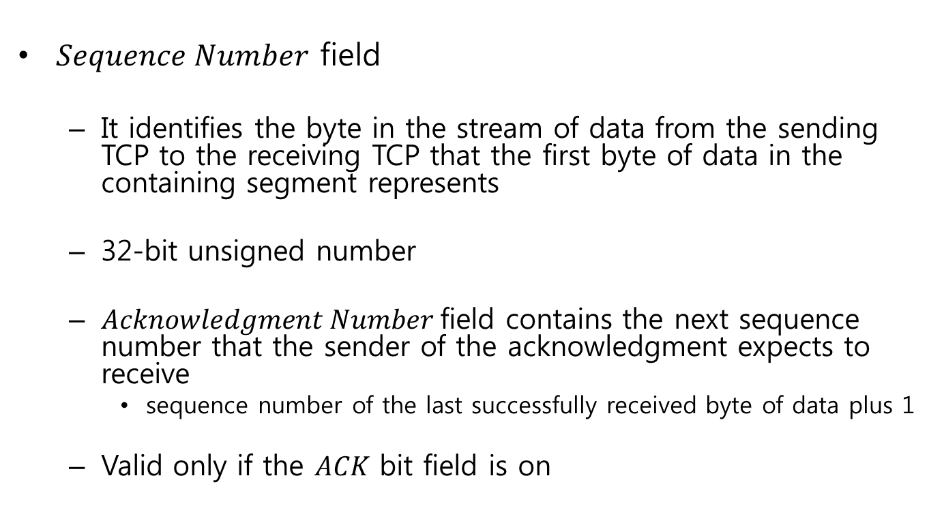
12.3 TCP Header and Encapsulation
$Sequence Number$ field
  It identifies the byte in the stream of data from the sending TCP to the receiving TCP that the first byte of data in the containing segment represents
  32-bit unsigned number
  $Acknowledgment Number$field contains the next sequence number that the sender of the acknowledgment expects to receive
    sequence number of the last successfully received byte of data plus 1
  Valid only if the $ACK$ bit field is on

Slide 8
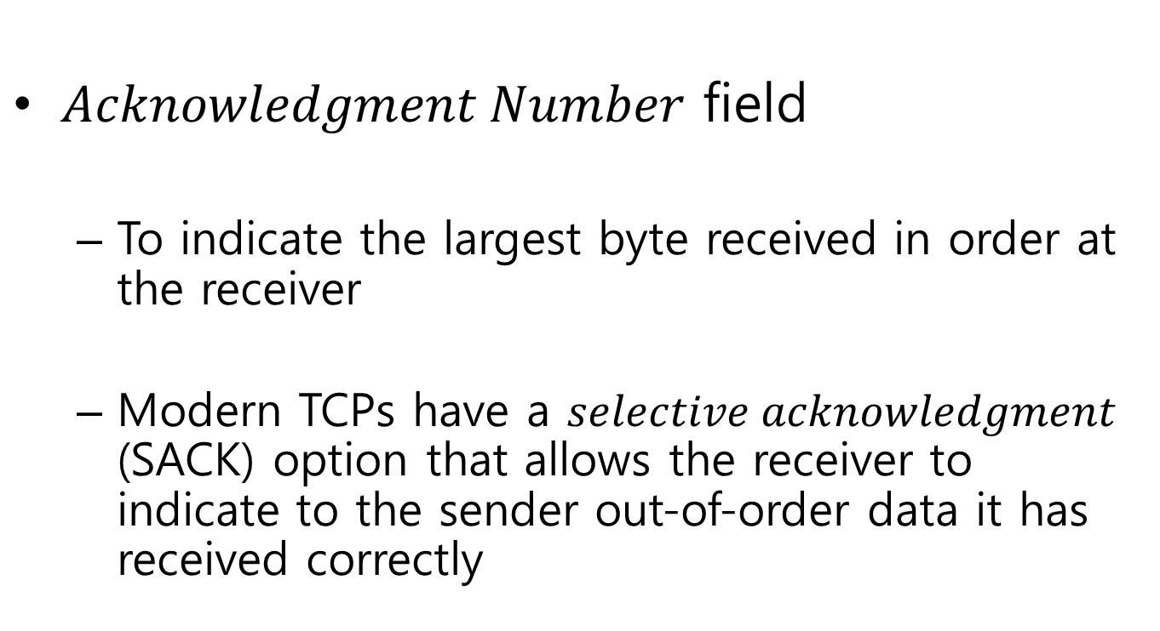
12.3 TCP Header and Encapsulation
$Acknowledgment Number$ field
  To indicate the largest byte received in order at the receiver
  Modern TCPs have a $selective acknowledgment$ (SACK) option that allows the receiver to indicate to the sender out-of-order data it has received correctly

Slide 9
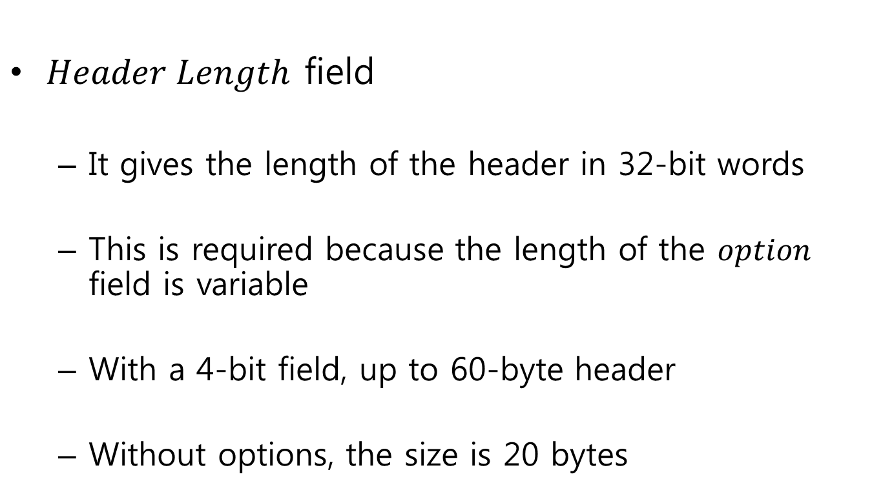
12.3 TCP Header and Encapsulation
$Header Length$ field
  It gives the length of the header in 32-bit words
  This is required because the length of the $option$ field is variable
  With a 4-bit field, up to 60-byte header
  Without options, the size is 20 bytes

Slide 10
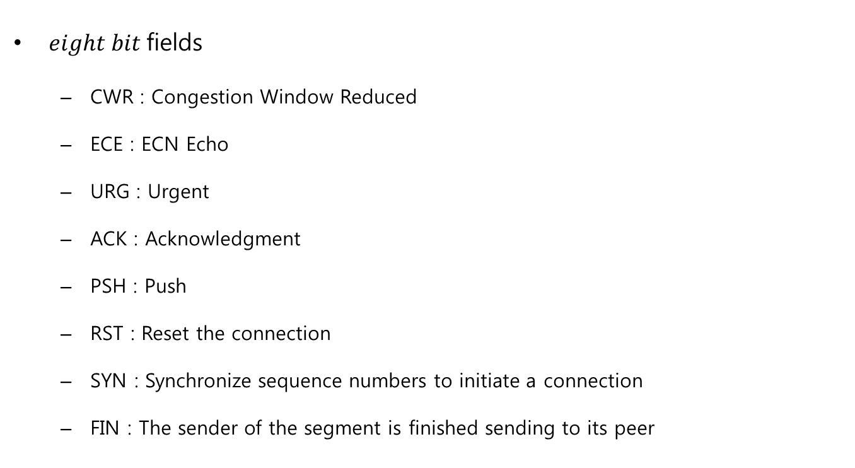
12.3 TCP Header and Encapsulation
$eight bit$fields
  CWR : Congestion Window Reduced
  ECE : ECN Echo
  URG : Urgent
  ACK : Acknowledgment
  PSH : Push
  RST : Reset the connection
  SYN : Synchronize sequence numbers to initiate a connection
  FIN : The sender of the segment is finished sending to its peer

Slide 11
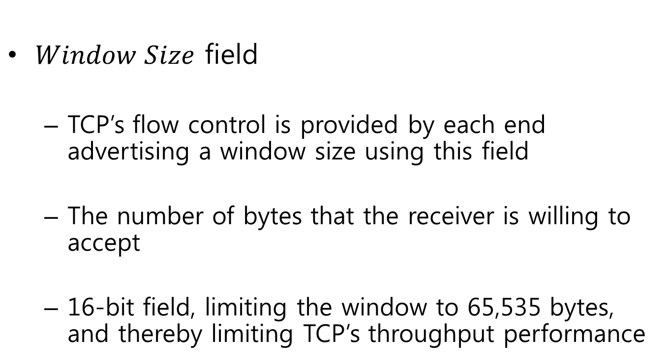
12.3 TCP Header and Encapsulation
$Window Size$ field
  TCP’s flow control is provided by each end advertising a window size using this field
  The number of bytes that the receiver is willing to accept
  16-bit field, limiting the window to 65,535 bytes, and thereby limiting TCP’s throughput performance

Slide 12
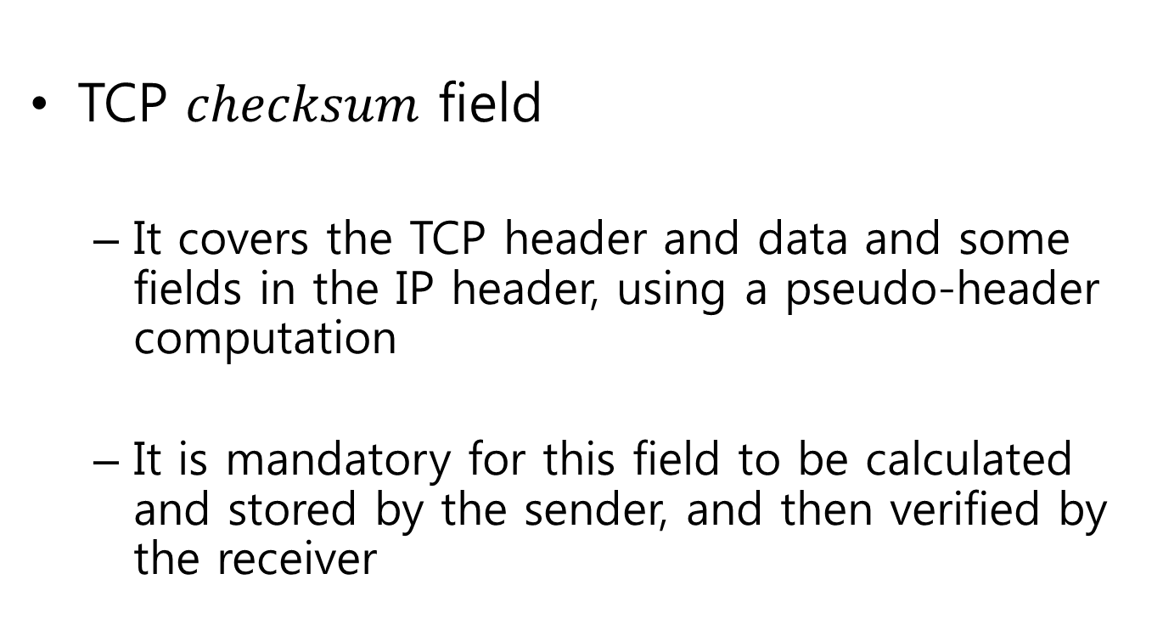
12.3 TCP Header and Encapsulation
TCP $checksum$ field
  It covers the TCP header and data and some fields in the IP header, using a pseudo-header computation
  It is mandatory for this field to be calculated and stored by the sender, and then verified by the receiver

Slide 13
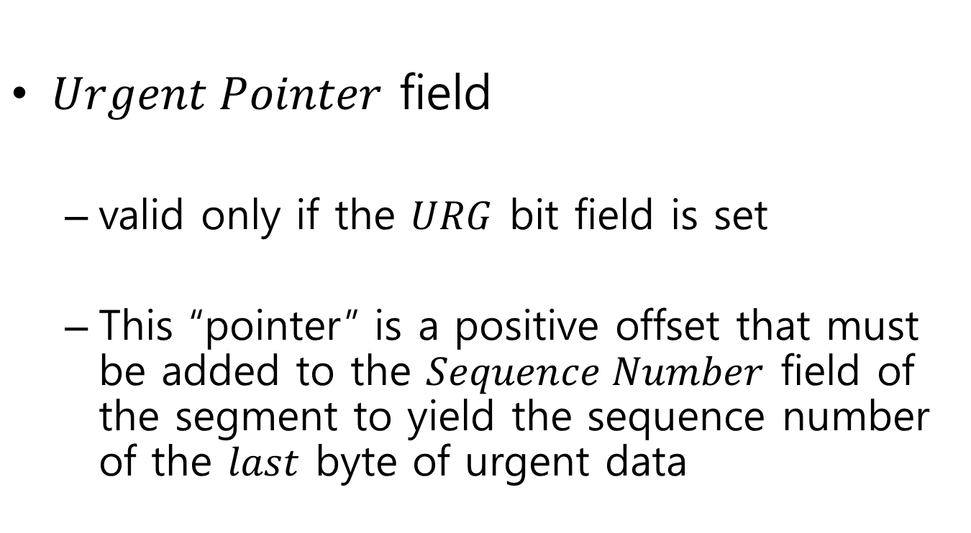
12.3 TCP Header and Encapsulation
$Urgent Pointer$ field
  valid only if the $URG$ bit field is set
  This “pointer” is a positive offset that must be added to the $Sequence Number$ field of the segment to yield the sequence number of the $last$ byte of urgent data

Slide 14
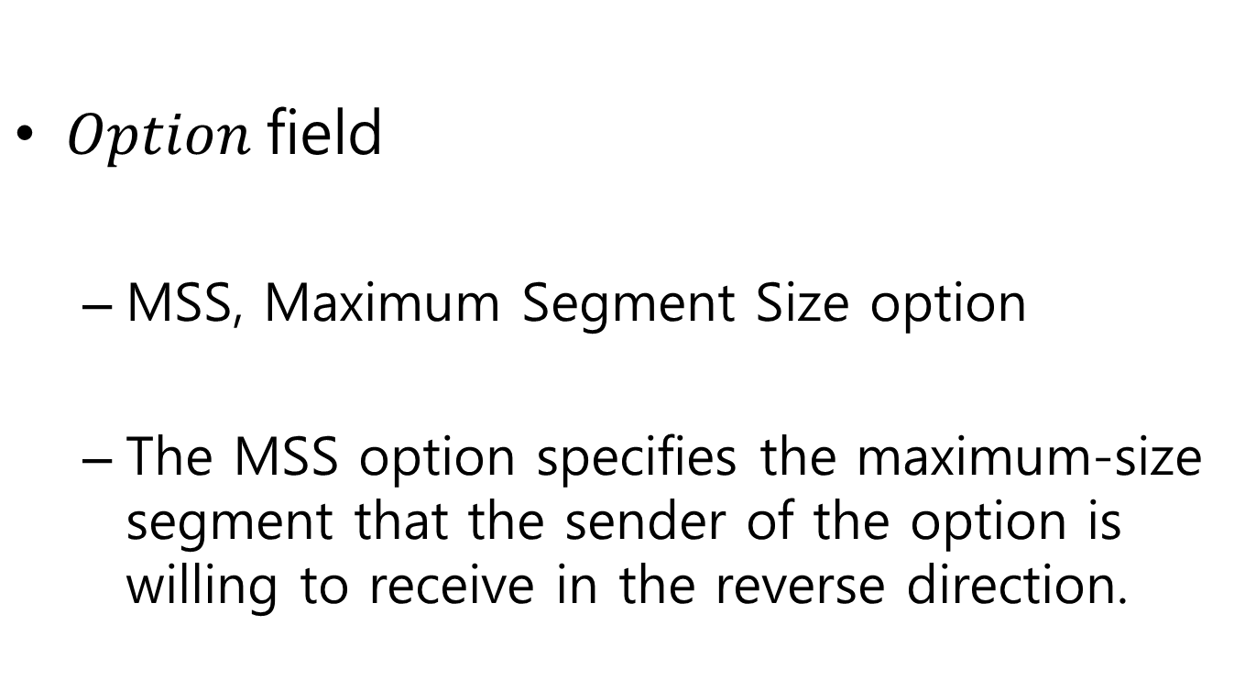
12.3 TCP Header and Encapsulation
$Option$field
  MSS, Maximum Segment Size option
  The MSS option specifies the maximum-size segment that the sender of the option is willing to receive in the reverse direction.

