Slide 1

Long Term Evolution (LTE)

Slide 2


Background: Base stations near Anam station

Slide 3
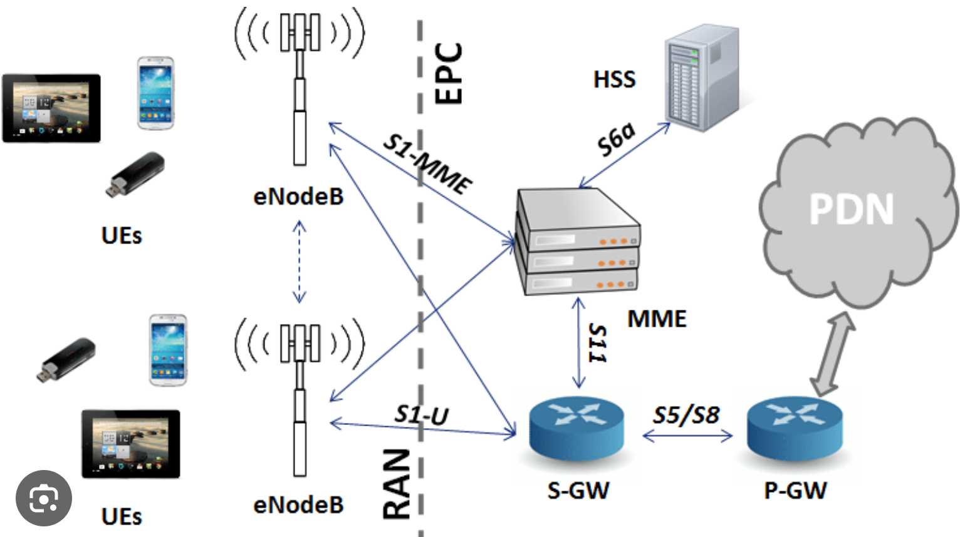
Introduction
Mobile communication network is composed of two parts

Slide 4
Introduction
4th Generation Cellular (Mobile) Communication
  2010s
Came along when Internet traffic was exploding
Naturally, the goal was providing “broadband”(= high speed)
  Mostly in download (upload is relatively weak)
    Up to 100 Mbps in high mobility
    Up to 1 Gbps in low mobility
LTE is actually the name of the radio access network (RAN)
  Core network in 4G is called Evolved Packet Core (EPC)
  “Evolved” = All IP

Slide 5
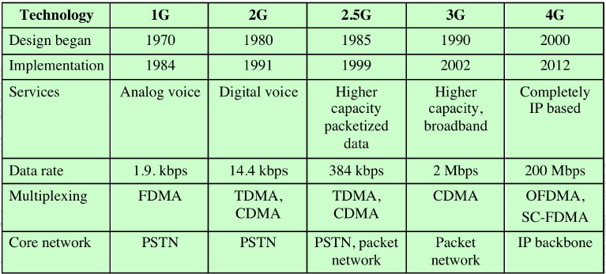
Generations
4G no longer supports circuit-switched voice
  Even voice is carried by IP packets over LTE (“Voice over LTE”)
Like IP for core network, OFDM is the biggest success for RAN
  Both continue in 5G

Slide 6
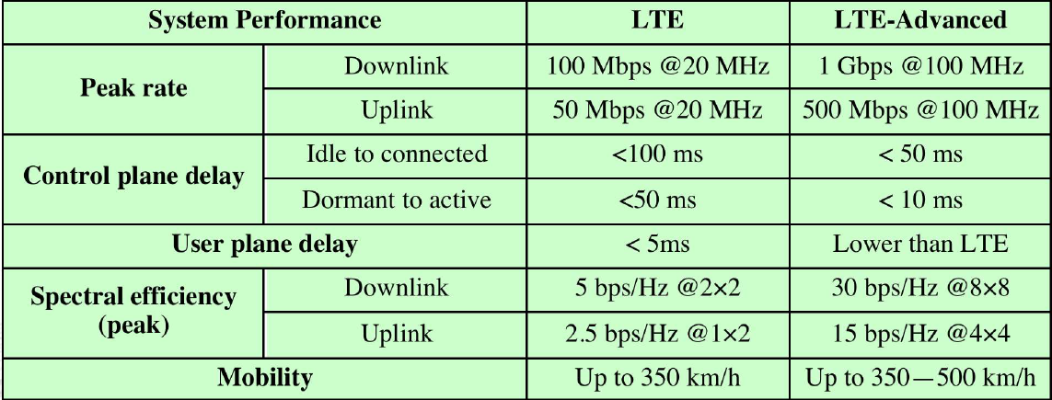
LTEs
LTE and LTE Advanced

Slide 7
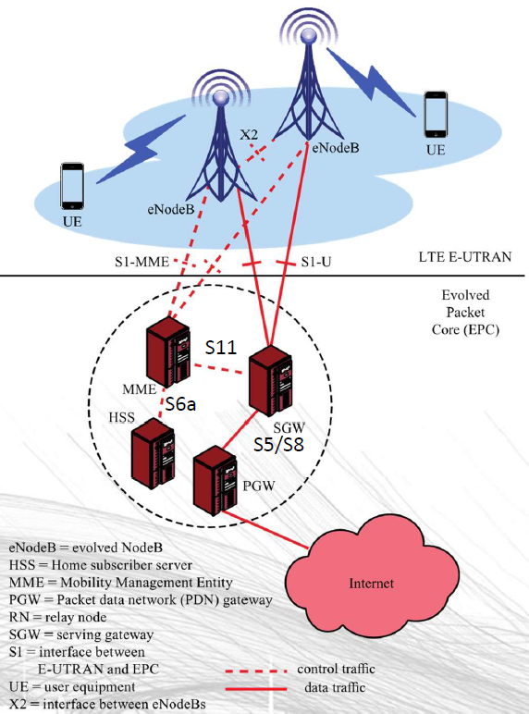
LTE architecture
Evolved Packet System (EPS)
  EPS = EPC + LTE
  EPC and LTE evolve independently
    LTE = E-UTRAN
  eNodeB is the base station
    Logical and more powerful than in 3G
    Participates in radio resource control, admission control, mobility management
  Bandwidth
    1.4 ~ 20 MHz
    Up to 100 MHz with carrier aggregation

Slide 8
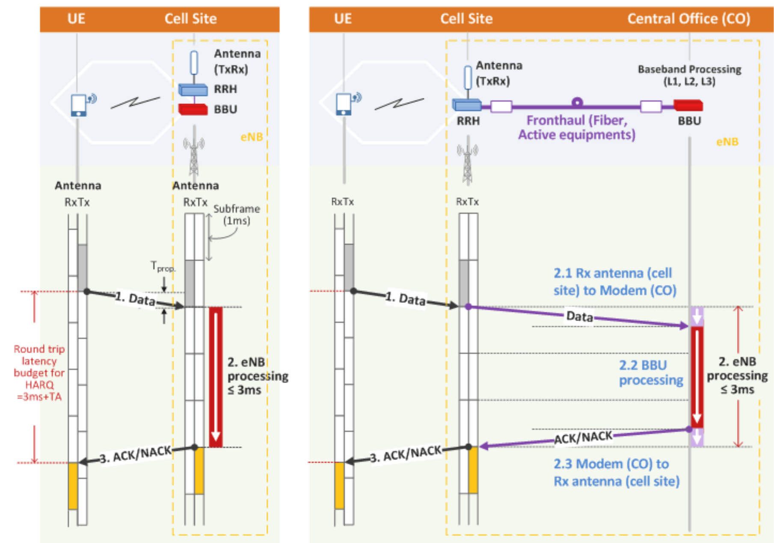
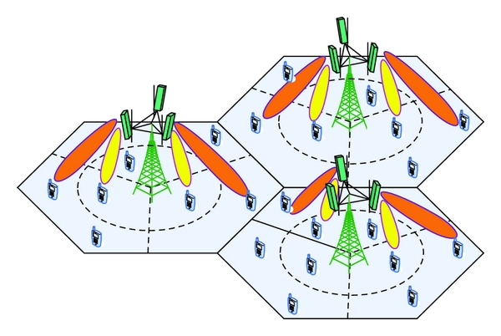
eNodeB is logical
Can have multiple cells or sectors
Some of its processing can be done elsewhere

Slide 9
EPS functions
Access control
  Network selection, authentication, authorization, admission control, policy and charging enforcement, lawful interception
Packet routing
Security
  Encryption, integrity protection
Mobility management
Radio resource management
Network management
IP networking

Slide 10
EPC components
Mobility Management Entity (MME)
  Supports user equipment context, identity, authentication, and authorization
  Mainly perform Non Access Stratum procedures, which consist of two main groups
    Functions related to bearer management (EPS Session Management)
      Bearer can be seen as a logical communication tunnel
    Functions related to connection management (EPS Mobility Management)

Slide 11
EPC components
Serving Gateway (SGW)
  Receives and sends packets between the eNodeB and the core network
  Perform packet routing and forwarding within EPC
  Anchor point for intra LTE-mobility
  Lawful intercept

Slide 12
EPC components
Packet Data Network Gateway (PGW)
  Connects the EPC with external networks
    Internet
    PSTN
  A router that performs UE IP assignment, per user packet filtering
  Anchor point for mobility with non 3GPP access network
  Lawful intercept

Slide 13
EPC components
Home Subscriber Server (HSS)
  Database of user-related and subscriber-related information
Interfaces
  S1 interface between LTE and EPC
    For both control purposes (connect MME to eNodeB) and for user plane data traffic(connect SGW to eNodeB)
  S5/S8 connects MME with PGW
  S11 connects SGW with MME

Slide 14
Radio access network
Mainly consist of eNodeB’s
Runs Access Stratum Protocol (AS)
X2 interface between eNodeB
  X2 control and X2 user
Main functions
  Radio resource management
    Radio bearer control
    Radio mobility control
    Scheduling (uplink and downlink)
  Header compression
  Security
  Connectivity to EPC

Slide 15
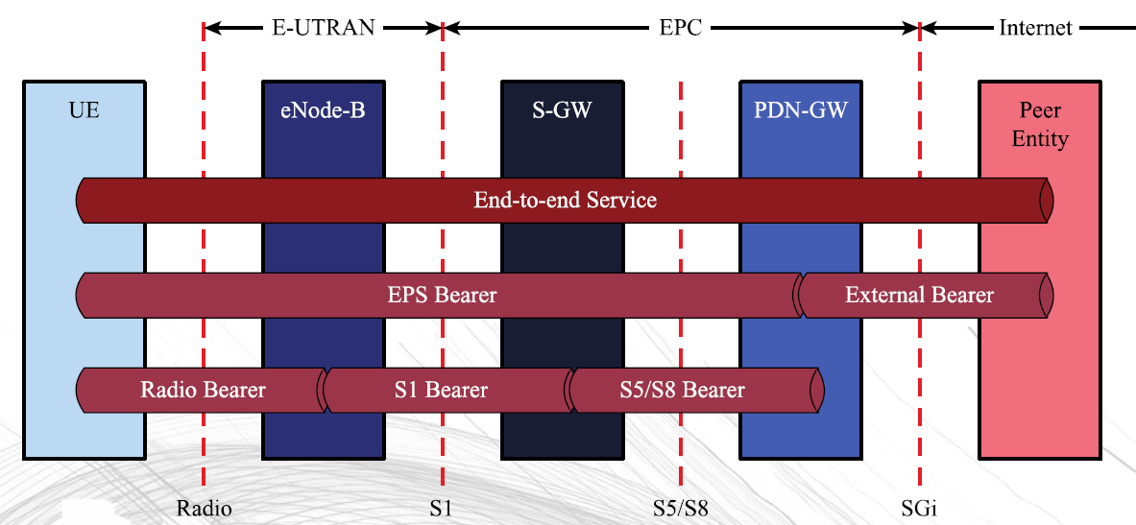
Radio resource management
“bearer” = packet “pipe” with committed resource
  Like circuit in circuit switching
  Runs between PGW and UE (smartphone)
  Can be mapped to specific QoS parameters
    Data rate (Mbps), delay, error rate, etc.

Slide 16
Radio resource management
When UE connect to the EPS, a persistent, default bearer connection is established through the life time of the connection
User plane transports IP packets between PGW and UE
  In EPC, it is tunneled using GPRS tunneling protocol (GTP)
  From eNodeB to UE, it is tunneled by Packet Data Convergence Protocol (PDCP)

Slide 17
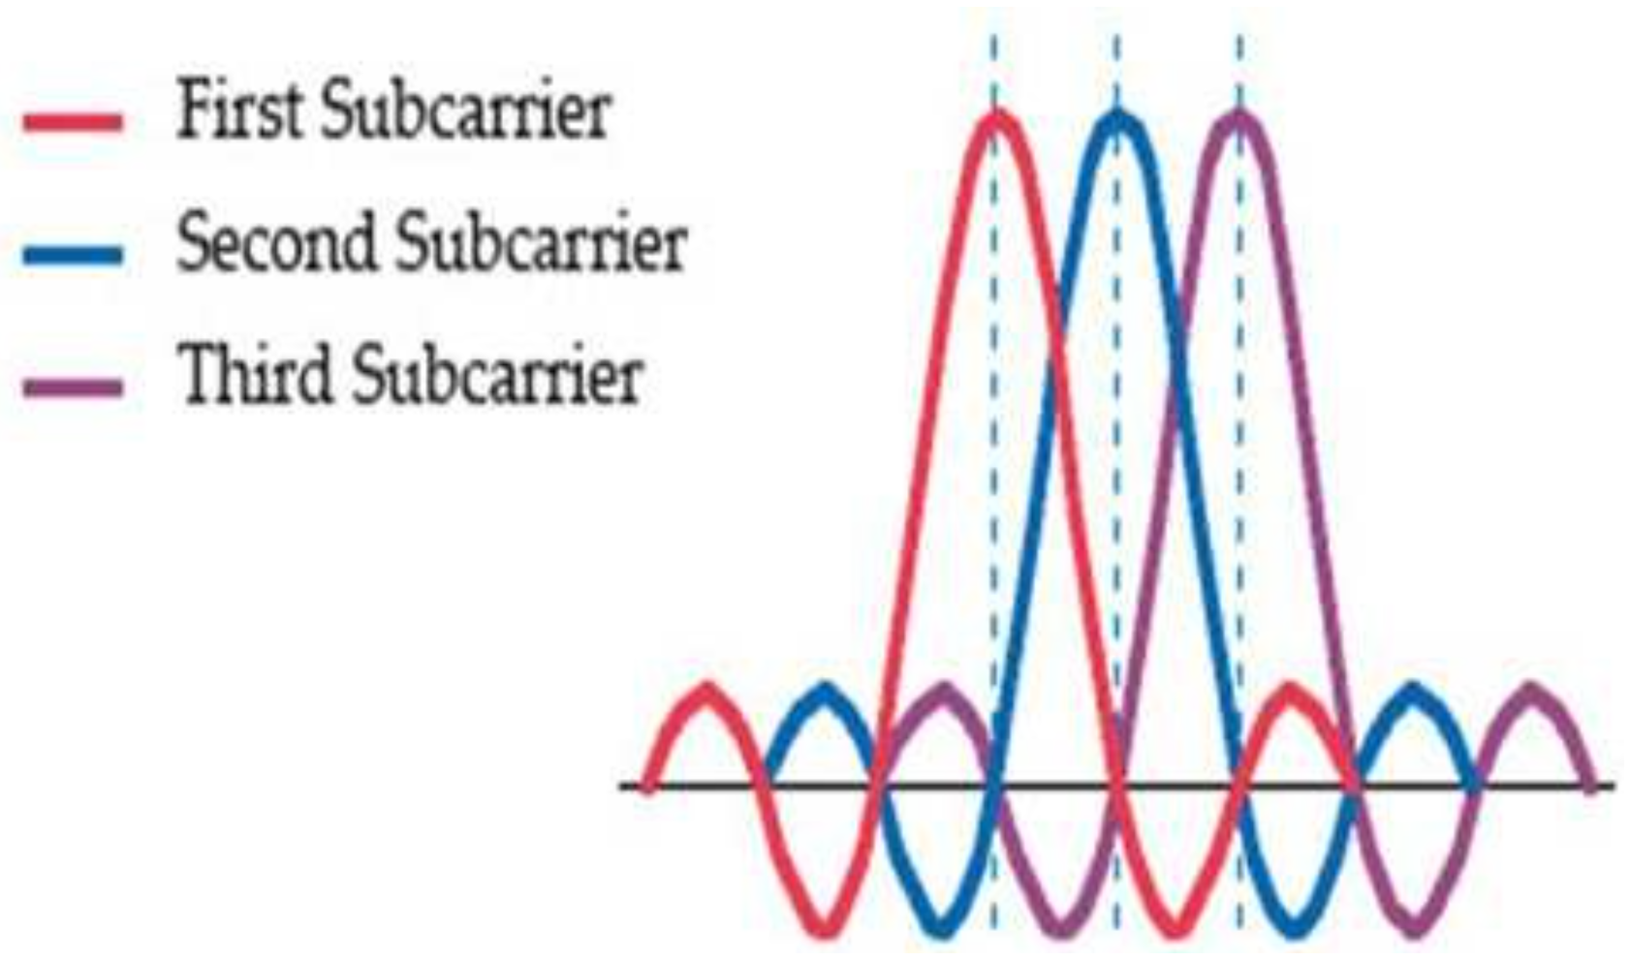
OFDM
Orthogonality between subcarriers

Slide 18
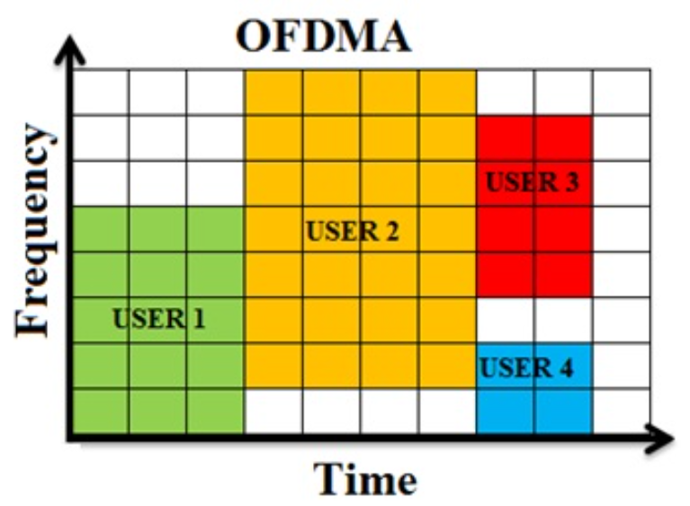
OFDMA
Very much like our classroom scheduling

Slide 19
Inter-cell interference coordination (ICIC)
When the same frequency is used in a neighboring cell
Goal is universal frequency reuse (N = 1)
  Must avoid interference when UEs are near each other at cell edges
  Interference randomization, cancellation, coordination, and avoidance are used
eNodeBs send indicators
  Relative Narrowband Transmit Power, High Interference, and Overload indicators
Later releases of LTE have improved interference control

Slide 20
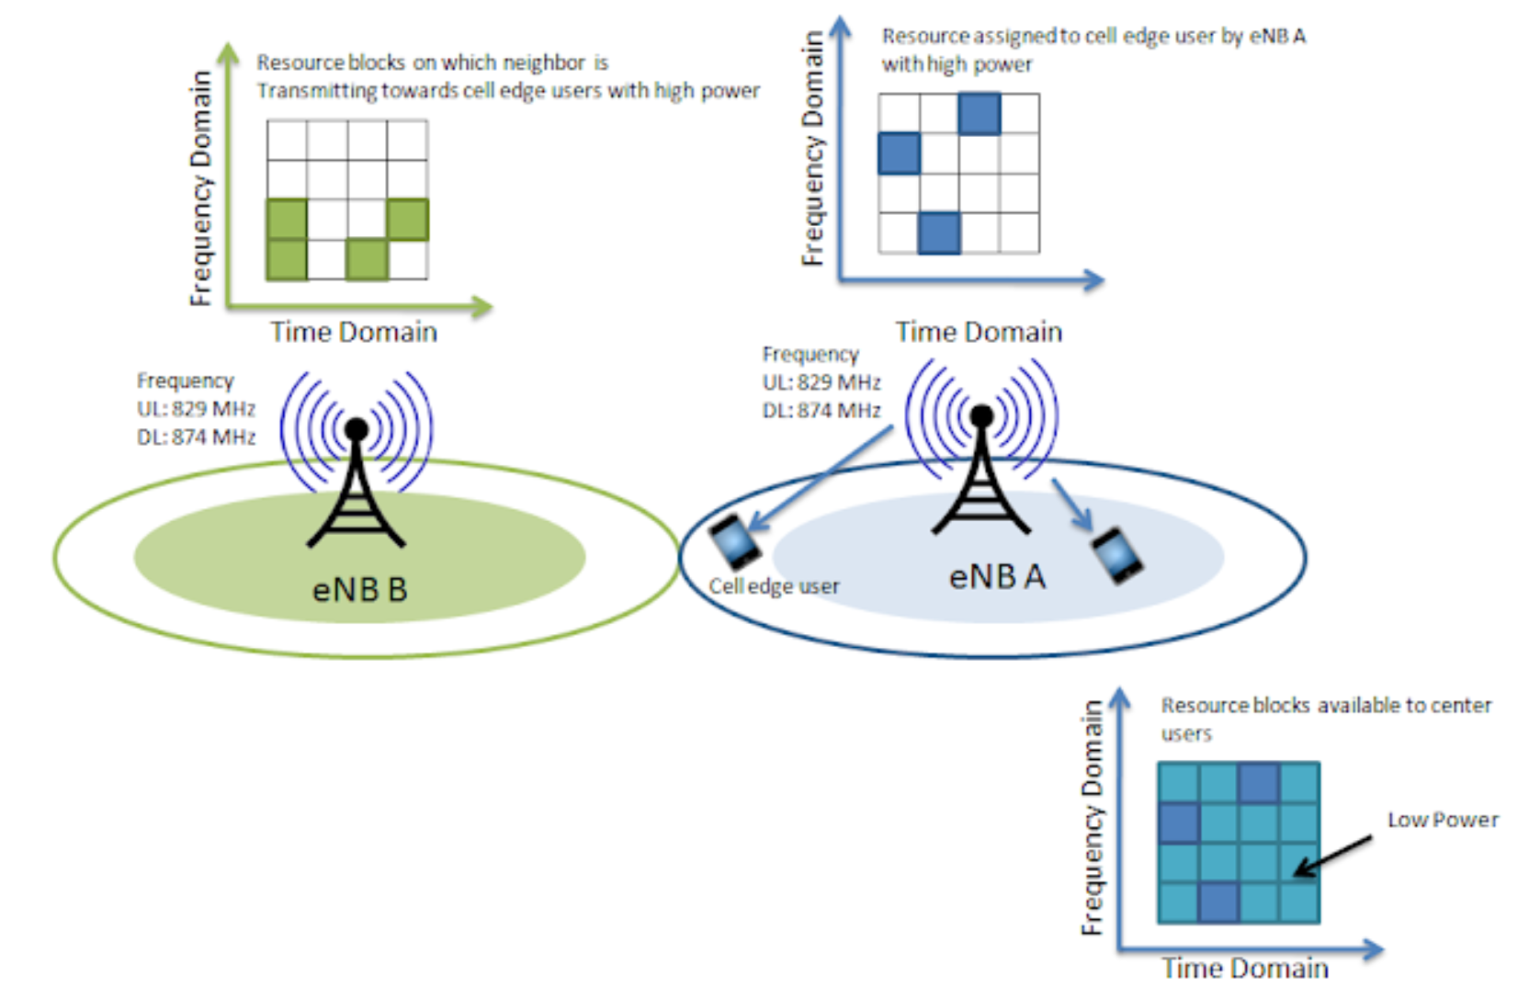
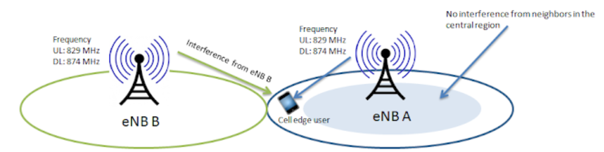
ICIC
User different power and frequency to mitigate inter-cell interference

Slide 21
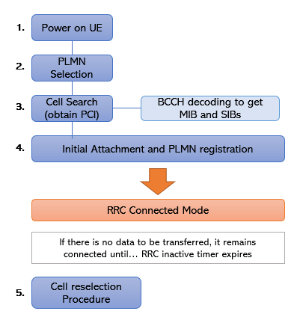
Connection procedure
Initially, UE (e.g. smartphone) selects Public Land Mobile Network (PLMN)
  Look into USIM
  Register to PLMN
Select a cell in the PLMN
  Last cell the UE camped on, or
  Scan one
  Synchronize to it
Mobility management
  Connected: handover
  Idle: cell reselection

Slide 22
Mobility management: hard handover
S1 mobility
  Preparation
    Decision has been made for handover and the destination MME and eNodeB have been identified
    MME sends handover request to destination eNodeB
    MME sends handover command to UE
  Execution
    UE performs RAN procedures for the handover
    Involving eNodeB’s exchange relevant data for handover
  Completion
    Target eNodeB notifies MME
    MME directs source eNodeB to release the resources that has been used by the UE

Slide 23
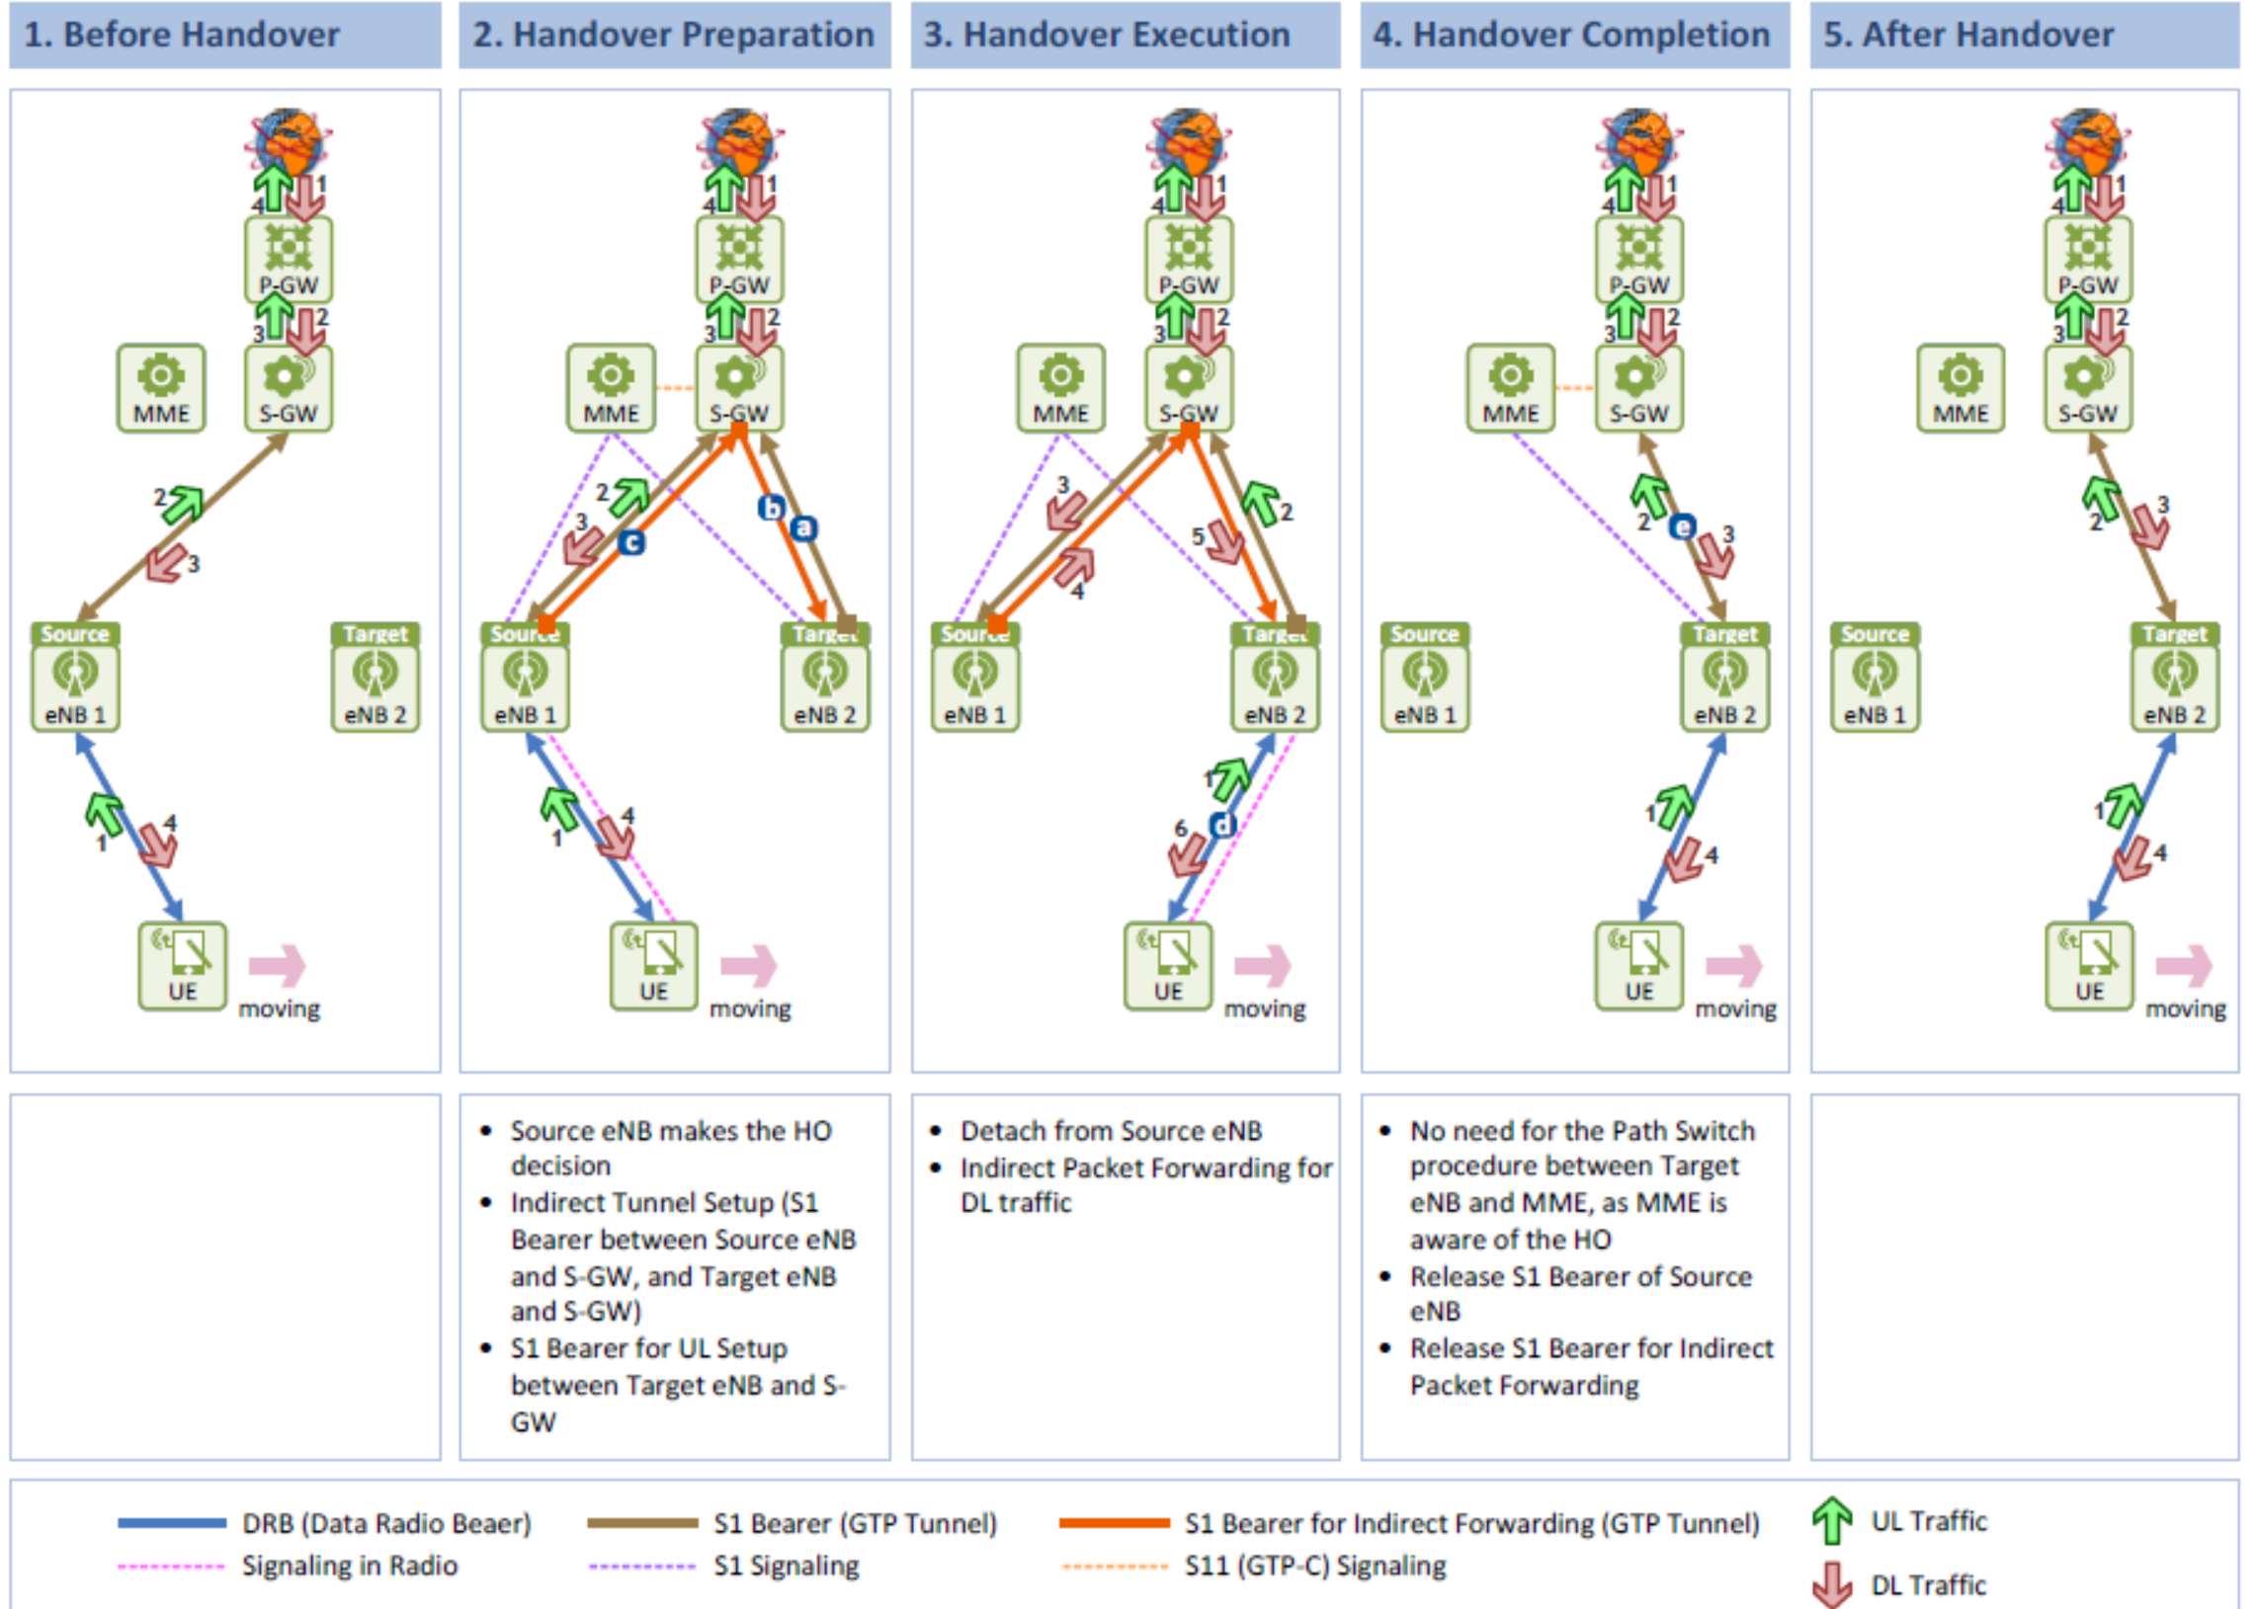
S1 handover

Slide 24
Mobility management
X2 mobility
  Preparation
    Source eNodeB sends handover request to destination eNodeB
    Destination eNodeB works with MME and SGW to establish resources for the UE
  Execution
    Source eNodeB signals the UE
    The UE performs RAN procedures for handover
    Data exchanges between involving eNodeB
  Completion
    UE sends handoff complete message to MME and SGW
    SGW switch GTP tunnel to the destination eNodeB
    Destination eNodeB asks source eNodeB to release the resource for the UE

Slide 25
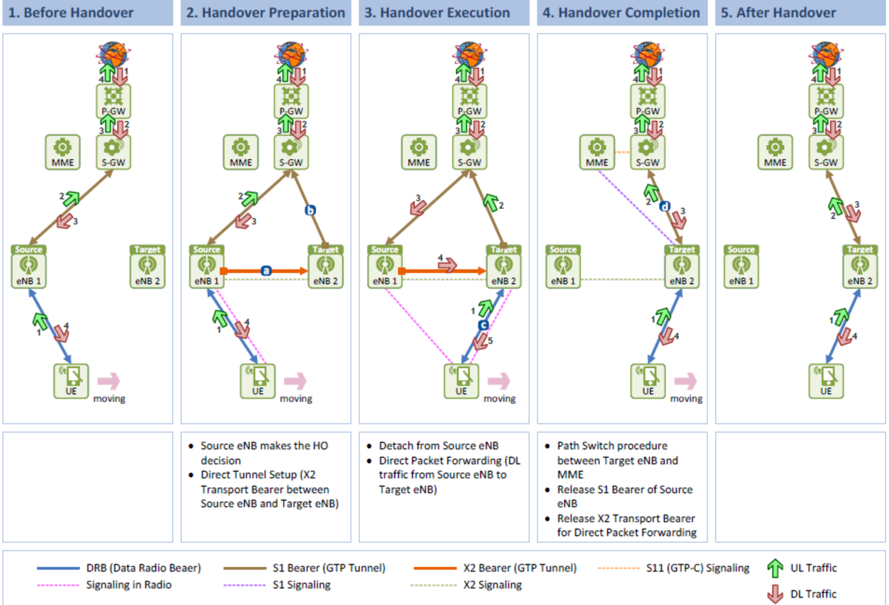
X2 handover

Slide 26
Mobility procedure
To determines handover decisions, following information might be included
  Radio link quality, UE capability, call type, QoS requirements, and policy related aspects
    Reference Signal Received Power (RSCP) indicates radio link quality for a connection in an LTE cell
  UE prepares measurement report which contains RSCP for the neighboring eNodeBs
    The serving eNodeB provides the list of eNodeB as requested by the UE

Slide 27
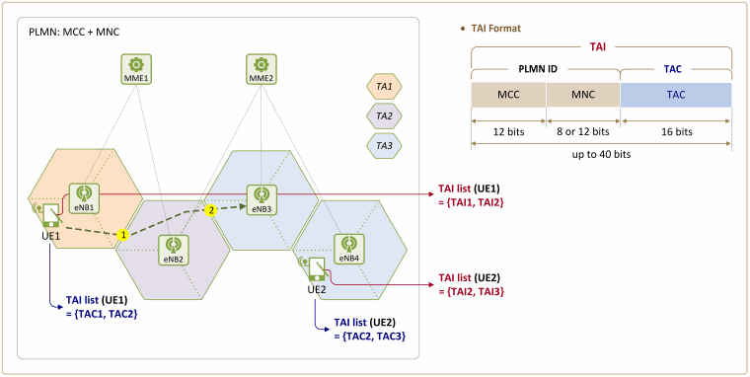
Mobility management
Cell reselection is mobility management for idle terminals
  Idle terminal periodically wakes up and measures signal power from its current serving cell
In case the mobility crosses tracking area (TA) boundary, update this information at MME
  For paging later

Slide 28
LTE channel structures and protocols
LTE radio interface is divided
  Control Plane
  User Plane
User plane protocols
  Part of the Access Stratum
  Transport packets between UE and PGW
  PDCP transports packets between UE and eNodeB on the radio interface
  GTP sends packets through the other interfaces
Control plane protocols
  Part of Non-Access Stratum (NAS) for communication between MME and UE
  Deals with mobility management, call setup, security functions between UE and MME

Slide 29
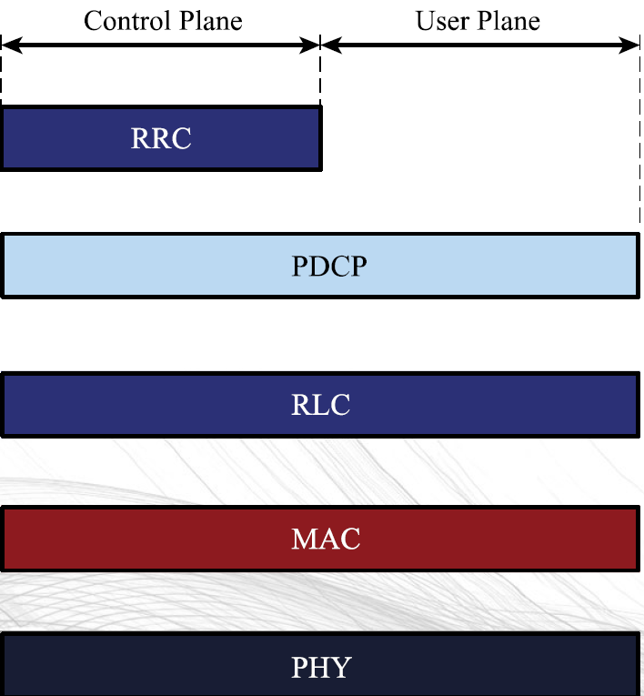
LTE channel structures and protocols

Slide 30
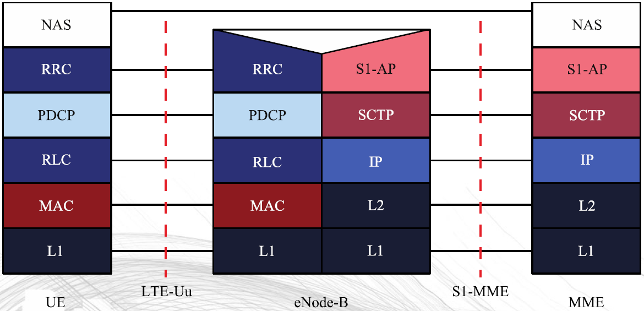
LTE channel structures and protocols
Control plane

Slide 31
Control plane protocols
NAS (Non Access Stratum)
  Mobility management, call setup, security functions between UE and MME
Radio Resource Control (RRC)
  Performs control plane functions to control radio resources
  Important aspects of RRC
    Connection states :RRC_IDLE and RRC_CONNECTED states
    Signaling Radio Bearers (SRB): Radio bearer to transmit RRC and NAS messages
    System Control Information : Master Information Block and System Information Block
      MIB and SIB contains essential information that UE needs to know about a cell characteristics

Slide 32
Non-Access Stratum (NAS) protocols
For interaction between the EPC and the UE
  Not part of the Access Stratum that carries data
EPS Mobility Management (EMM)
  Manage the mobility of the UE
EPS Session Management (ESM)
  Activate, authenticate, modify, and de-activate user-plane channels for connections between the UE, SGW, and PGW

Slide 33
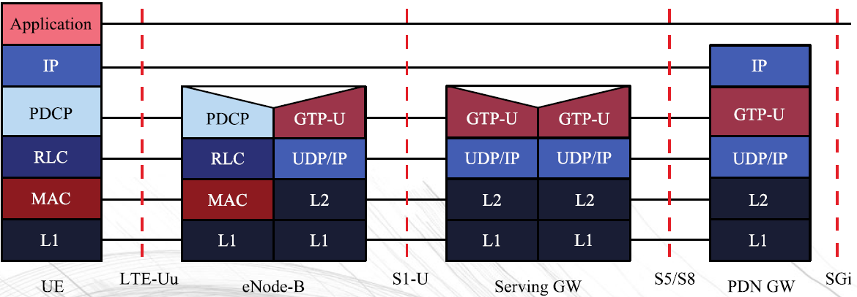
LTE channel structures and protocols
User plane

Slide 34
User and control planes
Packet Data Convergence Protocol (PDCP)
  Delivers packets from UE to eNodeB
  Involves header compression, ciphering, integrity protection, in-sequence delivery, buffering and forwarding of packets during handover
  One PDCP instance per bearer
Radio Link Control (RLC)
  Segments or concatenates data units
  Performs ARQ when MAC layer H-ARQ fails
  RLC operation modes:
    Transparent mode (TM): No header with no RLC functions for segmentation or concatenation. Used for broadcast and paging message, not for user plane data transmission
    Unacknowledged Mode (UM) : Provides in-sequence delivery of data, no retransmission
    Acknowledged Mode ( AM) : Best for error sensitive application

Slide 35
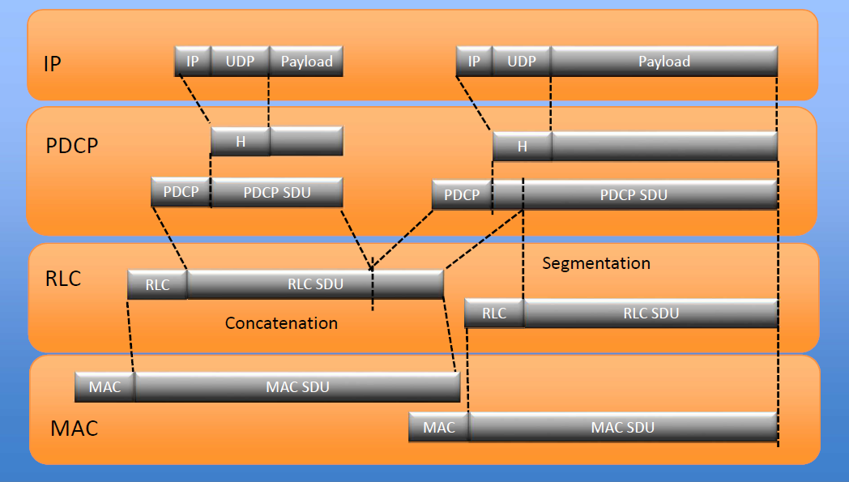
Segmentation and concatenation

Slide 36
User and control planes
Medium Access Control (MAC)
  Performs H-ARQ
  Prioritizes and decides which UEs and radio bearers will send or receive data on which shared physical resources
  Decides the transmission format, i.e., the modulation format, code rate, MIMO rank, and power level
Physical layer actually transmits the data

Slide 37
LTE channel structure
Three types of channels
  Channels provide services to the layers above
  Defined at the Service Access Points between protocol layer
  Type of channels
    Logical channels
      Provide services from the MAC layer to the RLC
      Provide a logical connection for control and traffic
    Transport channels
      Provide PHY layer services to the MAC layer
      Define modulation, coding, and antenna configurations
    Physical channels
      Define time and frequency resources use to carry information to the upper layers
Different types of broadcast, multicast, paging, and shared channels

Slide 38
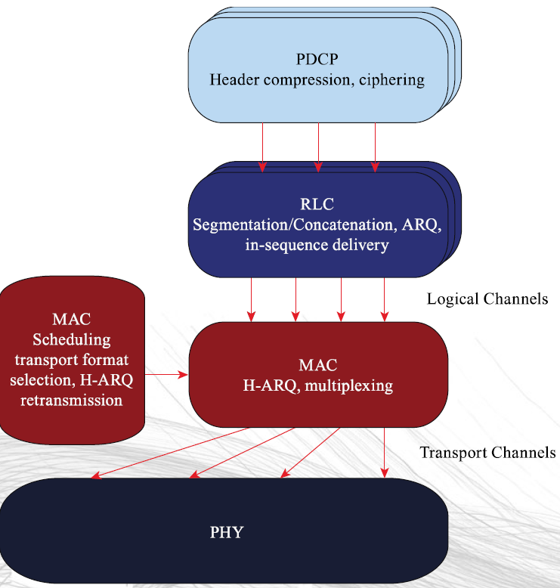
Radio interface architecture
Physical Channels

