Slide 1
Standardization of the In-Car Gesture Interaction Space
Automotiveui, 2013
Presenter : byungjo Kim

Slide 2
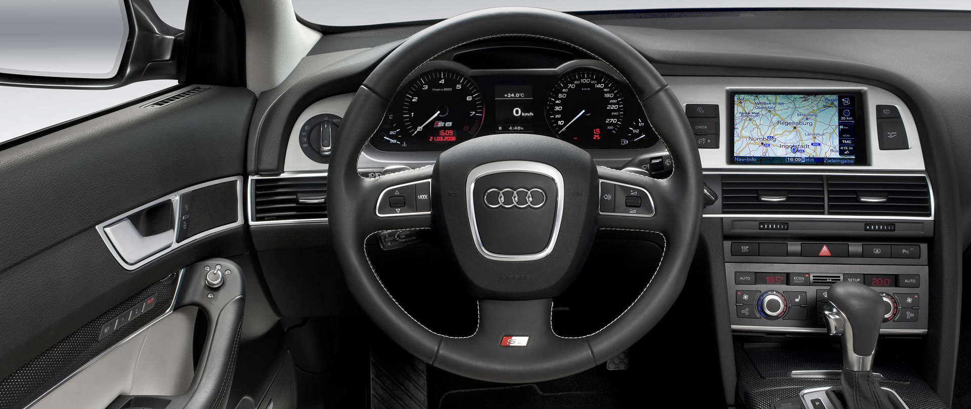
Towards Virtual Controls: Motivation
The current generation of cars is equipped with TOO MANY buttons/switches, indicator lamps..

Slide 3
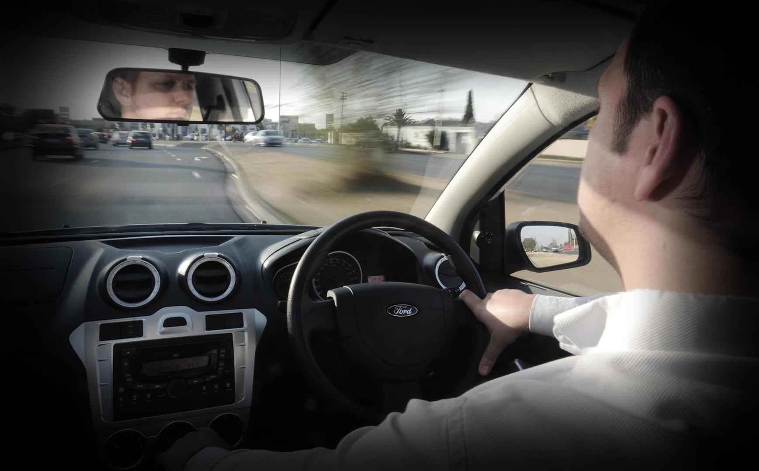
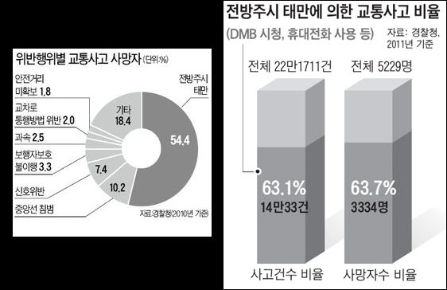
Towards Virtual Controls: Motivation
According to a 2013 study, driver distraction is the number of three cause for major accidents
Division of brain hampers reaction time and the ability of judgment and most critical

Slide 4
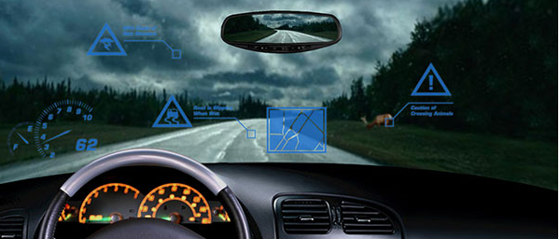
Rationale for Distraction
Regarding distribution and driving safety, a crucial factor to consider is the VISUAL WORKLOAD
  many of the in-car systems and indicators require permanent observation
  also the interaction with buttons/controls demands visual attention
Using a head-up display (HUD) has demonstrated
  to minimize the mental workload
  to decrease response times
  → it has shown an improvement of information presentation efficiency
  BUT, overlaid information might also deteriorate the reaction time

Slide 5
Rationale for Distraction
For in-car application, some studies* have confirmed that drivers would accept gesture control
  and it* has shown that at least one hand can be used to perform gestures without distracting the driver
Gestures can be indeed a good alternative to the current paradigm of physical interaction
  but before proceeding with the definition of gestures to control in-car function,
  an important issue to deal with is the application area to neither distract the driver nor other road participants
    where / how a gesture should be performed
*D. Bannach, Waving real hand gestures recorded by wearable motion sensors to a virtual car and driver in a mixed-reality parking game. In Computational Intelligence and Games, 2007. CIG 2007. IEEE Symposium on, pages 32–39, 2007
*C. J. Patten. Cognitive Workload and the Driver: Understanding the Eﬀects of Cognitive Workload on Driving from a Human Information Processing Perspective. PhD Thesis, Department of Psychology, Stockholm University, 2007

Slide 6
Standardization of Spatial Parameters
With increasing number and complexity of controls and information displays,
  International standardization agencies have started to standardize
    ISO 2575: symbols for use on controls, indicators, and tell-tales
    ISO 7397 / 4514: front vision / back vision
    ISO 4040: the placement of indicator units and control lamps in and around the dashboard
    ISO 3958: hand reach distances
The main aim of these standards is
  to improve operation efficiency by optimizing and harmonizing the arrangement / placement of indicator systems and control elements

Slide 7
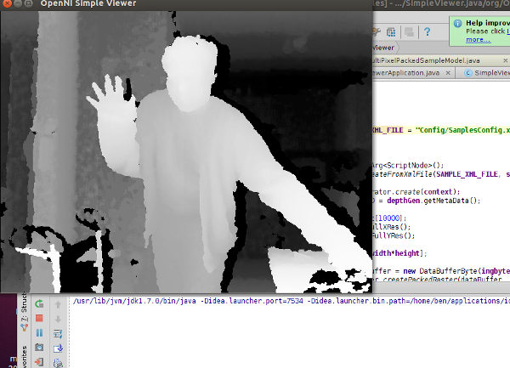
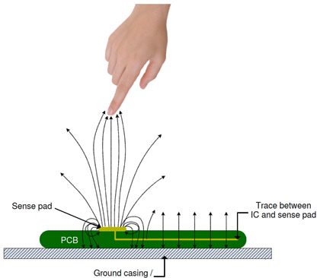
Challenge: “Invisible” Controls
Inherent problem of gestural interaction:
  Suitable techniques
  Selection of systems/functions to control with gesture
  Definition of the gesture-function mapping
Driven by latest advancements,
  Infrared image analysis from “depth cameras”
  Capacitive proximity sensing

Slide 8
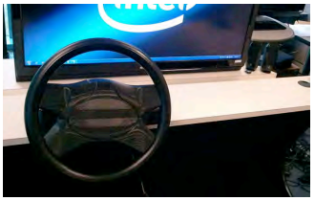
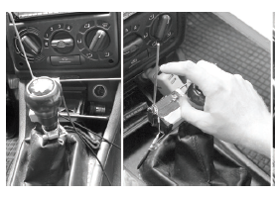
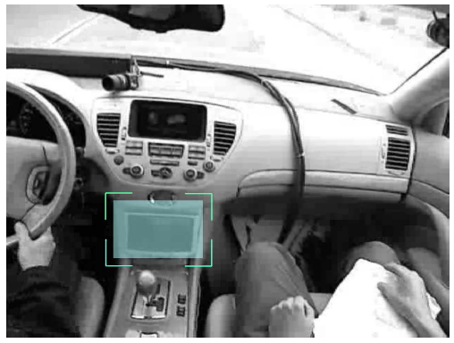
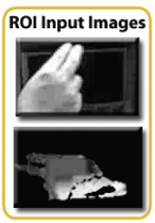
Challenge: “Invisible” Controls
The technology allows
  To perform micro-gestures on the steering wheel,
  Finger gestures in the gearshift area,
  Free multi-finger / hand gestures in the open space
More general research works
  Focused on the intuitiveness of gesture use
  Discussed the quantity of gestures for efficient application
  The ergonomics of in-car gestures
→ Unfortunately, NOBODY has investigated SPATIAL properties and TIME behavior of gesture execution in the car domain

Slide 9
Research Aim
To avoid interference between gesture execution and arranging control elements, the aim of this work is
  in the preparation for a later standardization of space/time properties of gestures
  and gesture classes similar to standards such as ISO 3958 / ISO 4040
The hypotheses investigated are as follows:
  H1: Drivers perform open gestures in almost the same space and with similar spatial extent & length of time
  H2: The region where a driver performs a specific gesture differs based on the task set and allow for clear space segmentation.

Slide 10
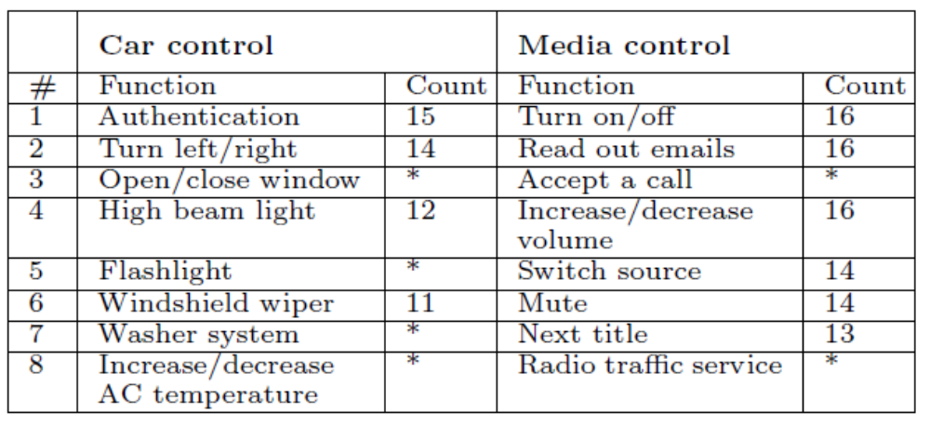
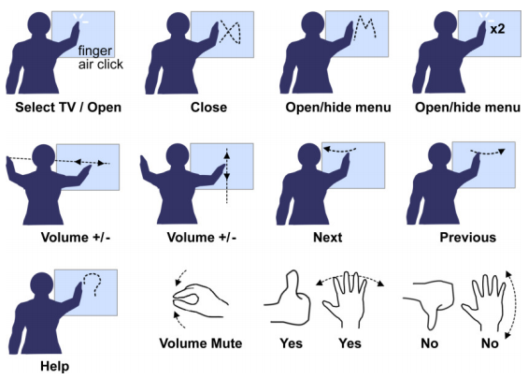
Gesture Selection & Reduction
Preceding the on-the-road driving tests, an opinion survey was conducted
  involving 67 participants of different age, gender, and technology affinity
Participants were
  First, asked about their preferred 5 functions
  Second, asked which finger/hand gesture they would like to use for each of these functions
Result of approval voting and expert discussion
Pic. from Vatavu for better understanding

Slide 11
Experiment Setup & User Study
Addressing the research questions of identifying the feature space of gestures,
An experiment setups :
  A real driving study on a blocked load
  Performing gestures as they would like to do in reality
  Only a small set of around ten functions/symbols was considered
  Be designed and executed along two different gesture classes (car / media control)
  The occurrence of functions to control with a gesture was randomized

Slide 12
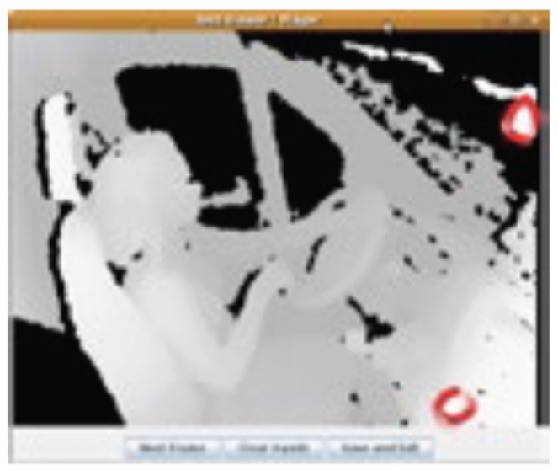
Data Recording portion
To obtain spatial properties of gestures executed by the participants,
  The RGBD (depth infrared) sensor of a Kinect was used
  The GoPro Hero cam was used as a RGB sensor
For accurate calculation of the actual position of gesture trajectories
  Three reference points in the vehicle were used
    Center of the steering wheel
    Rear mirror
    Center console

Slide 13
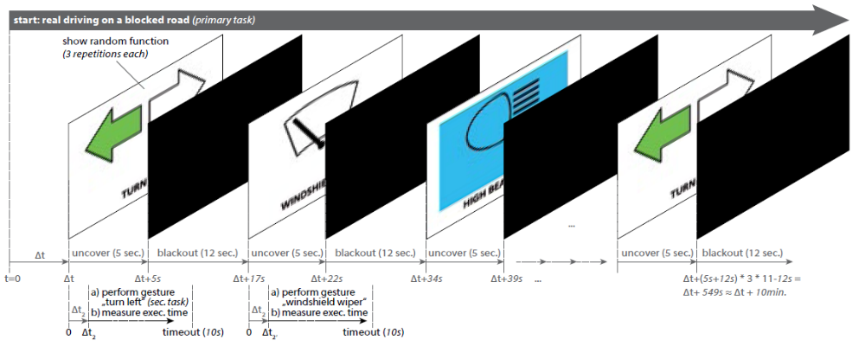
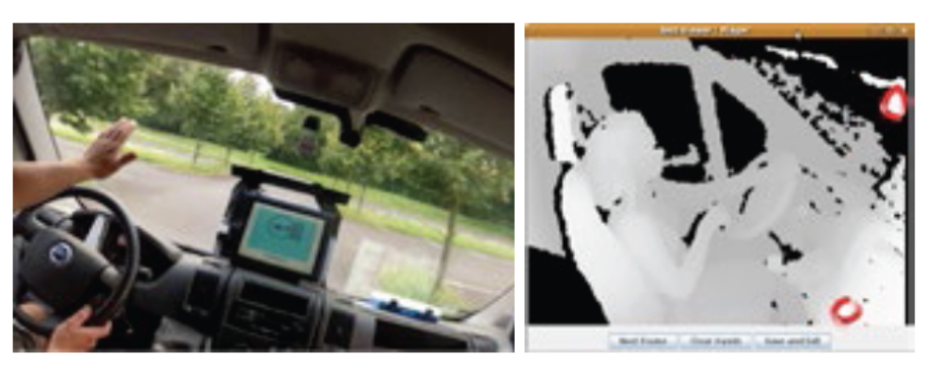
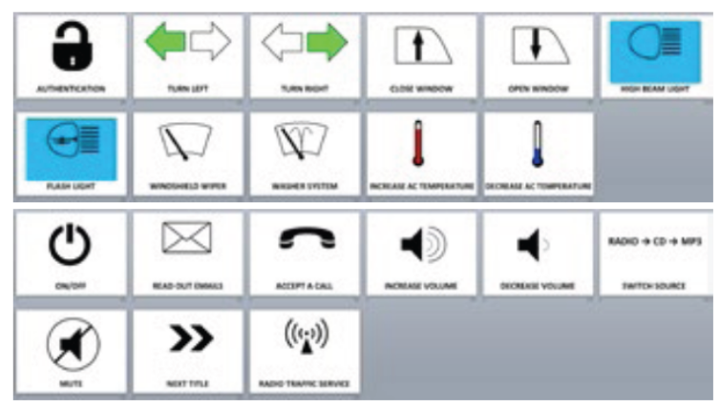
Evaluation

Slide 14
Evaluation; Data Preprocessing
To obtain higher-level spatial and temporal data, gesture trajectories were preprocessed.
  Even though gesture detection is possible with high performance with Kinect, it is not very well suited
Preprocessing included
  Determining the start and end frame of gesture
  Identifying subject’s hand and finger positions and orientations in each frame
  Calculating / mapping raw data positions into a Cartesian coordinate system

Slide 15
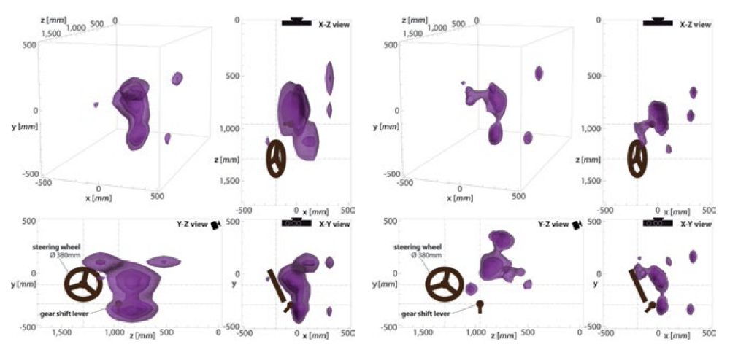
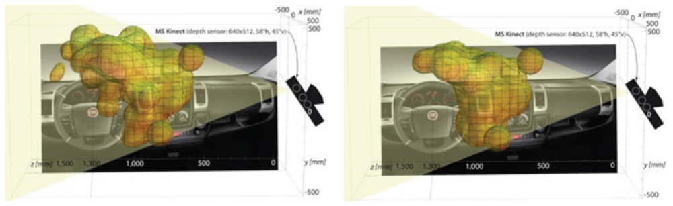
Evaluation; Gesture Density Plots
Execution area of car control
Execution area of media control

Slide 16
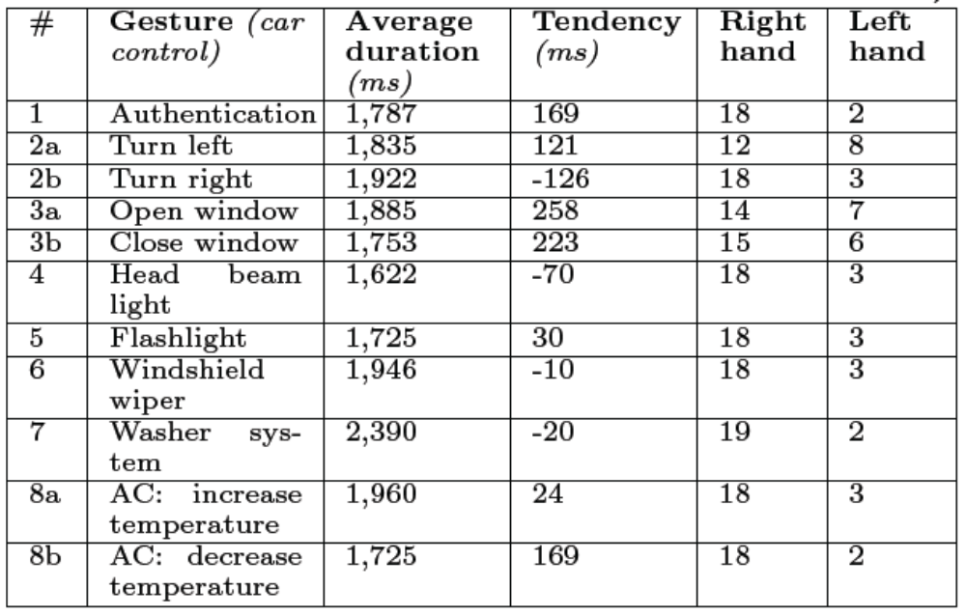
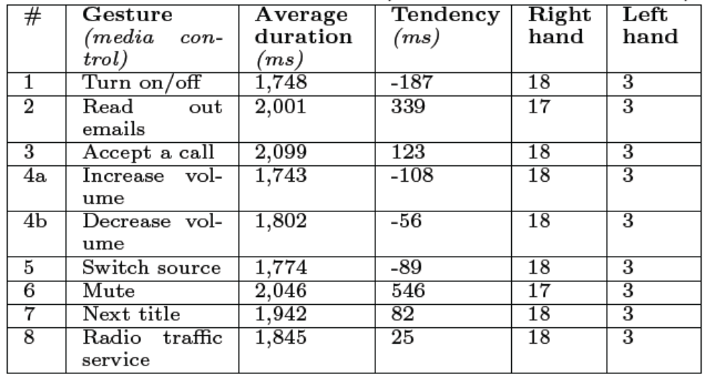
Results and Discussion
Gesture execution times
Execution times and tendency for gestures assigned to car / media control functions

Slide 17
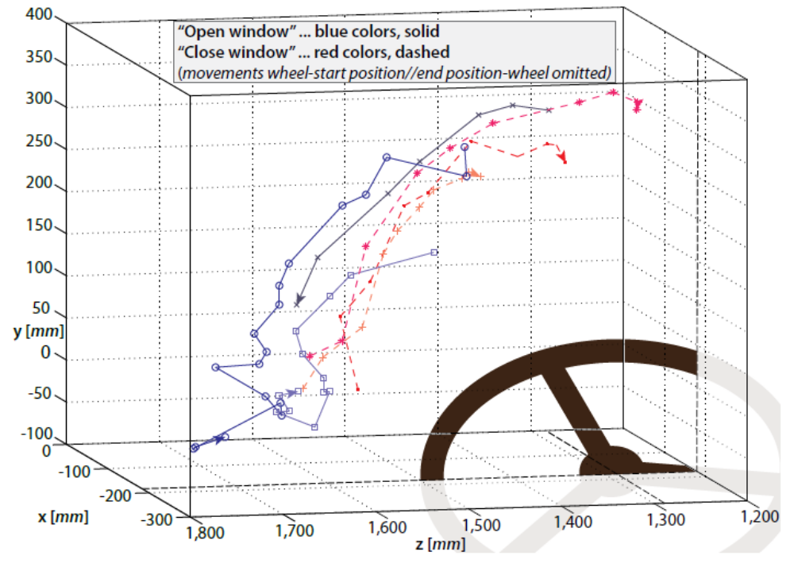
Results and Discussion
Similarity of gestures & execution regions
  From the gesture trajectories,
    It is NOT possible to forecast an “average trajectory”
    But, it is possible to define regions(s) where gestures will be performed
  Also detected a significant difference between the gesture execution regions of car / media control functions
Little variation of gesture trajectories for “open/close window”

Slide 18
Conclusion
In this paper, they have investigated
  execution regions, spatial extent, and time behavior of open gestures
Providing car (interior) manufacturer with gesture characteristics and execution regions would allow them to better design future in-vehicle interaction concepts

