Slide 1
An Overview of the IEEE 802.15.4a Standard
Aristotle University of Thessaloniki
&
CERTH
IEEE Communications Magazine 2010

Slide 2
Contents
Introduction
The alternative PHYs of 802.15.4a
  Ultra wideband (UWB) PHY
  Chirp spread spectrum (CSS) PHY
The MAC sub-layer
Summary

Slide 3
Contents
Introduction
The alternative PHYs of 802.15.4a
  Ultra wideband (UWB) PHY
  Chirp spread spectrum (CSS) PHY
The MAC sub-layer
Summary

Slide 4
Introduction
IEEE 802.15.4 provides low-cost and low-power wireless connectivity within short ranges of up to 20 m
  Suited for sensor networking
After the release of the IEEE 802.15.4, the capability of measuring distance between devices with high accuracy is needed
  For expanding the range of potential applications of a low-bit-rate
The above capability was precluded to the IEEE 802.15.4 due to the limited signal bandwidth

Slide 5
Introduction (cont.)
IEEE 802.15 Low Rate Alternative PHY Task Group (TG4a) was created with the goal of
  Defining alternative PHYs able to provide the desired ranging capability and correspondingly adapting the MAC
IEEE 802.15.4a was designed for providing
  High-precision ranging capability (1 m accuracy and better)
  High throughput
  Ultra low power consumption
  Scalability to data rates
  longer range, and low cost

Slide 6
Contents
Introduction
The alternative PHYs of 802.15.4a
  Ultra wideband (UWB) PHY
  Chirp spread spectrum (CSS) PHY
The MAC sub-layer
Summary

Slide 7
The alternative PHYs of 802.15.4a
IEEE 802.15.4a consists of two optional PHYs
  Ultra wideband (UWB) PHY
  Chirp spread spectrum (CSS) PHY
UWB PHY is specialized in higher range, high data rates and provides optional feature of precision ranging
  Indoor localization
CSS PHY is specialized in longer ranges and communications of devices moving at high speeds
  V2V
Both PHYs added scalability to data rates, longer ranges, lower power consumption and precision ranging capabilities

Slide 8
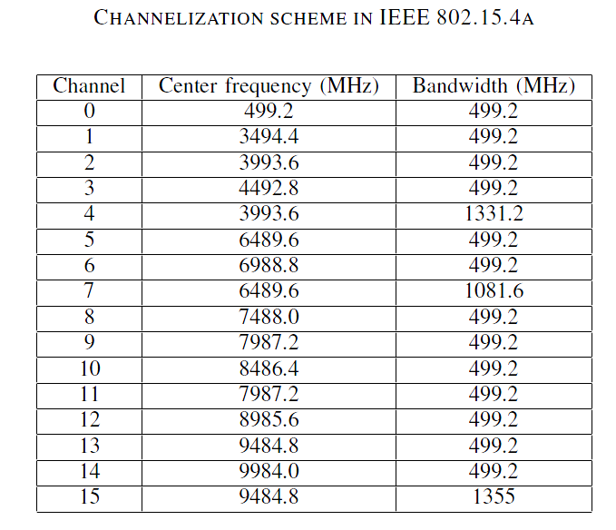
Ultra wideband (UWB) PHY overview
The UWB PHY uses an Impulse Radio approach
  Short pulses with a bandwidth matching the channel bandwidth are transmitted
  Each symbol is associated with a sequence of pulses, called burst
The UWB PHY supports three bands of operation
  Sub-gigahertz band : Ch. 0 (250-750 MHz)
  Low-band : Ch. 1 to 4 (3244-4742 MHz)
  High-band : Ch. 5 to 15 (5944-10234 MHz)
A compliant devices shall implement support for at least one of the mandatory channel {0 3 9}
The UWB channels {4 7 11 15} are all optional channels and are differentiated from other UWB channels by the larger bandwidth
  For devices to transmit at a higher power, then achieve longer range and enhance multipath resistance, while leading to more accurate range estimates

Slide 9
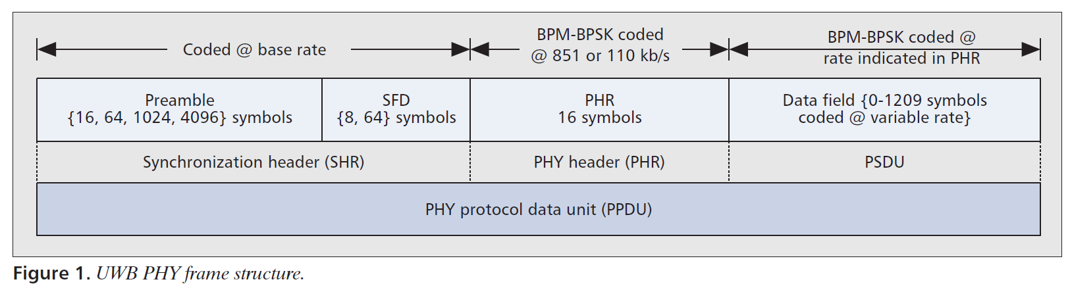
UWB PHY
UWB frame format
The SHR preamble is composed of a preamble and a start-of-frame delimiter (SFD)
The SFD signals is the end of the preamble and the beginning of the PHY header
  It is used to establish frame timing
  Its detection is important for accurate ranging counting
The PHR conveys information necessary for successful decoding of the packet to the receiver
  Data rate used to transmit PSDU
  The duration of the current frame’s preamble
  The length of the frame payload (0-1209 symbols)
  Six parity check bits to protect PHR

Slide 10
UWB PHY
UWB PHY modulation
A combination of burst position modulation (BPM) and binary phase shift keying (BPSK) is used to modulate the symbols
In the BPM-BPSK modulation scheme, a UWB PHY symbol carries two bits of information
  One bit is used to determine the position of a burst of pulses
  Additional bit is used to modulate the phase of this same burst

Slide 11
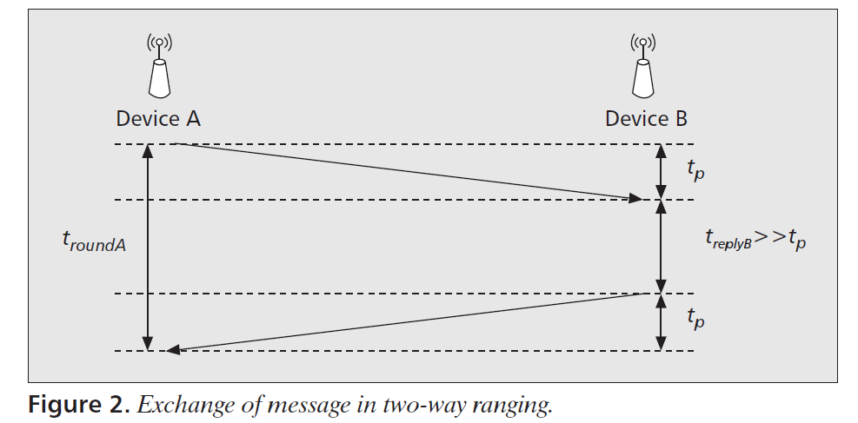
UWB PHY
Ranging
Only the UWB PHY supports ranging estimation by using the two-way ranging (TWR)
  Ranging without the need for a common time reference
  Device A sends a range request packet to device B
  Device B waits treplyB, known to both devices, to send a request back to device A
  Based on that packet, device A can measure the RTT (troundA) and extract the one-way time-of-flight (tp)
    trountA = 2tp + treplyB
The large bandwidth of the UWB signals enable accurate ranging estimations of less than 3 ns
  < 1m

Slide 12
UWB PHY
Ranging (cont.)
In order to safeguard the integrity of the ranging traffic, the IEEE 802.15.4a foresees a private ranging procedure based on the use of longer preambles
  Aimed at avoiding eavesdropping or jamming of ranging packets by malicious devices

Slide 13
  Chirp spread spectrum (CSS) PHY overview
The CSS is designed to provide robust performance for low-rate wireless personal area network (LR-WPAN) applications
  While leveraging the capability of CSS waveforms to support long range links or links to mobile devices moving at higher speeds
The CSS supports 2450 MHz band of operation
The channel plan offers 14 channels spaced at 5MHz
  CSS can have a greater benefit from more spectrum

Slide 14
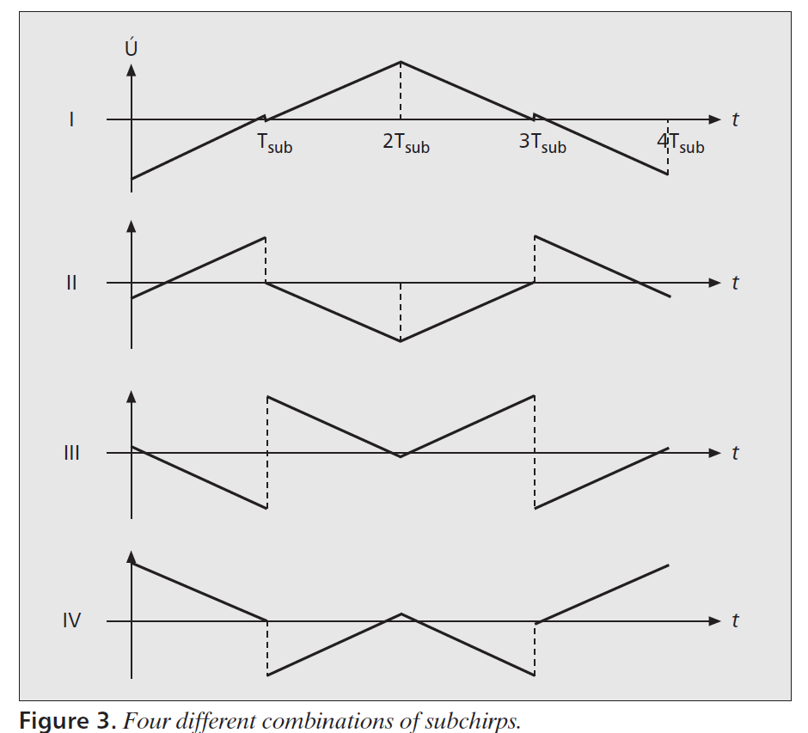
  CSS PHY
  Chirp symbols
A windowed chirp is a sinusoidal signal
  whose frequency increases or decreases linearly over a certain amount of time
The CSS uses patterns of smaller chirps to build one larger chirp symbol
  Sub-chirp

Slide 15
  CSS PHY
  CSS modulation and spreading
To encode information the CSS uses differential quadrature phase-shift keying (DQPSK) and bi-orthogonal coding
Unlike other spread spectrum, It does not add any pseudo-random elements to the signal
  It relies on the linear nature of the chirp pulses

Slide 16
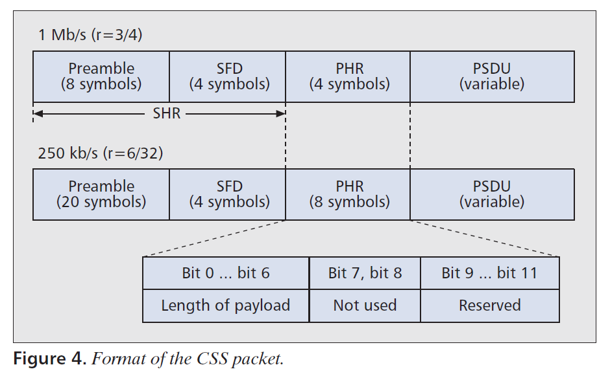
  CSS PHY
  CSS frame format
The PPDU packet structure of the CSS PHY
The SHR is for the synchronization
The PHR field is used to describe the length of the PSDU
  Up to 256 octets in length

Slide 17
Contents
Introduction
The alternative PHYs of 802.15.4a
  Ultra wideband (UWB) PHY
  Chirp spread spectrum (CSS) PHY
The MAC sub-layer
Summary

Slide 18
The MAC sub-layer
Network topologies
IEEE 802.15.4a supports all types of devices and topologies defined by the IEEE 802.15.4 in its MAC section
Two classes of devices supported are
  Full functional devices (FFDs)
    All network functionalities are implemented
  Reduced functional devices (RFDs)
    Only support a reduced set of functionalities (e.g. temperature sensor node)

Slide 19
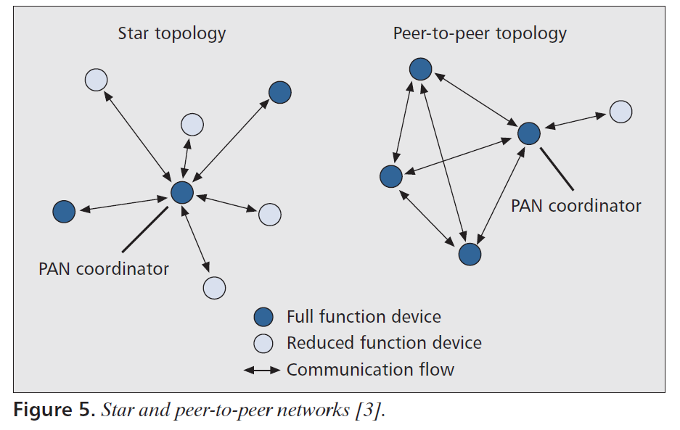
The MAC sub-layer
Network topologies (cont.)
RFDs and FFDs organize themselves in PANs
  The common configuration of a PAN will be a star topology
RFDs can only connect with the PAN coordinator
  FFDs can communicate directly as long as they are within physical reach
The adopted topology is an application design choice
  Star topology : fire detection for low latency
  Peer to peer topology : security for large-area coverage

Slide 20
The MAC sub-layer
MAC strategies
According to the IEEE 802.15.4/4a, access to the medium within a PAN can be either scheduled-based or contention-based
Medium access within a PAN is controlled by the PAN coordinator, which may choose between two access modalities
  Beacon-enabled
  Nonbeacon-enabled

Slide 21
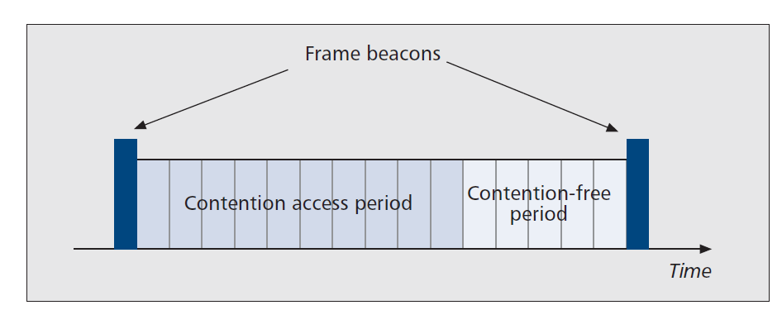
The MAC sub-layer
MAC strategies (cont.)
Beacon-enabled PAN
  The period between two consecutive beacons defines a superframe
    Divided in 16 slots
    The first slot is always occupied by the beacon
    Other slots are divided into CAP and CFP
  CAP (Contention Access Period) is used for the data communications by random access
  CFP (Contention Free Period) is used for the specific devices assigned time slots by the PAN coordinator
    GTS (Guaranteed Time Slots)
Non beacon-enabled PAN
  Only random access is used

Slide 22
The MAC sub-layer
MAC strategies (cont.)
Depending on the network topology, devices adopt a CSMA/CA protocol to access the medium
  Beacon-enabled
    Slotted CSMA/CA
  Nonbeacon-enabled
    Unslotted or standard CSMA/CA
Channel access mechanism is the significant difference between IEEE 802.15.4/4a
  The ALOHA for UWB

Slide 23
The MAC sub-layer
MAC strategies (cont.)
By this, application scenarios with relaxed throughput requirements would benefit
  such as industrial control and monitoring of temperature, sound, vibration, pressure or pollutants, would benefit from the ALOHA scheme
The CSMA/CA access was kept as an option in order to address high-density and high-traffic scenarios, and to enable the use of the CSS PHY.

Slide 24
The MAC sub-layer
Data transfer model
The three data transfer modes IEEE 802.15.4/4a are modified accordingly
  1. Data transfer to a coordinator
    Beacon-enabled PAN
      It first listens for the network beacon in order to synchronize to the superframe structure
      At the appropriate time, the device transmits its data frame using slotted CSMA/CA or ALOHA to the coordinator
      The coordinator may confirm the successful reception of the data by transmitting an optional ACK frame
    Nonbeacon-enabled PAN
      A device wishing to transfer data simply transmits its data frame using unslotted CSMA/CA or ALOHA to the coordinator

Slide 25
The MAC sub-layer
Data transfer model (cont.)
  2. Data transfer from a coordinator
    Beacon-enabled PAN
      Coordinator announces in the network beacon then the interested device selects a free slot and sends a data request to the coordinator
      Coordinator receives the data request then selects a free slot and sends data using slotted CSMA/CA or ALOHA
    Nonbeacon-enabled PAN
      Coordinator stores the data for the appropriate device anticipating a request from it
      If a device may request the data
        If a message is pending, the coordinator transmits the data frame
        If a message is not pending, the coordinator indicates this fact either with an ACK frame or a data frame with a zero-length payload
  3. Peer to peer data transfers
    Every device may communicate with every other devices in its radio sphere of influence without the PAN coordinator using unslotted CSMA/CA or ALOHA

Slide 26
Contents
Introduction
The alternative PHYs of 802.15.4a
  Ultra wideband (UWB) PHY
  Chirp spread spectrum (CSS) PHY
The MAC sub-layer
Summary

Slide 27
Summary
The IEEE 802.15.4a standard is a novel PHY standard capable of satisfying an evolutionary set of industrial and consumer requirements for LR-WPAN communications
  Requiring precision ranging, extended communication range, and robustness against interference and mobility
Backward compatibility with the IEEE 802.15.4 standard and the provision of a wider variety of applications will be the key features for its penetration to the constantly evolving wireless world

