Slide 1
Simple Mail Transfer Protocol (SMTP)
Chapter 15

Slide 2
15.0 SMTP Overview
The Internet's first killer app: the main protocol of email
Later it became the exemplar of major application protocols leading to HTTP → SIP

Slide 3
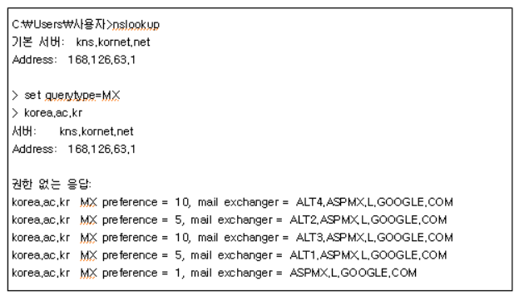
15.1 Overall Structure of Email Delivery
Similar to real-life postal delivery
    e.g.) Put letter in envelope → Write recipient name and address → Hand it to post office → Transfer through the inter-post-office delivery network → Deposit in recipient mailbox → Recipient retrieves from mailbox
Email account
  hyogon@korea.ac.kr
    hyogon: Account name
      Mailbox
    Korea.ac.kr: Domain

Slide 4
15.1 Overall Structure of Email Delivery
Email Sending
  Send request to the mail server (MX) responsible for the sender domain
    Enters the queue of the sending mail server
  When sending from the sending server queue
    Extract the domain name after the @ symbol of the recipient email address
    Look up MX RR by domain name
    Establish TCP (port 25) connection to the MX server of the receiving domain
    SMTP protocol transfers mail between sending domain MX and receiving domain MX
      Client: sending domain MX
      Server: receiving domain MX

Slide 5
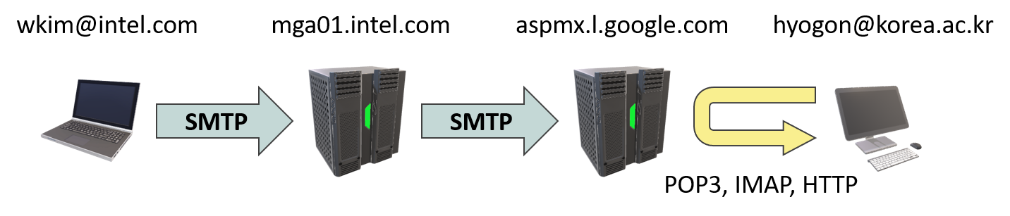
15.1 Overall Structure of Email Delivery
Email Reception
  The receiving domain MX receives the mail and puts it in the mailbox corresponding to the account name (before the @ symbol) of the recipient email address
    Mail stays in the mailbox until the recipient comes to retrieve it
  The recipient retrieves mail (pull) using a protocol other than SMTP
    SMTP is a “push” protocol
    Because we cannot know whether the recipient has connected, or where they connected from even if they did
  Reception protocols are broadly of 3 types
    HTTP
    IMAP
    POP3

Slide 6
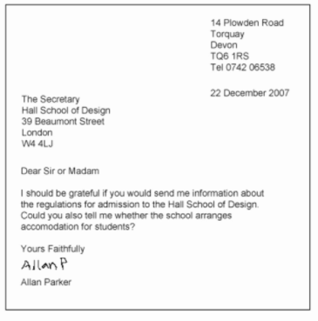
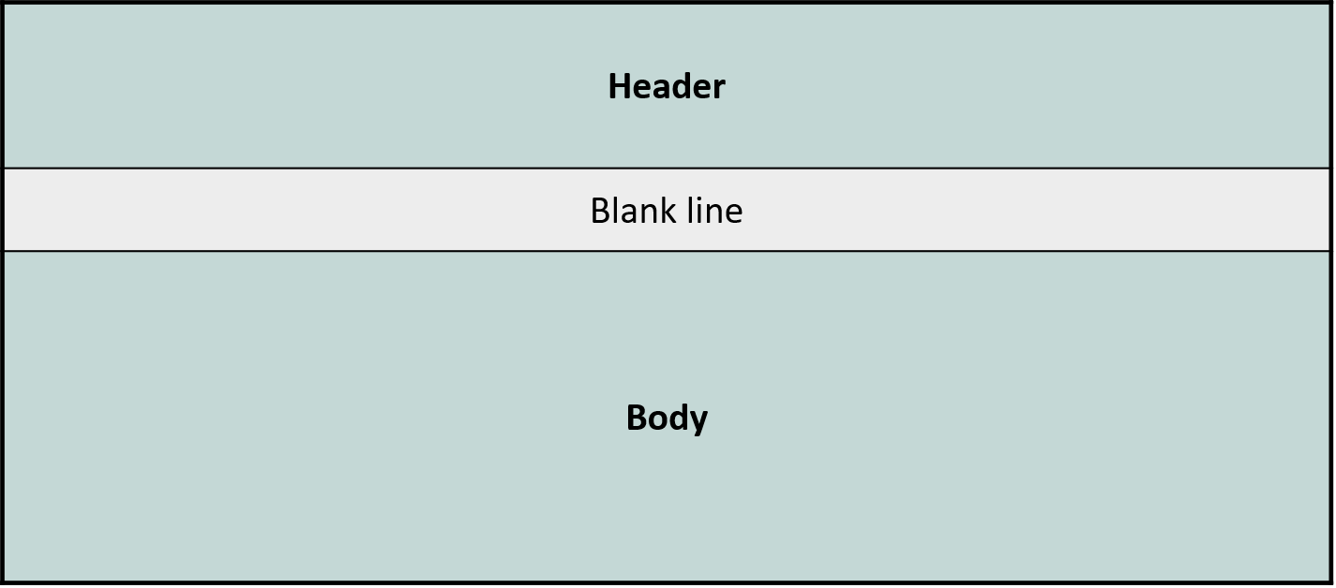
15.1 Overall Structure of Email Delivery
Email Format
  The email written by the user is formatted by the email SW into the form required by the SMTP protocol
    Similar to Western letter format
    A standard separate from SMTP

Slide 7
15.1 Overall Structure of Email Delivery
Email format (detailed in 15.4)
  Header
    From, To, Subject, body format, etc. (written by email SW)
    Header information accumulated by servers passed through during transit from sending MX to receiving MX
      Receive time at each server, authentication success status, etc.
  Body
    Same content can have various formats
      Cf. MIME

Slide 8
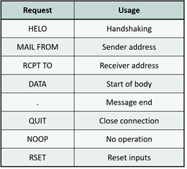
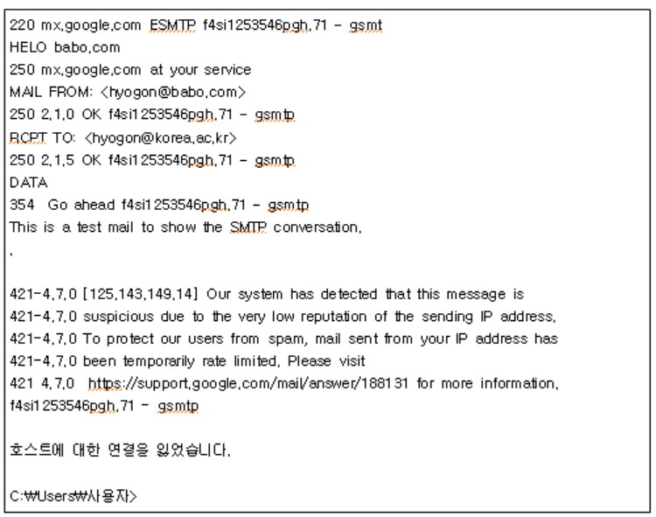
15.2 SMTP Protocol
SMTP: a very simple language
  Originally port 25 → recently security strengthened by using TLS together on ports 465 or 587
  Requests (“verbs”)
  Return codes
    1xx: connection error
    2xx: successful completion
    3xx: intermediate stage
    4xx: temporary error
    5xx: permanent error

Slide 9
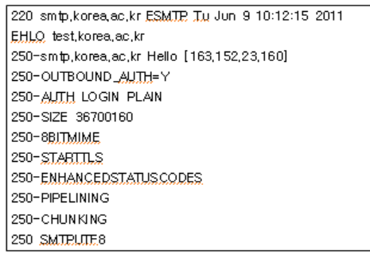
15.2 SMTP Protocol
ESMTP
  Overcomes problems of SMTP, adds features → currently used
    Through EHLO handshaking, whether the receiving MX supports ESMTP can be determined
    Sends a list of verbs and features typically supported by ESMTP

Slide 10
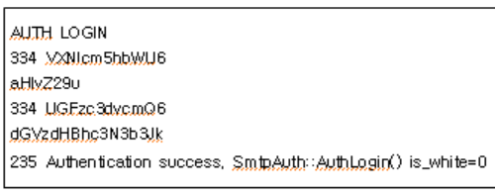
15.2 SMTP Protocol
ESMTP
  OUTBOUND_AUTH=Y
    User authentication will be enforced for external mail transmission requests
      To prevent outsiders from carelessly using our mail server to send mail
  AUTH
    Authentication methods
      PLAIN: Username and password submitted as one string
      LOGIN: submitted separately

Slide 11
15.2 SMTP Protocol
ESMTP
    The receiving-side server informs up to what size of mail it will accept
    The sending side can also confirm by using SIZE as a keyword in MAIL FROM
  8BITMIME
    Originally in SMTP only 7-bit ASCII characters could be used
    Characters other than 7-bit ASCII can also be used in the mail body
    The sending-side mail server prevents the receiving server from zero-ing out the leading bit as follows

Slide 12
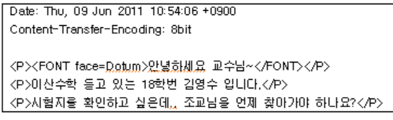
15.2 SMTP Protocol
ESMTP
    8BITMIME If unavailable, Base64 encoding must be used → 33% data volume increase
    8BITMIME usage example
  STARTTLS
    When authenticating Username and password, when wanting to transmit encrypted
  ENHANCEDSTATUSCODES
    More detailed status of the mail system

Slide 13
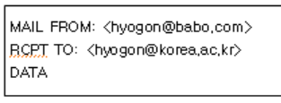
15.2 SMTP Protocol
ESMTP
  PIPELINING
    Parallelizes sequentially-proceeding SMTP conversation
    Allows the sending-side server to send multiple SMTP commands simultaneously to the receiving-side server
  CHUNKING
    Supports the function needed to chunk and transmit large binary messages (chunking)
    Uses BDAT verb instead of DATA verb

Slide 14
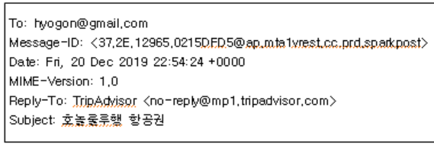
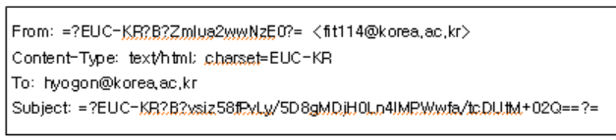
15.2 SMTP Protocol
Korean representation in headers
  8BITMIME or MIME headers are outside the processing scope
  How to use characters other than 7-bit ASCII in headers
    Binarysimply written as such (recent trend): EHLOresponse includes SMTPUTF8 keyword?
    7-bit ASCIIconversion (e.g.: Base64 encoding)

Slide 15
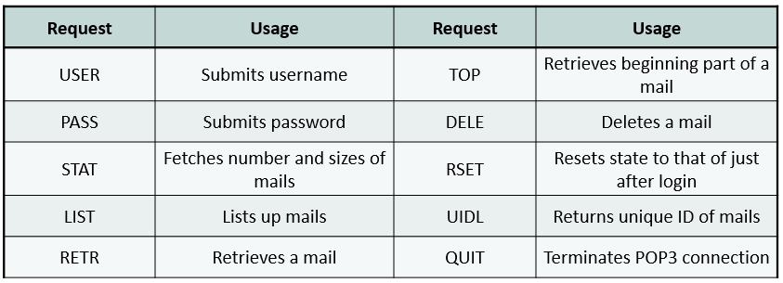
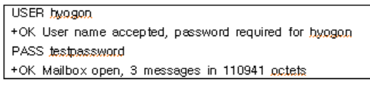
15.3 Mail Retrieval Protocols
POP3
  Requests and their purpose
    Originally serviced on port 110 → recently security strengthened by using TLS together on port 995
  USER and PASS: authentication

Slide 16

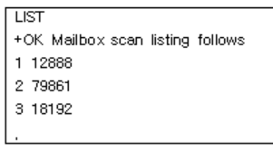
15.3 Mail Retrieval Protocols
POP3
  STAT
    Number and size of mails in the mailbox
  LIST
    Lists all mails and shows their sizes

Slide 17
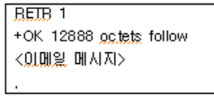
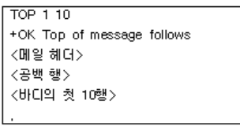
15.3 Mail Retrieval Protocols
POP3
  RETR
    Retrieve the mail using mail number as argument
  TOP
    Retrieve only the front portion of the mail: specifies line number
      Useful for viewing the header and the front part of mail body

Slide 18
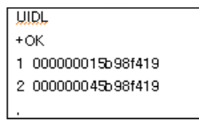
15.3 Mail Retrieval Protocols
POP3
  DELE
    Delete: mail number as argument
      Deletion takes effect after the POP3 session ends
  RSET
    Reverts to the state right after login
  UIDL
    Lists the unique ID instead of the mail number
  QUIT
    POP3 session termination

Slide 19
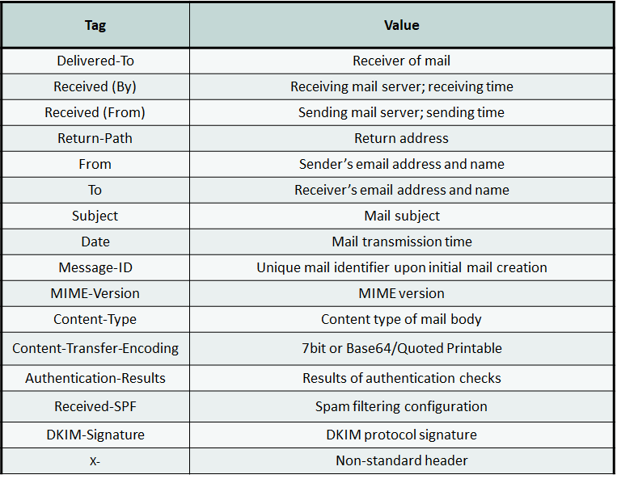
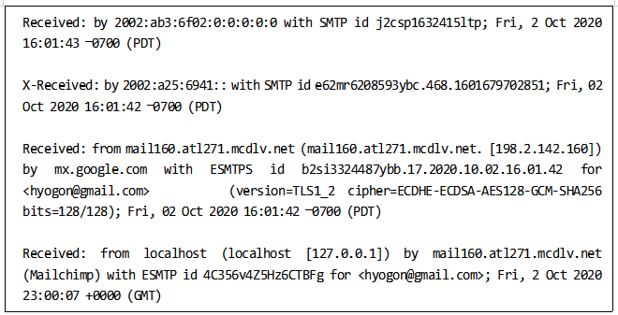
15.4 Mail Header Fields
Delivered-To
  Mail recipient's email address
Received
  List of mail servers passed through (stack)

Slide 20
15.4 Mail Header Fields
Return-Path
  Entered through MAIL FROM at the sending-side mail server, the user's email address
    Bounce-back address: can be designated to a different server
From, To: sender, recipient's email address
  DATA entered after
  From and Return-Path values may differ
Subject
  DATA entered after

Slide 21
15.4 Mail Header Fields
Message-ID
  Unique ID
MIME-Version = 1.0
Content-Type
  Text, audio, image, multipart, application, etc.
  Each is further subdivided (see Section 15.5)
Content-Transfer-Encoding
  Representation method of mail body (default: 7-bit ASCII)
    Cf. Base64, Quoted Printable, 8bit

Slide 22
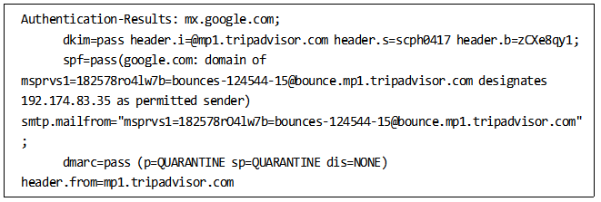
15.4 Mail Header Fields
Authentication-Results
  Receiving-side server performed various mail authentication results
    Each item separated by semicolons
    auth-server; dkim; spf; dmarc
    Removes false headers
Received-SPF
  Sender address forgery inspection field

Slide 23
15.4 Mail Header Fields
Mail security methods
  Sender Policy Framework (SPF)
    Is this server eligible to send email for the given domain? (“WHO”)
  DomainKeys Identified Mail (DKIM)
    Has the mail content been tampered with? (“WHAT”)
  Domain-based Message Authentication, Reporting and Conformance (DMARC)
    Specifies policy for handling suspicious mail received from a given domain (“HOW”)

Slide 24
15.4 Mail Header Fields
SPF: spam mail filtering through sender eligibility check
  Blacklisted spam sender forging email address(thus domain) to send spam prevented
  Each domain registers TXT RR for SPF in DNS
    IPs of servers that can send email from that domain
  Mail receiving server check: sending server's IP ∉ domain email server IP?
    Domain extracted from MAIL FROM, HELO, EHLO
  TXT-stored SPF information
    IPv4 and IPv6 addresses of servers that can send mail from that domain (“ipv4:”, “ipv6:”)or
    domain names representing the IP addresses that can send mail on behalf of the domain (“include:”)
      Recursive(recursive) IP address acquisition may require TXT queries until obtained

Slide 25
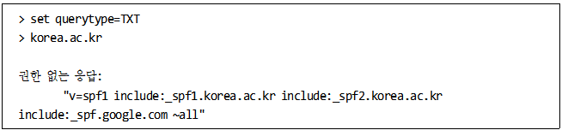
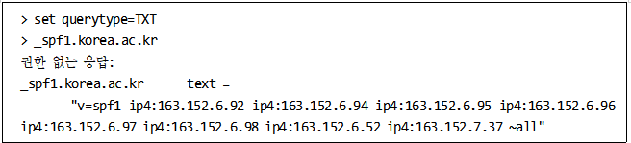
15.4 Mail Header Fields
SPF
  SPF version 1
  “include:” triggers another TXT query
  “~all”: suspicious mail handling policy
    ~all: receive but mark as failure
    -all: reject reception
    +all: unconditional reception
  All transit mail servers can perform SPF inspection → Authentication-Results header

Slide 26
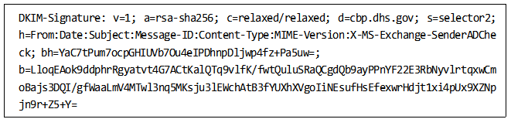
15.4 Mail Header Fields
DKIM: Message integrity inspection
  Sender signature: major headers(From,To,Data,Subject) and part/whole of body hash → encryption
    Added to DKIM-Signature header field
  The pair of the private used for signing, the public key, is registered in DNS
    Public key domain name example: selector._domainkey.example.com
    Private-public key pair identification by selector + _domainkey (fixed keyword) + signing domain name
  Mail recipient uses selector._domainkey.example.com to TXT-query public key from DNS
    Signature decryption ↔ compare hash value of relevant mail part

Slide 27
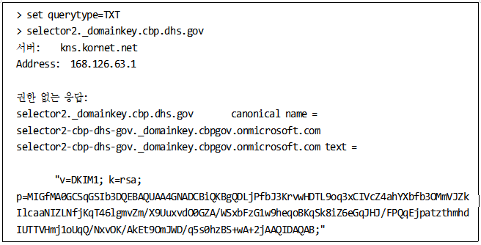
15.4 Mail Header Fields
DKIM: Message integrity inspection
  “d=” : domain (cbp.dhs.gov)
  “s=” : selector (selector2)
  Domain name = selector2._domainkey.cbp.dhs.gov for TXT query
  “k=” : signature algorithm (RSA)
  “p=” : public key

Slide 28
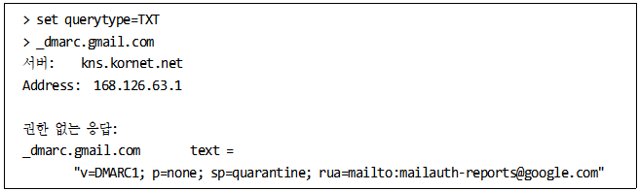
15.4 Mail Header Fields
DMARC: SPF/DKIM classified suspicious mail handling policy (request)
  Unconditional reception vs. receive but to spam folder vs. reject reception
  DMARC policy is queried as _dmarc prepended to domain TXT
  “p=” : policy
    None: only record in the report
    Reject: reject reception and bounce back
    Quarantine: to spam folder
  “sp=” : subdomain policy
  “rua =”: URI to send reports to

Slide 29
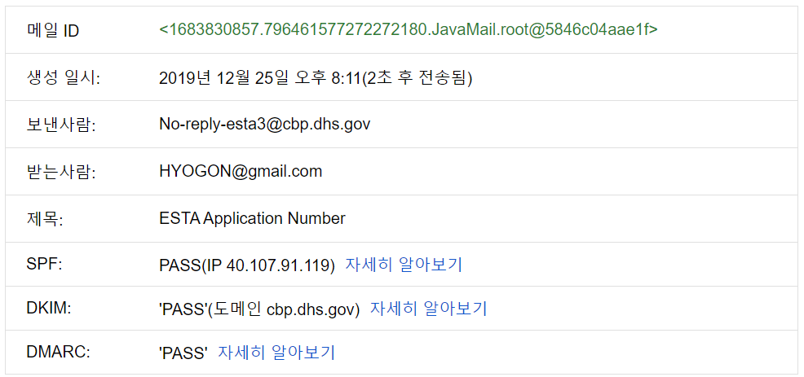
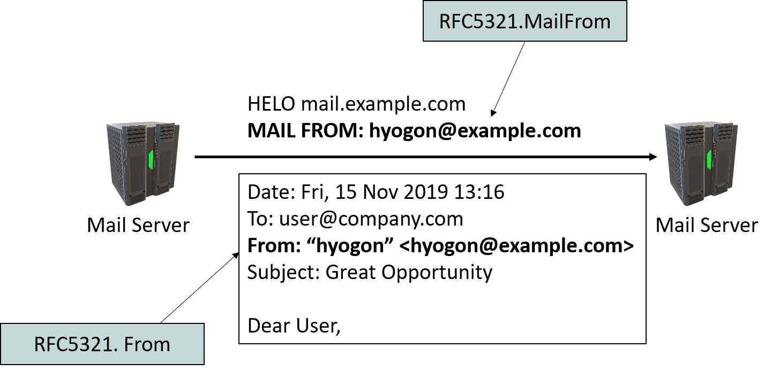
15.4 Mail Header Fields
DMARC
  “adkim =”
    Strict (s): d value and sender domain name must match exactly
    Relaxed (r): d subdomain match is acceptable
  “aspf =”
    s: From header value and MAIL FROM domain name must match exactly
    r: From header value subdomain match is acceptable

Slide 30
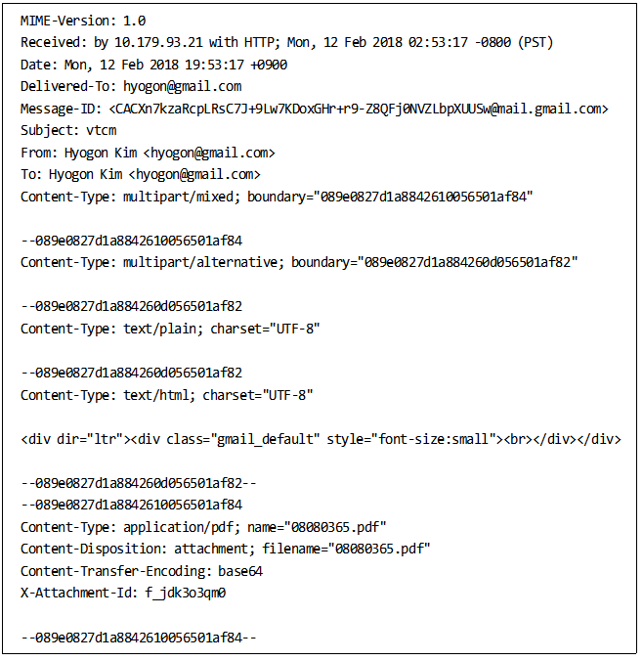
15.5 MIME
Multipurpose Internet Mail Extension (MIME)
  To accommodate SMTP which uses only 7-bit ASCII in mail body
    Needed for media or application document attachments, needed in cases that cannot be expressed in 7-bit ASCII (Korean, etc.)
Header fields
  MIME-Version = 1.0
  Content-Type: application, audio, image, message, model, multipart, text, video
  Multipart enables recursive structure
    Each part has its own Content-Type
    “boundary”: random string

Slide 31
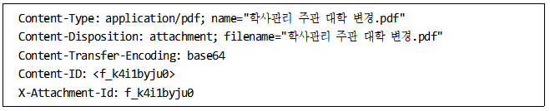
15.5 MIME
Header fields
  Content-Transfer-Encoding
    Base64, Quoted-printable: 7-bit ASCII-converted
    7bit: no conversion, default
    8bit, binary: no conversion, intermediate servers may forcibly convert to 7bit
  Content-ID
    Unique value of the part (usable for mutual reference)

Slide 32
15.5 MIME
Header fields
  Content-Description
    Adds description text to non-text body parts
  Content-Disposition
    Whether to display as attached file or as inline in the browser

Slide 33
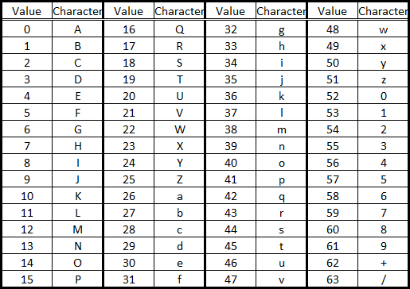
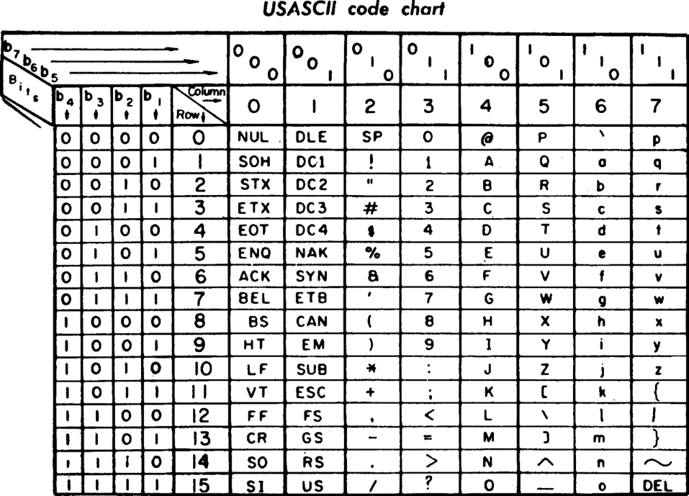
15.5 MIME
Base64 encoding
  Korean uses Base64, European languages use Quoted Printable
  Method and example
    Slice body into 6 bit units, fill leading 2 bit with 00
    Treat each byte as base-10 (decimal) and find it in the Base64 table to insert into the new mail body
    01010000 01111001 01110100 01101000 01101111 01101110 → 00010100 00000111 00100101 00110100 00011010 00000110 00111101 00101110 → 20, 7, 37, 52, 26, 6, 61, 46 → UHl0aG9u → ASCII code in SMTP message representation
  If body is not a multiple of 3, pad the end with 0 bits: = or ==
  33% data increase: data should not exceed SIZE's ¾

Slide 34
15.5 MIME
Base64 decoding
  Method and example
    Base64 table, obtain the number corresponding to the mail's ASCII character
    Padding byte(s) removed: ='s count
    Remove the leading 00 bits of each byte
    8 bit units grouped and read as ASCII
    VXNlcm5hbWU6 → 21,23,13,37,28,38,57,33,27,22,20,58 → 00010101 00010111 00001101 00100101 00011100 00100110 00111001 00100001 00011011 00010110 00010100 00111010 → 01010101 01110011 01100101 01110010 01101110 01100001 01101101 01100101 00111010 → Username

