Slide 1
3.7: Loopback
김대영
2014021627

Slide 2
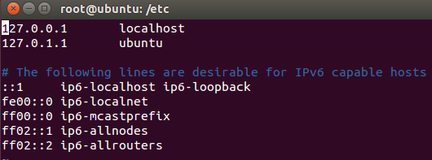
Loopback Interface
  Loopback interface provided by the operating system to enable TCP/IP and other communications on the same host computer.
  - acts like a real network interface.
  Traditionally, UNIX assigns the IPv4 address of 127.0.0.1
  ( ::1 for IPv6) to the loopback interface.
  Assigns the name localhost.

Slide 3
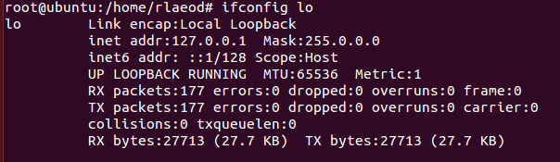
Loopback Interface
The IPv6 address ::1 has a 128-bit-long prefix.
So it represents only a single address.

Slide 4
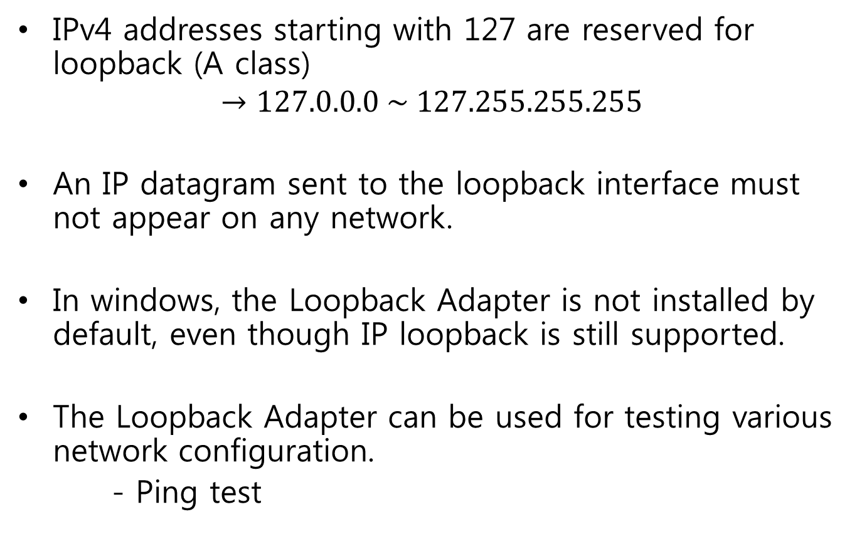
Loopback Interface
IPv4 addresses starting with 127 are reserved for loopback (A class)
$$→127.0.0.0 \sim 127.255.255.255$$
An IP datagram sent to the loopback interface must not appear on any network.
In windows, the Loopback Adapter is not installed by default, even though IP loopback is still supported.
The Loopback Adapter can be used for testing various network configuration.
- Ping test

